Slide 1
Our weekly bulletin
Week Beginning : Monday 30th September

Slide 2
Day | Date | In School Events | Events and Trips
Monday | 30th | Maths Weeks Scotland IDL S2, 4 and 5 Maths Games | S3 swimming (P1&2) S1 trip to Money Museum
Tuesday | 1st October | S1, 3 and 6 Maths Games
Wednesday | 2nd |  | CB Mathemagical Maths Games RIC Tournament with visiting schools
Thursday | 3rd |  | S3/4 trip to the Money Museum
Friday | 4th

Slide 4
West Lothian Cross Country
Can all pupils going to the cross country on Wednesday please remember to bring suitable clothing to be outside running. The forecast at the moment is 12°C with cloud.
We will up at the hill for 12:45 and back in class before 2pm.
GOOD LUCK & HAVE FUN

Slide 5
Maths Week
During Monday and Tuesday we will be running sessions for each year group in the dining area.
The timetable is as follows:
Monday P1 - Set up
Monday P2, P3 - 2A and 2B
Monday P4, P5 - All S4s
Monday P6, P7 - All S5s
Tuesday P1 - Set up
Tuesday P2, P3 - 3A, 3B, 3C
Tuesday P4, P5 - 1A, 1B, 1C
Tuesday P6, P7 - S6 mentors
Wednesday
The tournament from 9.30 to 2.30 in the hall.
S4 pupils not attending Cross country as helpers during the day and eight S1-3 pupils will represent Cedarbank.

Slide 6
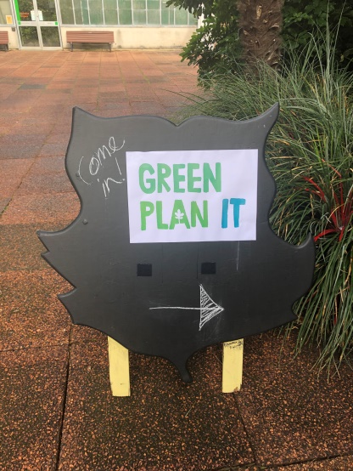
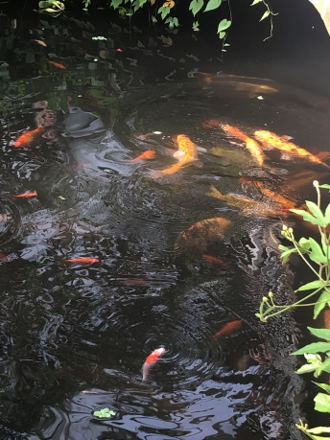
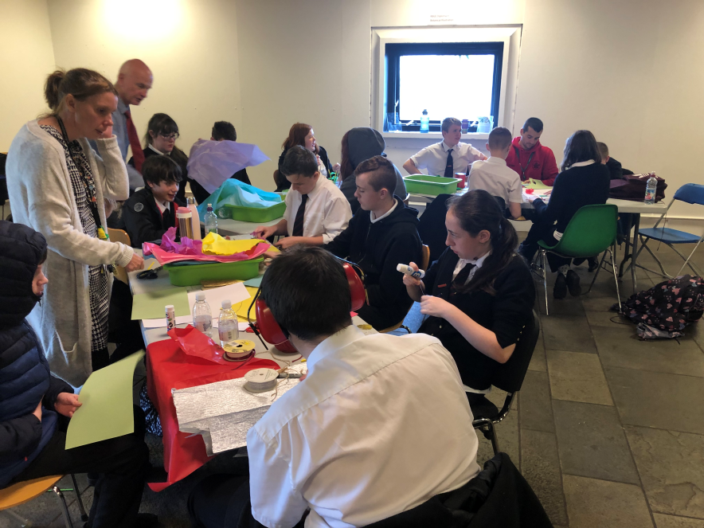
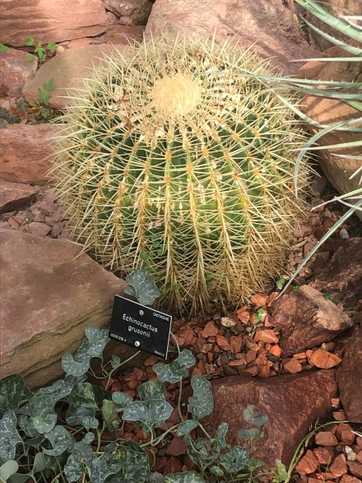
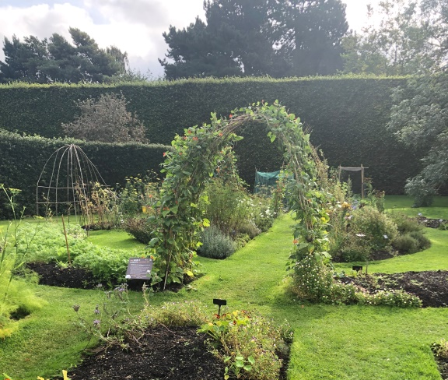
S3
Green Plan it
Challenge
Last Tuesday S3 went to the Royal Botanic Gardens to attend the launch event of the
Green Plan it project.
During the day we got to have a wander around the gardens to see some amazing plants
and we loved watching the fish.
We also took part in designing a super plant with super powers!

Slide 7
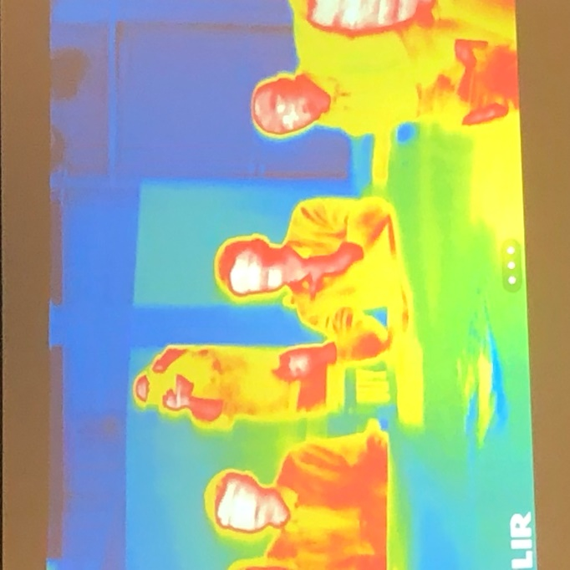
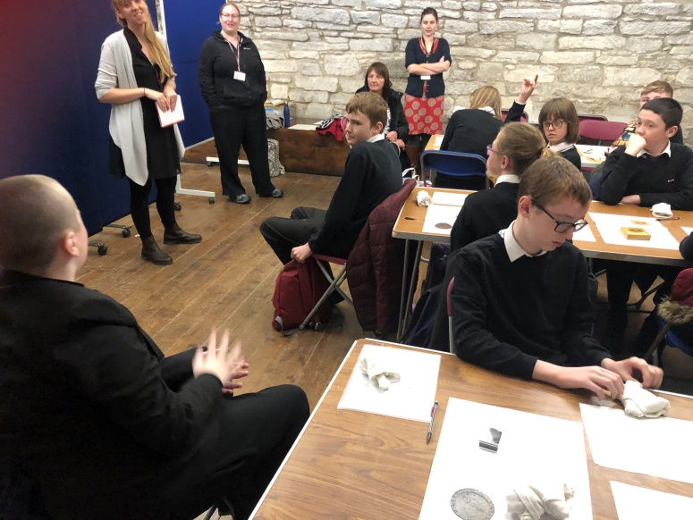
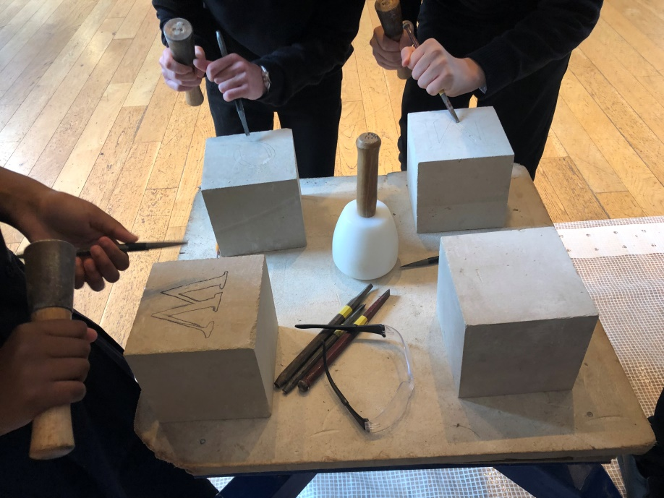
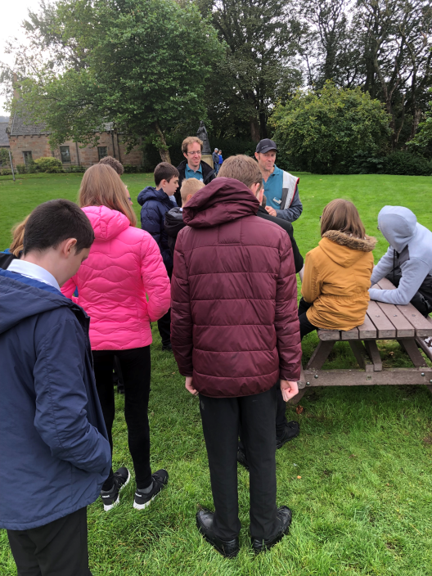
Last Wednesday, S2 attended a DYW careers event at
Linlithgow Palace.
They tried out stone masonary, used a thermal imaging camera with the Climate Change team,
handled historic objects with some Historic Environment Scotland curators.
We finished the day
by having an
orienteering and tree
identification session
with the rangers.

