Slide 1
Our weekly bulletin
Week Beginning : Monday 28th October

Slide 2
Day | Date | In School Events | Events and Trips
Monday | 28th |  | S3 Swimming (p1&2)
Tuesday | 29th | Dog Safety Workshops S1-3
Wednesday | 30th | Dog Safety Workshops S1-3 S2 Bikeability (pm)
Thursday | 31st |  | Badminton Festival in Tranent
Friday | 1st November

Slide 3
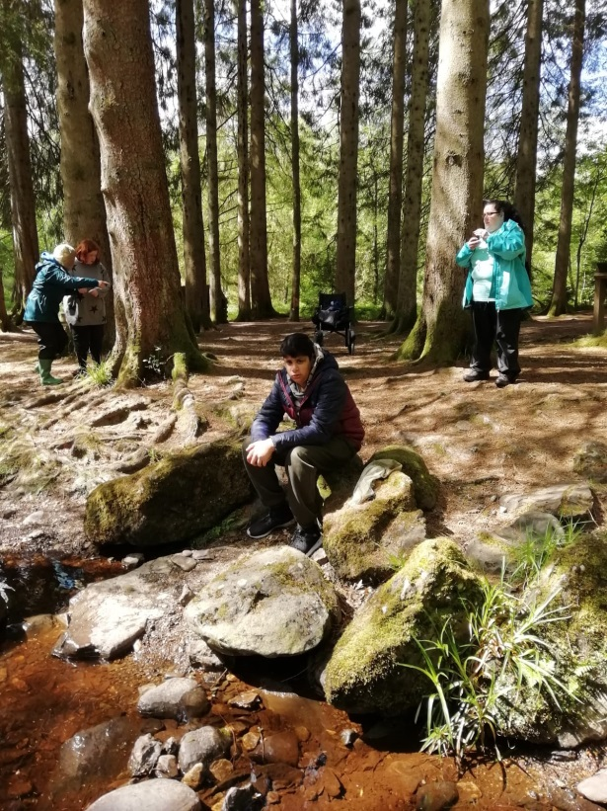
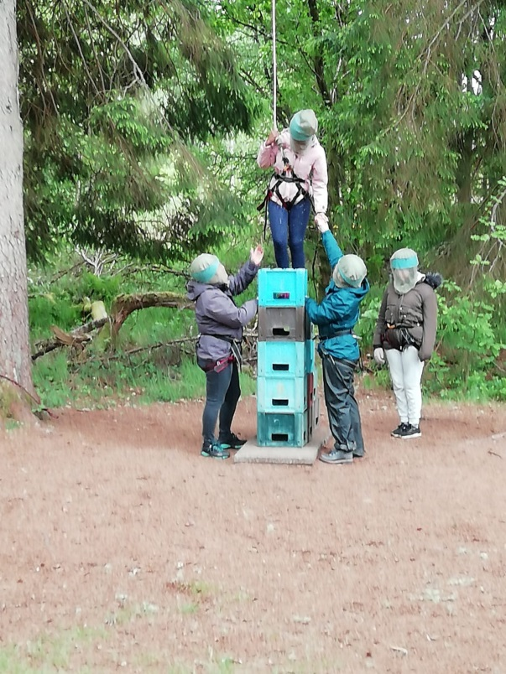
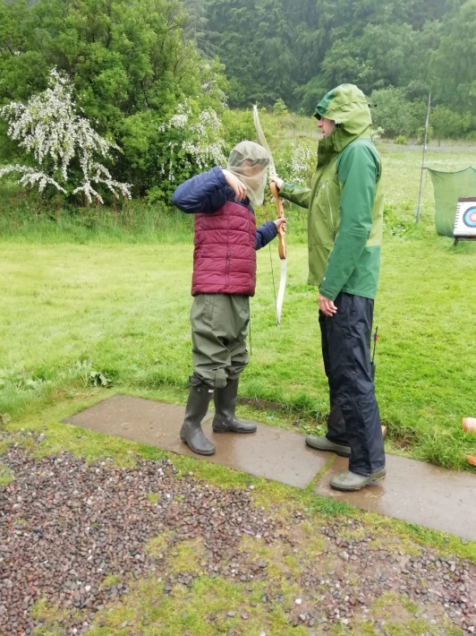
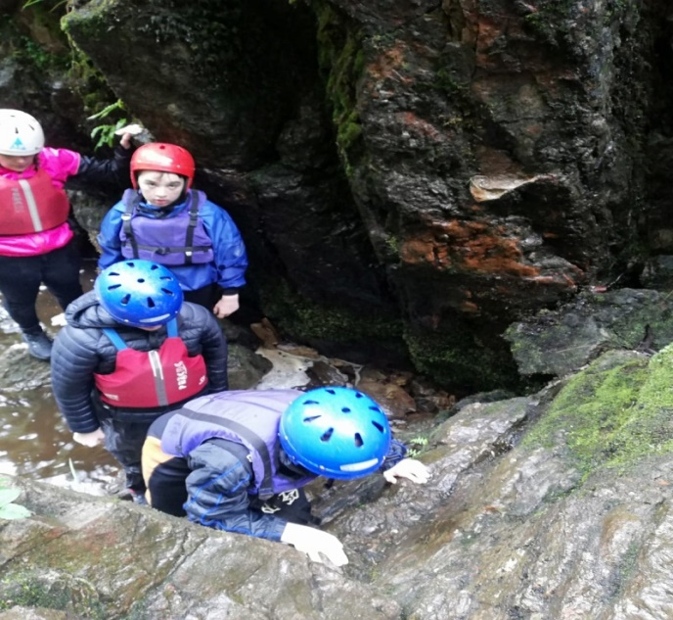
Not got your name down for camp yet?
See
Mr Stewart or Mr Cox ASAP

Slide 5
Dog’s Trust Dog Safety Workshops
Rachel, from the Dog’s Trust, will coming to talk to us about how to be safe around dogs. The workshops will be in the hall and last the whole lesson. Your teacher will be with you during the session.
Tuesday 29th
P2 - 1C
P3 - 3C
P4 - 1A + 3A
P5 - 2A
Wednesday 30th
P3 - 2B
P4 -1B
P5 -3B

Slide 6
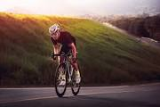
S2 Bikeability
S2 will be starting their block of BikeAbility Level 2 out on the roads this Wednesday.
Can pupils please bring warm sporty clothes so that you can cycle comfortably and also feel warm. Jogging bottoms and a hoody/light jacket would be ideal.

Slide 7
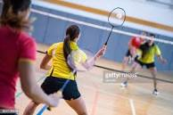
Badminton Festival
Good luck to all the pupils attending the Lothian Schools’ Disability Badminton Festival in Meadowmill Sports Centre on Thursday.
It should be a really fun filled day. Please remember to bring your PE kit.

