Slide 1
Our weekly bulletin
Week Beginning : Monday 27th January

Slide 2
Day | Date | In School Events | Events and Trips
Monday | 27th |  | S1 Swimming (p1&2)
Tuesday | 28th
Wednesday | 29th
Thursday | 30th |  | Sportshall Athletics, Linlithgow
Friday | 31st

Slide 3
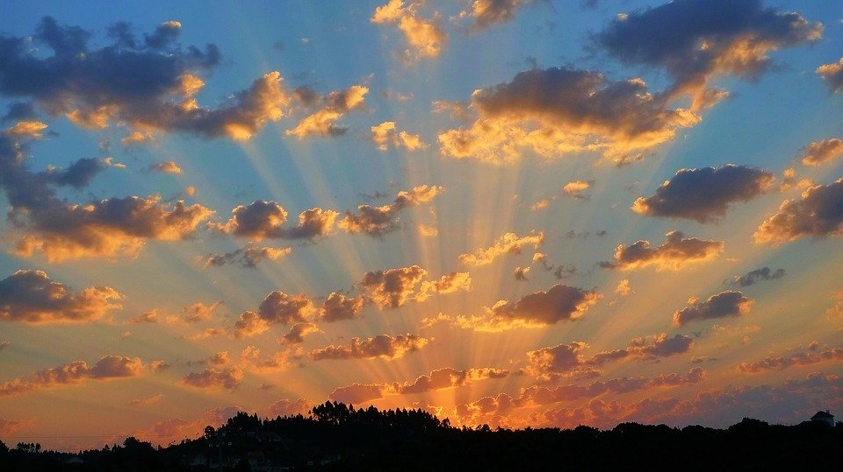
Word of the Week
crepuscular (adjective)
Relating to twilight; dim.
Active during twilight (at dawn or dusk, when the light is not bright).
“He peered through the crepuscular gloom, trying to find his dog”
“Deer are crepuscular animals, being most active just after sunrise and just before sunset”

Slide 4
Radio 2's 500 words competition has launched for 2020! This is open to pupils aged 5-13 and can be really good fun to enter! More information can be found at https://www.bbc.co.uk/programmes/p00rfvk1
There is plenty of great advice from the judges in this BBC Live Lesson too https://www.bbc.co.uk/teach/live-lessons/500-words-2020-live-lesson/zn7jkmn
If you choose to enter this can be worked on at home. Mrs Keir will also open Room 8 on Thursday lunchtimes until the closing date (Feb 27th) for anyone wishes to work on their story. Good luck!

Slide 5
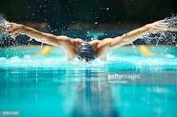
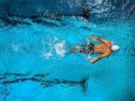
S1 Swimming Monday 27th January
Swimming for S1 periods 1 and 2

