Slide 1
Our weekly bulletin
Week Beginning : Monday 25th November

Slide 2
Day | Date | In School Events | Events and Trips
Monday | 25th | ChildSmile Varnishing S1-3 | S2 Swimming (p1&2)
Tuesday | 26th | S4 Parent/Carer Night @ DCHS
Wednesday | 27th | S2 Bikeability (pm)
Thursday | 28th |  | PE Football, Midlothian
Friday | 29th | Cedarbank Christmas Fayre

Slide 4
S2 Swimming
Cancelled today
25th November
The next swimming lesson will be on 2nd December

Slide 5
S4 Parent and Carer Night @DCHS
We look forward to seeing you at Deans for your S4 Parent Carer Night, from 5-7pm.
Don’t forget to make appointments with your teachers.

Slide 6
S2 Bikeability
S2 will be continuing their block of Bike Ability Level 2 out on the roads this Wednesday.
Can pupils please bring warm sporty clothes so that you can cycle comfortably and also feel warm. Jogging bottoms and a hoody/light jacket would be ideal.

Slide 7
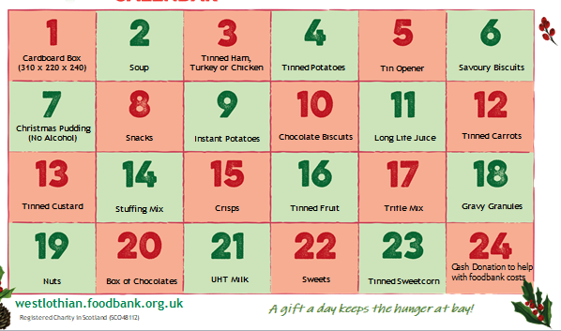
Festive Foodbank Collection
S2B are accepting donations for the Festive Foodbank collection from Monday 2nd December until Friday 13th December. Below, is a list of the type of items that we are looking for as donations. S2B will visit classes during Life Skills to donations, each day.
Many thanks.

Slide 8
Friday 29th November Christmas Fayre
We will be off timetable on Friday, to help
set up for the Fayre.
If you are helping at the Fayre, please remember
to bring your form back. Uniform required to be worn.
If you are not helping, you do not need to wear your
Uniform during the fayre

