Slide 1
Our weekly bulletin
Week Beginning : Monday 21st October

Slide 2
Day | Date | In School Events | Events and Trips
Monday | 21st | Pupils off school
Tuesday |  | Welcome back!
Wednesday | 23rd | S2 Open afternoon
Thursday | 24th |  | Bag packing at Morrisons
Friday | 25th | S1-6 School Photos

Slide 4
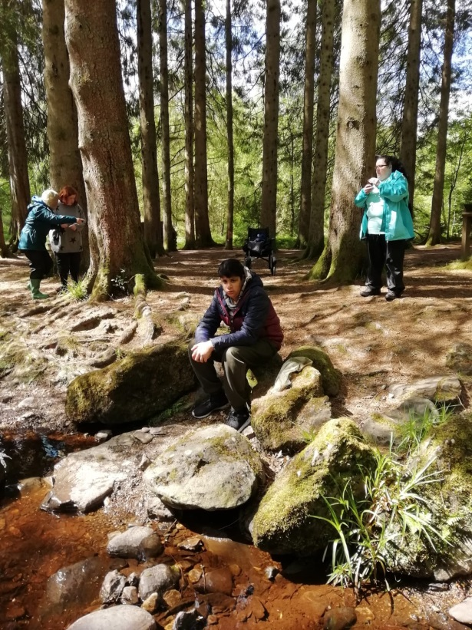
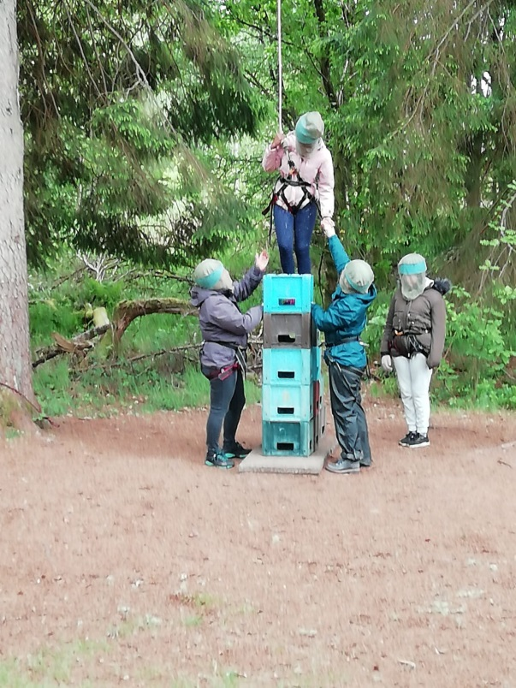
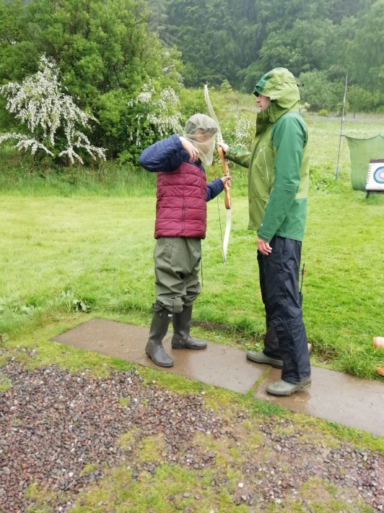
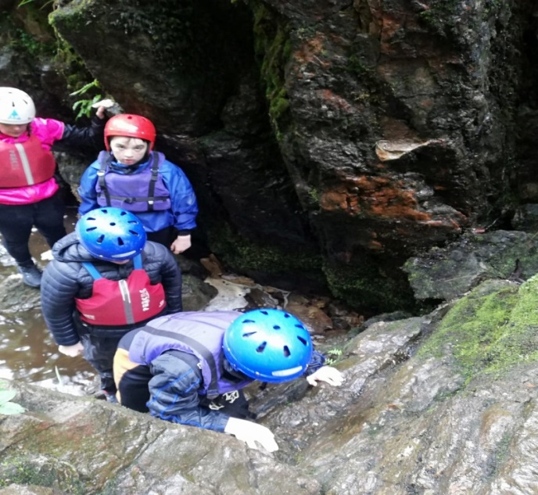
Not got your name down for camp yet?
See
Mr Stewart or Mr Cox ASAP

Slide 5
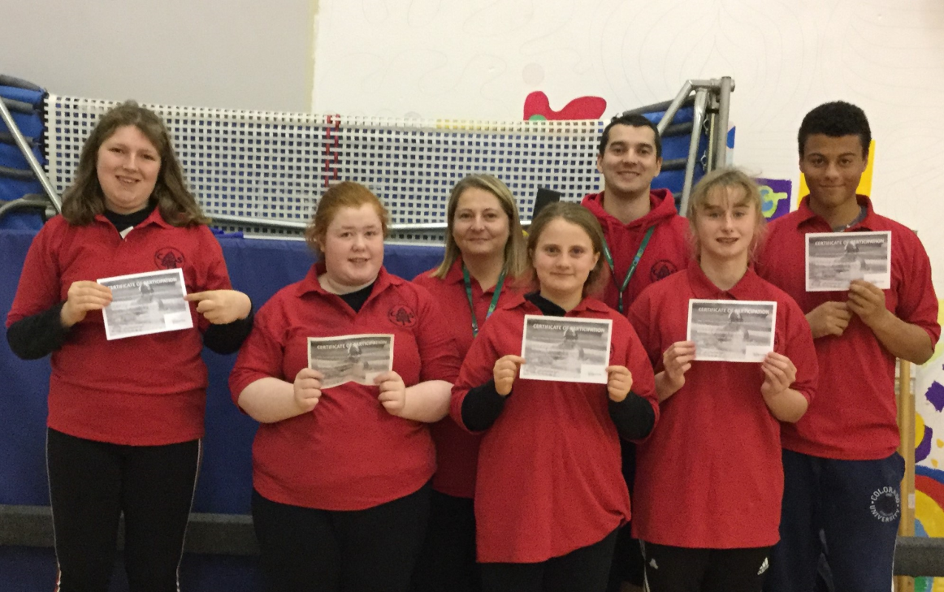
Lothian Swimming Qualifiers
Michael, Lia, Brogan, Rosie and Lucy did a fantastic job at the swimming meet in Prestonpans on 10th October and have qualified for the National event!
GREAT JOB TEAM

Slide 6
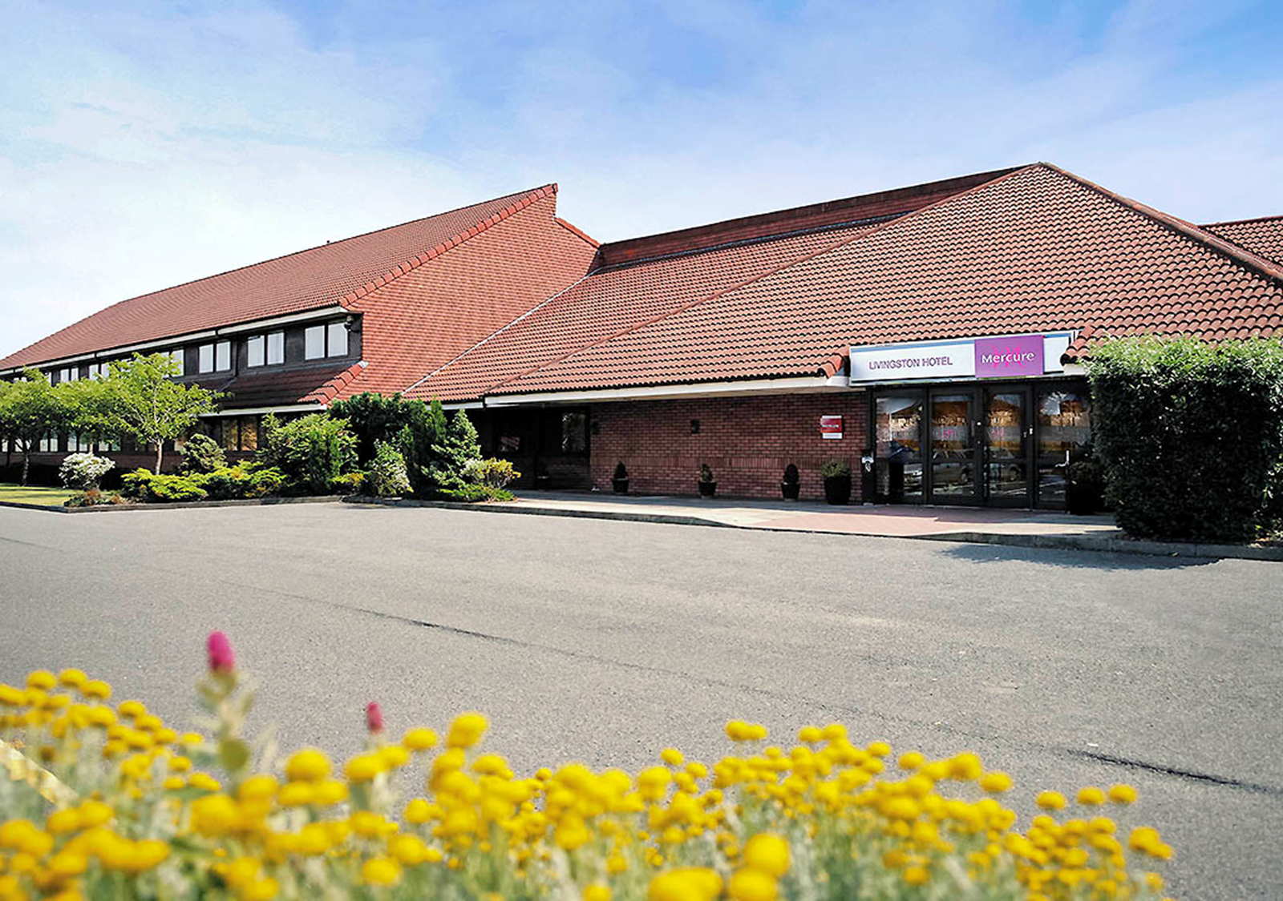
Wednesday 23rd October
All pupils from S4 and 2 pupils from S5 will visit the Mercure Hotel in Livingston to find out what jobs you can do in the hotel industry.

Slide 7
S2 Open Afternoon
Wednesday 23rd October
During p6 and 7, we welcome our S2 student’s
adults who are coming to visit.

Slide 8
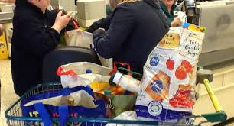
Thursday 24th October
Bag Packing at Morrisons
Bag packing will be happening today.
Good luck to all of those involved.

Slide 9
Friday 25th October School Photos
Please come in your school uniform, including ties.
There will be individual and group photographs taken.

