Slide 1
Our weekly bulletin
Week Beginning : Monday 20th January

Slide 2
Day | Date | In School Events | Events and Trips
Monday | 20th | Scotland Week | S1 Swimming (p1&2)
Tuesday | 21st
Wednesday | 22nd
Thursday | 23rd | Burns Celebration Event | S1-3 Scottish No Uniform Day
Friday | 24th |  | Whole School Scottish Café Food for Thought Parental Engagement 2

Slide 3
Word of the Week
caledonia (noun)
(adjective: Caledonian)
The Roman name for Scotland. Nowadays, Caledonia is still used as a romantic or poetic name for Scotland, and companies that want to demonstrate their Scottish roots might use Caledonia or Caledonian in their name. Examples are the Caledonian Sleeper (the train that travels overnight from Scotland to England) and the Caledonian Hotel in Edinburgh.
There is a famous song called Caledonia by Dougie MacLean, which he wrote when he was a homesick young man. Listen to it here: https://youtu.be/wP8A9rtg0iI

Slide 4
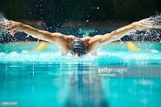
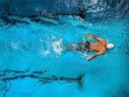
S1 Swimming Monday 20th December
Swimming for S1 periods 1 and 2

Slide 5
Burns Celebration Event
Thursday 23rd January
For S1- 3, this is a no Scottish No Uniform Day!
Wear something tartan, if you have it
There will be an early lunch from 12.15 until 1.00 pm (Period 5).
A small taste of Scotland will be served during the afternoon,
taking account of dietary requirements.

Slide 6
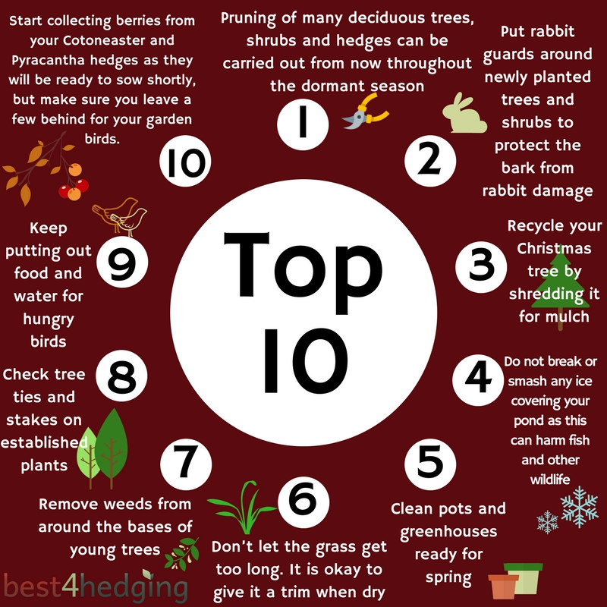
Food for Thought
Friday 24th January
Come and join us, with your adults, for some more seasonal cooking and gardening.
Each session will last for an hour. And will run from 1-2pm and 2-3pm.
You can come to both, or just one. Any questions, ask Ms Cook or Miss Ballentyne.

Slide 7
Radio 2's 500 words competition has launched for 2020! This is open to pupils aged 5-13 and can be really good fun to enter! More information can be found at https://www.bbc.co.uk/programmes/p00rfvk1
There is plenty of great advice from the judges in this BBC Live Lesson too https://www.bbc.co.uk/teach/live-lessons/500-words-2020-live-lesson/zn7jkmn
If you choose to enter this can be worked on at home. Mrs Keir will also open Room 8 on Thursday lunchtimes until the closing date (Feb 27th) for anyone wishes to work on their story. Good luck!

