Slide 1

Our weekly bulletin
Week Beginning : Monday 18th November

Slide 2
Day | Date | In School Events | Events and Trips
Monday | 18th | Book Week | S2 Swimming (p1&2) Rescheduled Cross Country
Tuesday | 19th
Wednesday | 20th | S2 Bikeability (pm)
Thursday | 21st |  | Swimming Event, Glasgow
Friday | 22nd | Children In Need Café @Deans

Slide 3
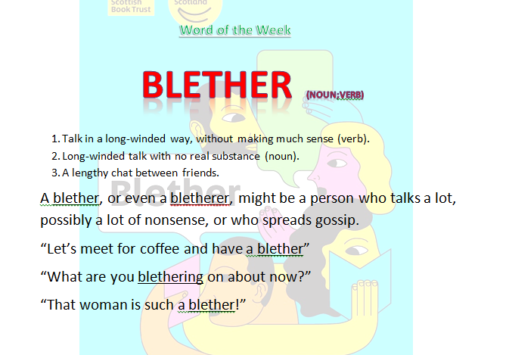

Slide 4
Re-Scheduled Cross Country - Meadowmill
Monday 18th November
There are lot of students out today,
representing the school at the Cross Country event.
Wishing you the best of luck to those of you attending!

Slide 5


Scottish Book Trust Film Clip https://twitter.com/scottishbktrust/status/1177127725049491457
We have copies of this year’s book ‘Blether’ to gift to all pupils S3 and older
(age 14+). These will be distributed via Form Tutors.
Resources will be available for use during the week and it would be great to see as many pupils and staff joining in with the Book Trust’s campaign sharing why books are #MoreThanAStory to you.

Slide 6
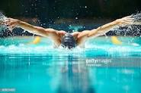
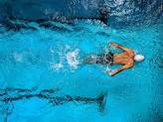
S2 Swimming
Cancelled
18th and 25th November
The next swimming lesson will be on 2nd December

Slide 7
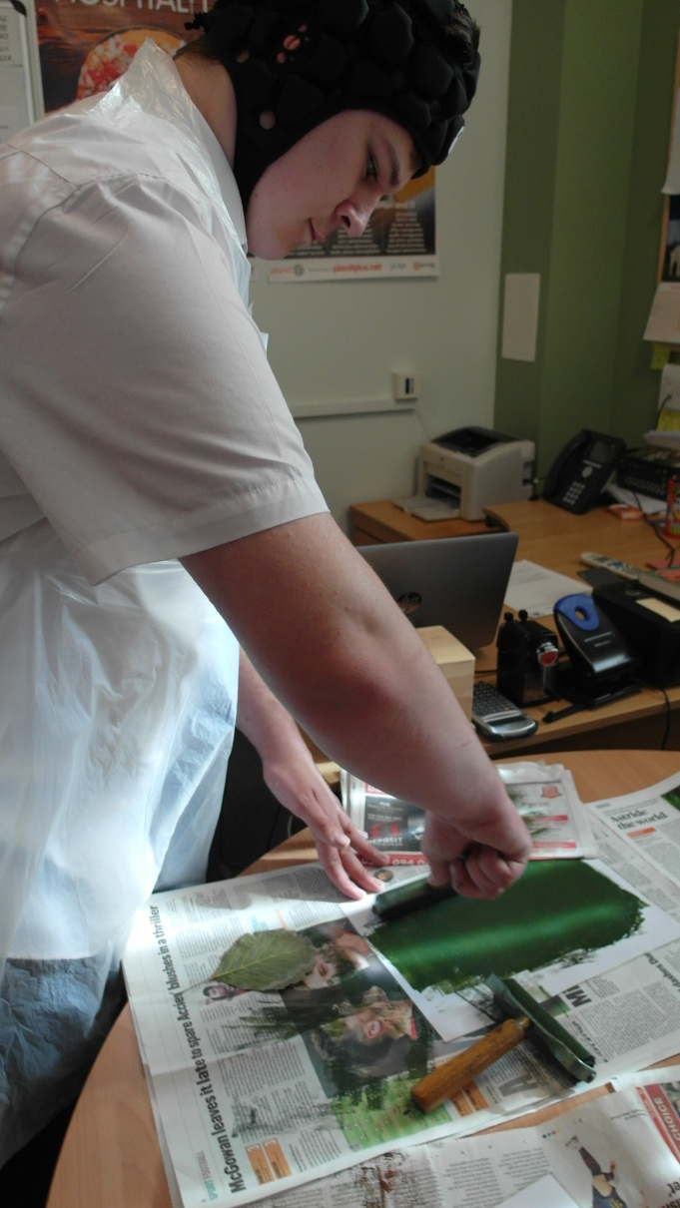
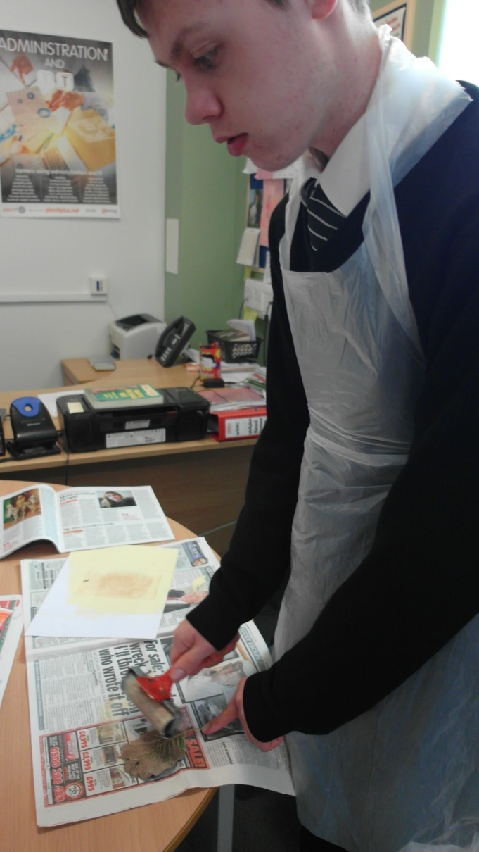
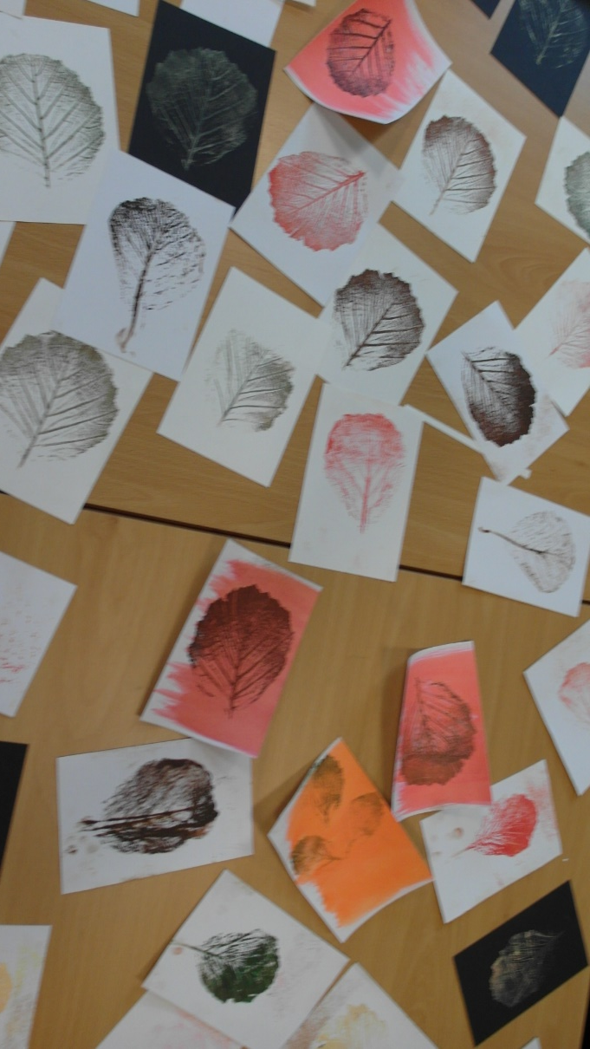
From Autumn Watch to Wish Tree

Slide 8
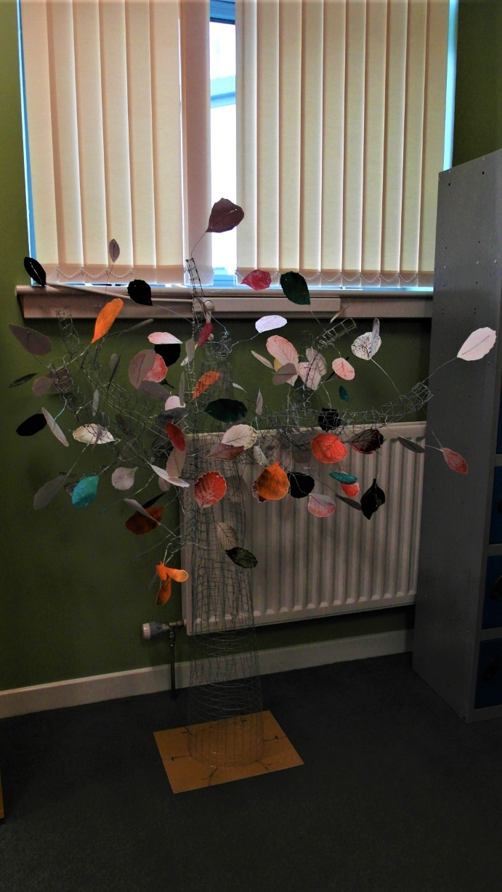
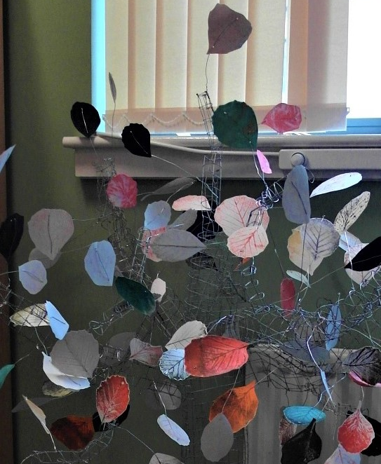
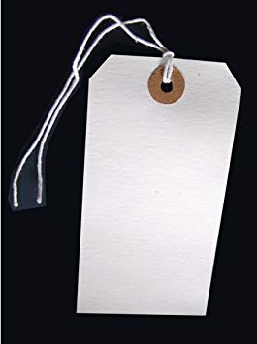
DCHS Cedarbank Seniors Wish Tree
Write on the luggage tag your own hopes and dreams for the future. You do not need to add your name. Tags are beside the wish tree.
Tie it carefully on to the wish tree. As our tree is made out of wire, you can even tie it to the trunk!
Reminder for DCHS pupils only

Slide 9


Children in Need Café
Mr Henderson and Mrs da Silva’s ASDAN classes will run the
Friday 22nd November at Deans

Slide 10

Christmas Fayre Requests
Annie and Ms Fallon are
making bird feeders to sell
at the Christmas Fayre.
If you have any spare ribbon or empty tins (soup, beans etc) please could you bring them into school for them to use.
Thank you

Slide 11
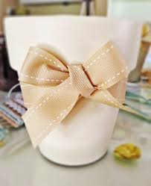
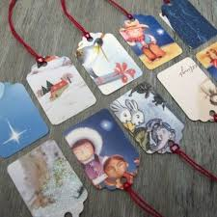
Christmas Fayre Requests
3C are making Christmas gift tags and planting
seasonal bulbs.
If you have any old cards (just the front of them)
please could you bring them in.
If you have any bulbs (hyacinths, snowdrops, daffodils, etc) that you
can donate, we’d really appreciate them.
If you have any ribbon, to help decorate the pots, that would be fab.

