Slide 1
Our weekly bulletin
Week Beginning : Monday 16th December

Slide 2
Day | Date | In School Events | Events and Trips
Monday | 16th |  | S2 Swimming (p1&2) S1 trip to the Botanic Gardens for the Mincemeat Hunt
Tuesday | 17th
Wednesday | 18th | Whole school Christmas Assembly | Whole School trip to the Pantomime
Thursday | 19th
Friday | 20th | S1-3 Christmas No Uniform Day End of Term

Slide 4
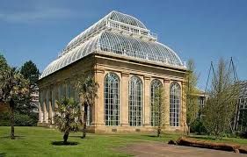
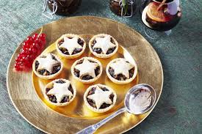
Monday 16th December
S1 Mincemeat Hunt
Botanic Gardens, Edinburgh
10am-2pm
S1 are going to the Botanic Garden today to find out about the different plants
that are used in traditional festive foods, and where in the world those plants come from.
We are looking forward to seeing you willow art you make too.
The bus will leave at 9am, and return for about 3pm.
Please make sure you have a snack, as there will be no chance to buy anything
at the Botanic Gardens.
A school packed lunch will be provided

Slide 5
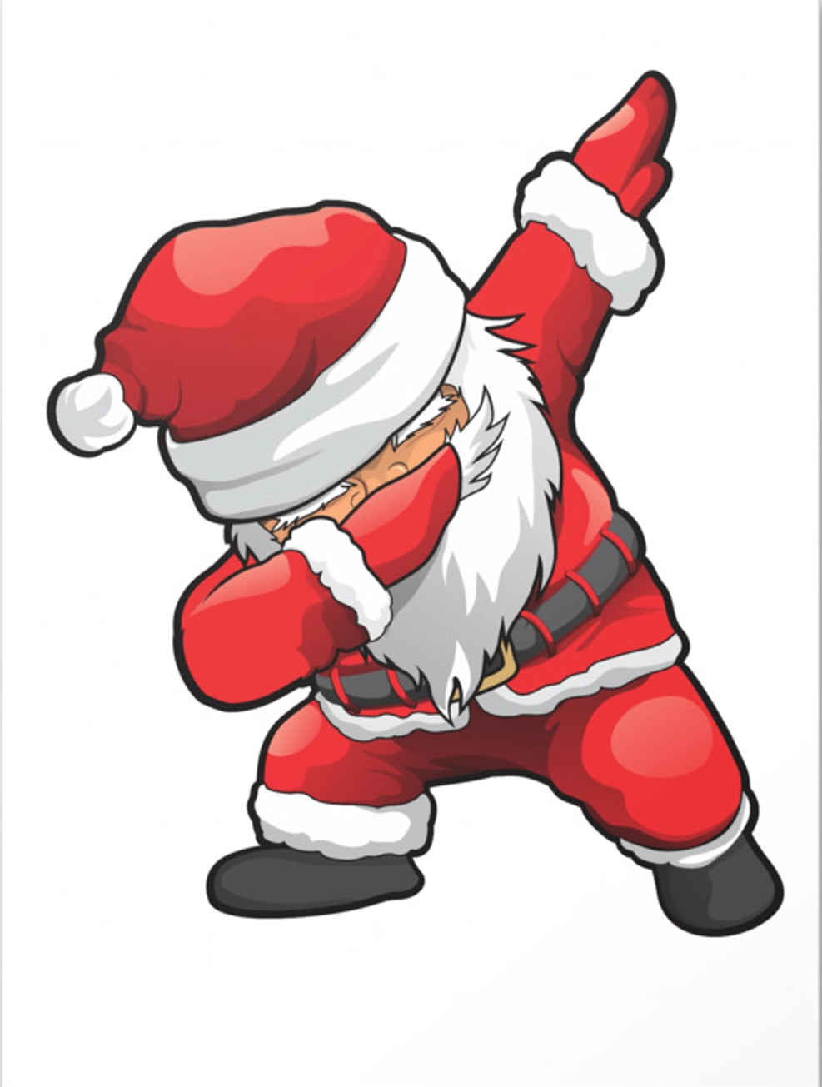
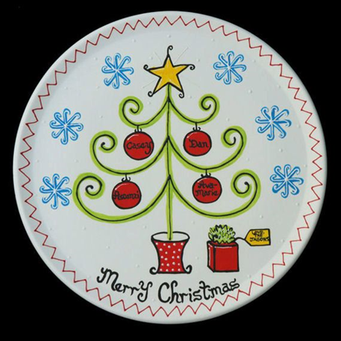
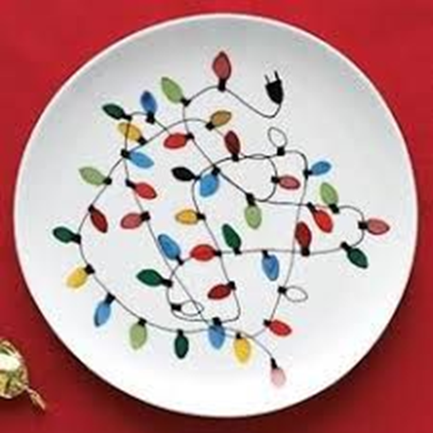
BGE Art and Design, Christmas and Home Sweet Home Plates
The Christmas Fayre is over and you now have the opportunity to buy your own Christmas Plate/Home Sweet Home Plate!
Ask Miss Galloway/Mrs Thomson if your plate is still available and for £2 you can personalise it further with a name and take it home as a Christmas gift.

Slide 6
Festive Foodbank Collection
A massive thank you to each and every person that has donated to our Festive Foodbank collection.
S2B are going to meet Kathleen from West Lothian Foodbank on Tuesday morning, with our donation.

Slide 7
Wednesday 18th December
The whole school Christmas assembly will start at 10.15am on in Baptist church.

Slide 8
Wednesday 18th December Pantomime at Howden Park Centre
Each class with walk with their Tutor teachers and
PSW will walk to Howden Park Centre and sit
together in the theatre.
We aim to leave Cedarbank School at approximately 12.15 for the panto starting at 1pm.
We will all return to Cedarbank School following
the show and taxis will collect all pupils from the
main building.
There will not be the opportunity to buy any
snacks or drinks from the venue but you can bring
your own with you.

Slide 9
It is the Christmas break next week.
There is no school for over two weeks.
We are going to be on holiday.
Our last day of term is Friday 20th December.
We hope that you have a lovely break,
you have worked so hard this term.
We look forward to seeing you back at school after the holiday. The first day of the next term is Tuesday 7th January.

