Slide 1
Our weekly bulletin
Week Beginning : Monday 13th January

Slide 2
Day | Date | In School Events | Events and Trips
Monday | 13th | S4/5 assembly p5
Tuesday | 14th | BGE Assembly Respected p1 by 1A
Wednesday | 15th
Thursday | 16th
Friday | 17th

Slide 3
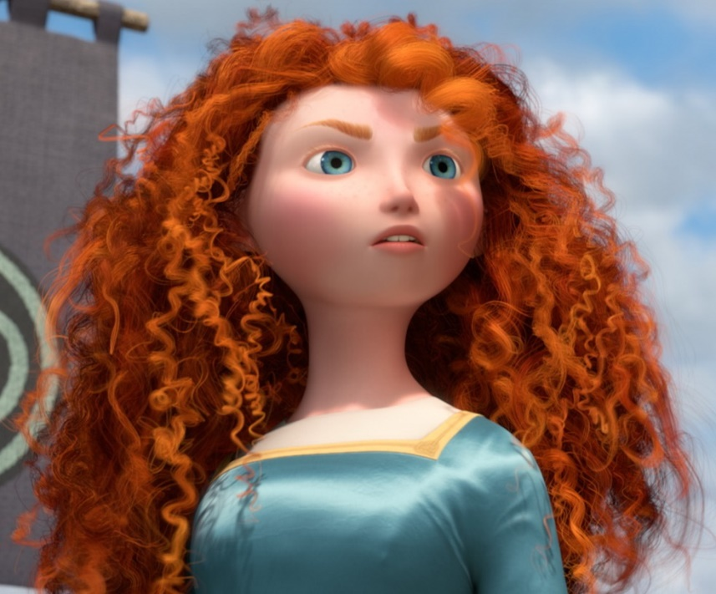
Word of the Week
feisty (adjective)
(verb: resolve; adjective: resolute)
Full of spirit, energy, courage, determination.
Someone who is willing to stand up for him or herself might be described as feisty.
This adjective is often applied to someone you wouldn’t expect to be strong, maybe because they are small or elderly.
“I like her attitude: she’s feisty, digs in and never gives up”
“Rescue cats can be funny, feisty and full of life”

