Slide 1

Our weekly bulletin
Week Beginning : Monday 11th November

Slide 2
Day | Date | In School Events | Events and Trips
Monday | 11th | Anti-Bullying Week | S2 Swimming (p1&2)
Tuesday | 12th |  | Into Film Festival cinema trip for all
Wednesday | 13th | S2 Bikeability (pm) Childsmile Varnishing (S1-3) | Nurture Trip (am)
Thursday | 14th | NSPCC Assembly | S4-6 Skills Scotland Exhibition
Friday | 15th | Food for Thought Afternoon

Slide 3
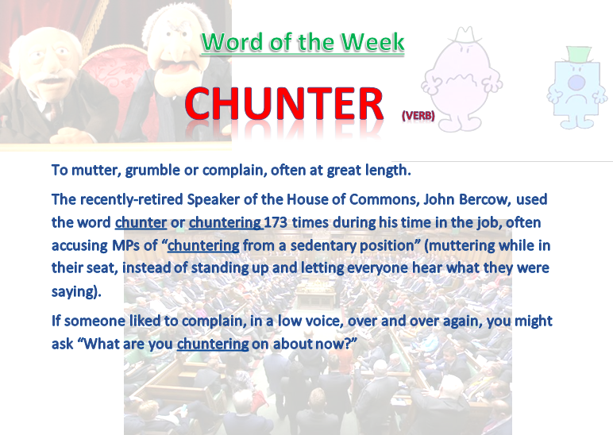

Slide 4
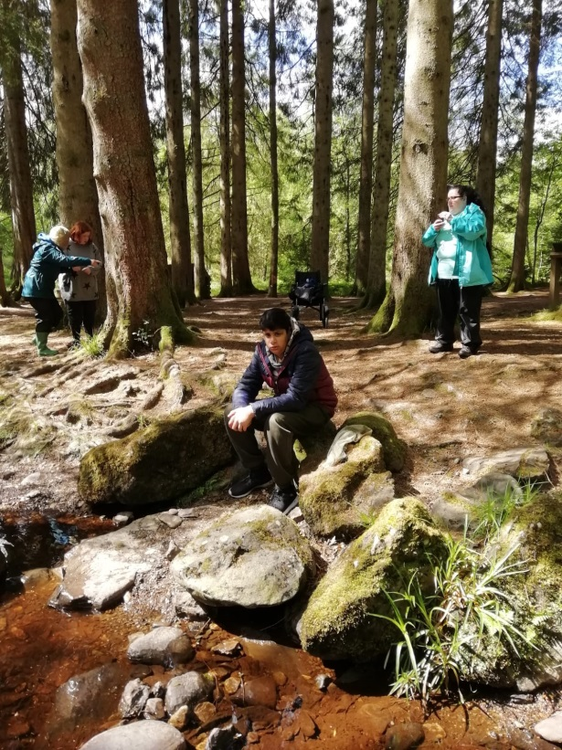
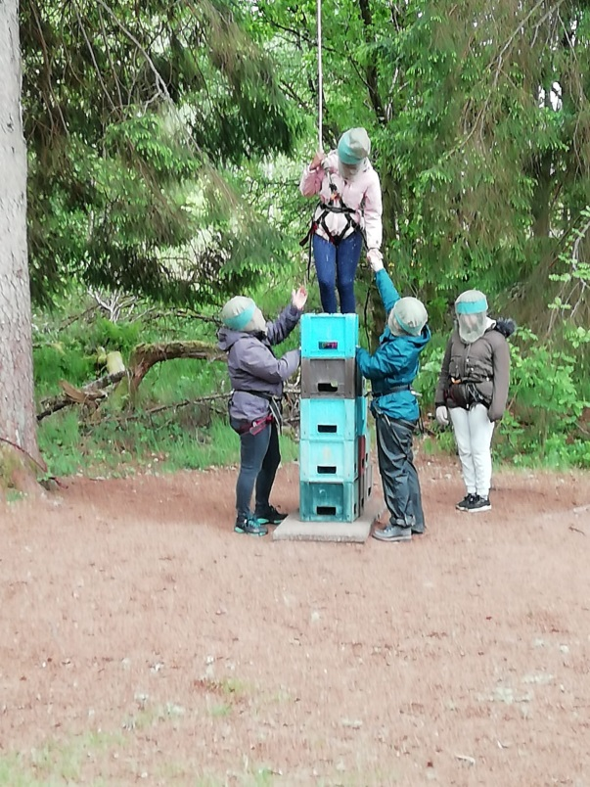
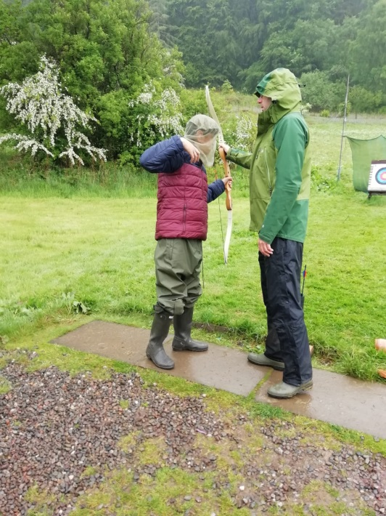
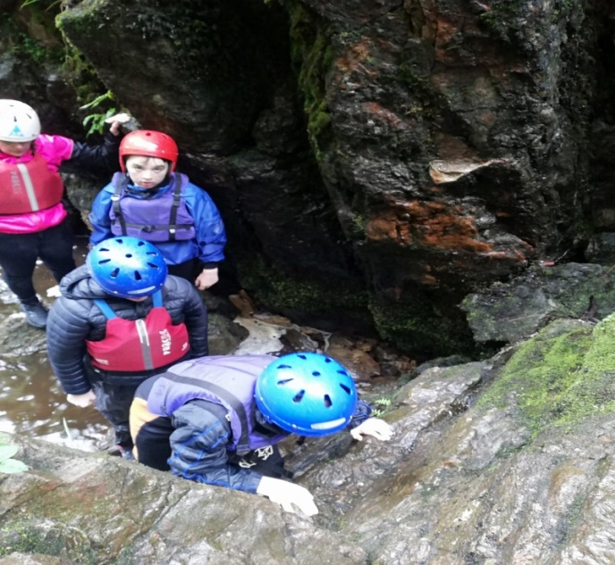
Not got your name down for camp yet?
See
Mr Stewart or Mr Cox ASAP

Slide 5
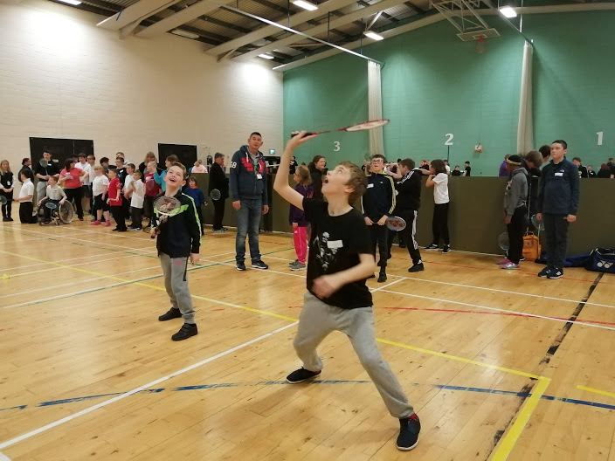
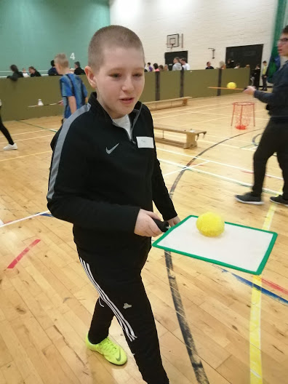
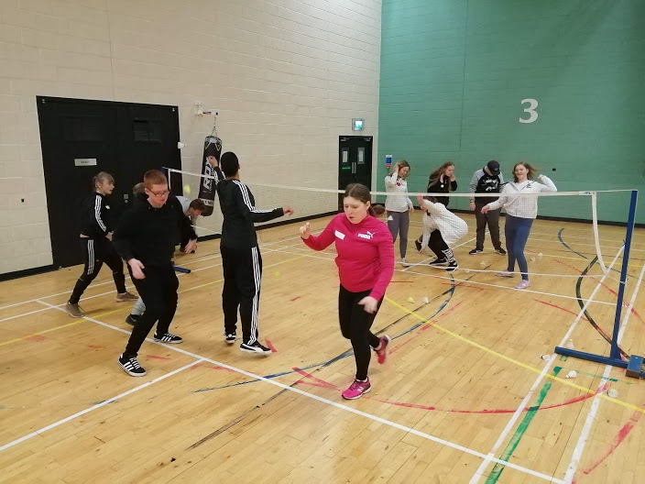
Badminton Festival
Well done to all the pupils that attended the Lothian Schools’ Disability Badminton Festival in Meadowmill Sports a few weeks ago, It was great fun!

Slide 6
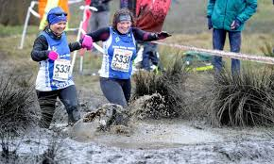
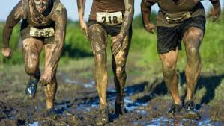
Cross country
It was a real shame that we didn’t make it to the cross country last week but Ms O’Hagen wouldn’t have liked us coming back to school like this! The event has been re arranged for Monday the 18th of November.

Slide 7


Anti Bullying Week – Don’t Be Mean Behind The Screen.
This week is Anti – Bullying week and we are focusing on Cyber/Online bullying this week.
We will also be having a Poster competition to raise awareness of Cyber/Online bullying
A4 sheet of paper, make it colourful and bold.
There will be a winner from each year group.
Winners posters will be copied and put up round Cedarbank School.
GOOD LUCK

Slide 8
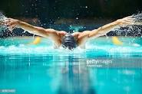
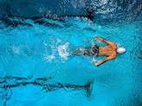
Swimming
The S2s are ready to start their 5 week swimming block this week in Inveralmond pool.
They will be working towards their STA swimming certificates.

Slide 9

Into Film Festival
Tuesday 12th November
Whole School trip
10am
Deans pupils collected at 9.15am
Coach arrive CB main building 9.30am
All of S1, and some other pupils will travel in the coach
S2 and S3 will walk to the cinema, leaving by 9.15am
Pupils to walk and remain with their Tutor Groups
Students and Staff from Armadale will be arriving separately.
Please bring a snack to enjoy during the movie.
No money to be brought. The kiosk will not be open, so you will not be able to buy anything.

Slide 10
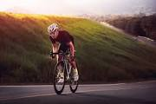
S2 Bikeability
S2 will be continuing their block of BikeAbility Level 2 out on the roads this Wednesday.
Can pupils please bring warm sporty clothes so that you can cycle comfortably and also feel warm. Jogging bottoms and a hoody/light jacket would be ideal.

Slide 11

Christmas Fayre Requests
Annie and Ms Fallon are
making bird feeders to sell
at the Christmas Fayre.
If you have any spare ribbon or empty tins (soup, beans etc) please could you bring them into school for them to use.
Thank you

Slide 12
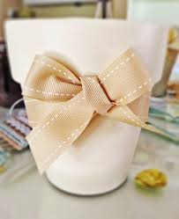
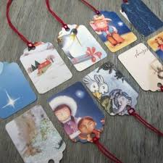
Christmas Fayre Requests
3C are making Christmas gift tags and planting
seasonal bulbs.
If you have any old cards (just the front of them)
please could you bring them in.
If you have any bulbs (hyacinths, snowdrops, daffodils, etc) that you
can donate, we’d really appreciate them.
If you have any ribbon, to help decorate the pots, that would be fab.

