Slide 1
Our weekly bulletin
Week Beginning : Monday 10th February

Slide 2
Day | Date | In School Events | Events and Trips
Monday | 10th | p6 School Council Meeting | S1 Swimming (p1&2) ASDAN @Deans trip to Recycling Centre
Tuesday | 11th | BGE Assembly p1 S1 meeting with Sam (from SDS) during p2,3 & 4
Wednesday | 12th |  | S5 Pupils visit Armadale
Thursday | 13th | p5 Eco-Committee meeting
Friday | 14th | February Break

Slide 3
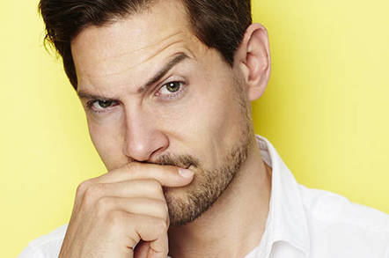
Word of the Week
sceptical (adjective)
Noun: Sceptic; adverb: sceptically (American spelling; skeptical)
Not easily convinced; having doubts.
If a person is sceptical, or a sceptic, they are not ready to be convinced about something, and would need a lot of evidence before they would change their mind.
“Despite hearing stories about a ghost in the empty building, he remained sceptical, because he hadn’t seen it for himself”
“He seemed to think he would pass his exam without doing any revision in his own time, but his teacher was sceptical”

Slide 4
Radio 2's 500 words competition has launched for 2020! This is open to pupils aged 5-13 and can be really good fun to enter! More information can be found at https://www.bbc.co.uk/programmes/p00rfvk1
There is plenty of great advice from the judges in this BBC Live Lesson too https://www.bbc.co.uk/teach/live-lessons/500-words-2020-live-lesson/zn7jkmn
If you choose to enter this can be worked on at home. Mrs Keir will also open Room 8 on Thursday lunchtimes until the closing date (Feb 27th) for anyone wishes to work on their story. Good luck!

Slide 5
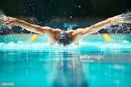
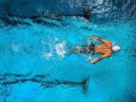
S1 Swimming Monday 10th February
Swimming for S1 periods 1 and 2

Slide 6
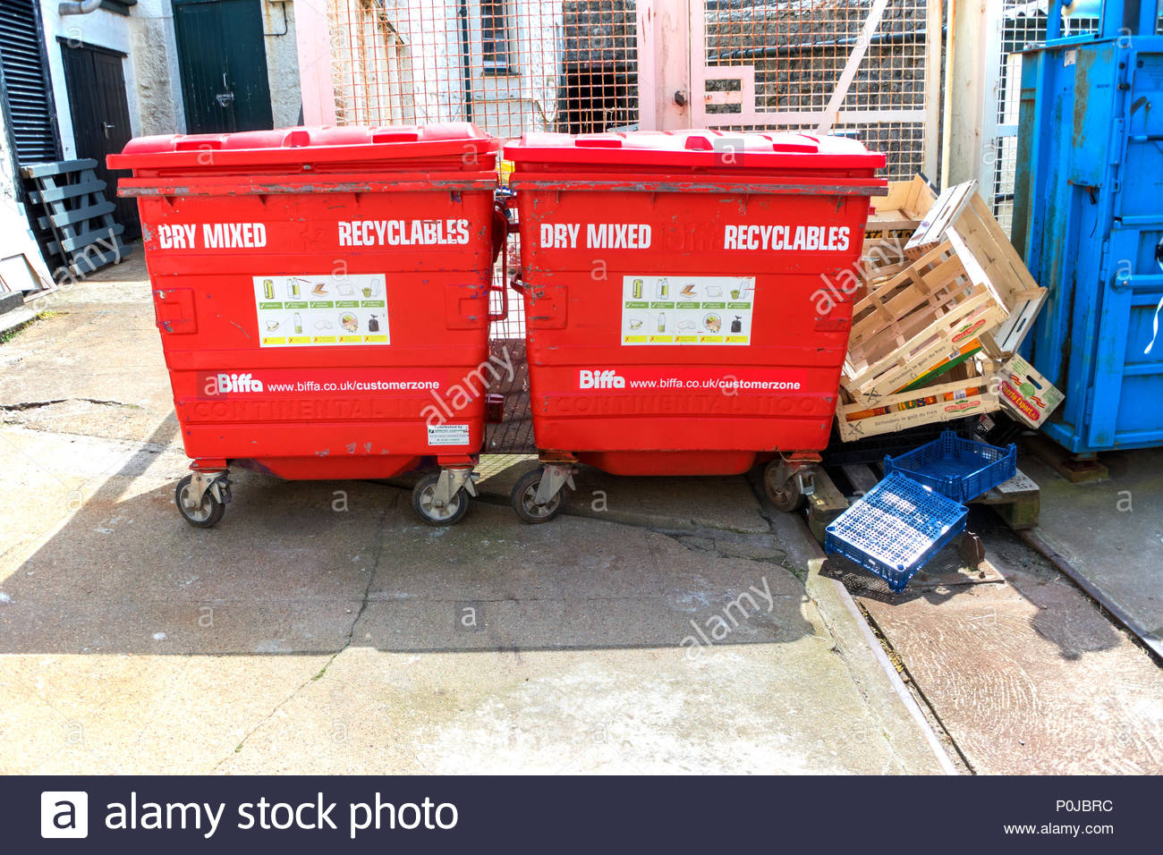
ASDAN classes at Cedarbank@Deans are going to visit a recycling centre on MONDAY 10th February.

Slide 7
Full Pupil Council Meeting Monday 10th Feb with Ms O'Hagan p6 in room 8.
Agenda items:
Rights Respecting School Bronze Award
PEF Pupil Participatory Budget

Slide 8
Sam Morgan
Sam is a career adviser – he helps people to think about skills and preparing for the world of work.
TUESDAY 11th FEBRUARY:
1A – period 2
1B – period 3
1C – period 4
You will go to the meeting room and have a lesson with Sam Morgan about skills that you might need in the future.

Slide 9
2A and 2B will continue to visit the Howden Park Woods during wider achievement on Wednesday afternoons.

Slide 10
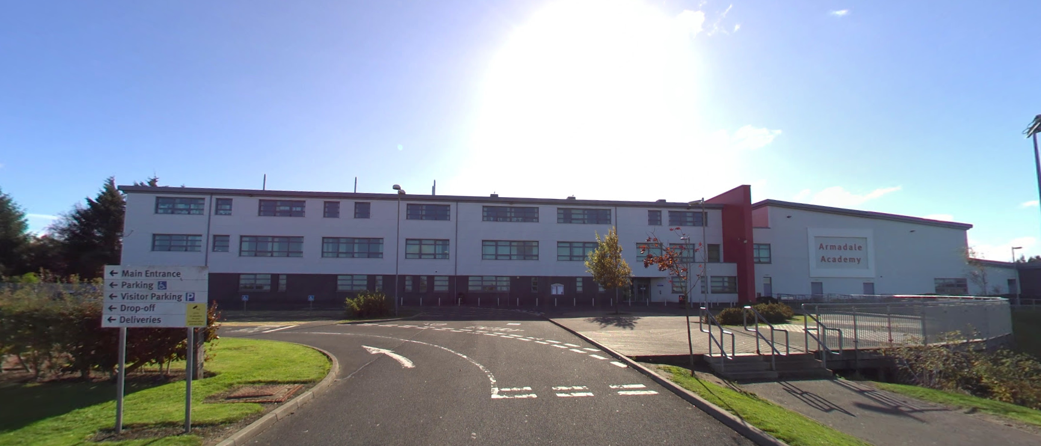
WEDNESDAY 12th FEBRUARY
All S5 pupils will go to Armadale Academy at 1.30pm for their first transition visit.
Have fun!

Slide 11
Eco- Committee Meeting Thursday 13th February
Meeting in Rm 12 at 12.15pm
Agenda:
Environmental Review
Ideas for next steps

Slide 12
It is the February Break. We are going to be on holiday.
There is no school on Friday 14th, Monday 17th and Tuesday 18th February.
We hope that you have a lovely break,
you have worked so hard this term.
We look forward to seeing you back at school after the holiday.
The first day of the next term is Wednesday 19th February.

