Slide 1
Our weekly bulletin
Week Beginning : Monday 9th December

Slide 2
Day | Date | In School Events | Events and Trips
Monday | 9th |  | S2 Swimming (p1&2)
Tuesday | 10th |  | Cross Country @ Peffermill Singing at the Airport Snooker Championships trip
Wednesday | 11th | Whole School Christmas lunch
Thursday | 12th | S2 Parent/Carer evening 4-6pm | Singing at the Centre
Friday | 13th | Nurture Group Breakfast

Slide 4
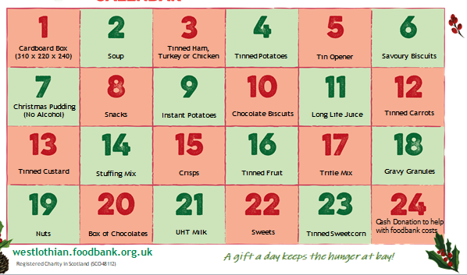
Festive Foodbank Collection
S2B are accepting donations for the Festive Foodbank collection from Monday 2nd December until Friday 13th December. Below, is a list of the type of items that we are looking for as donations. S2B will visit classes during Life Skills for donations, each day.
Many thanks.

Slide 5
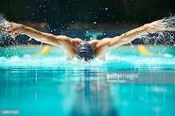
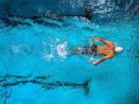
S2 Swimming Monday 9th December
Swimming for S2 periods 1 and 2

Slide 6
Snooker Championships Emirates Arena Tuesday 10th December
Senior students are going to Glasgow to see the Snooker Championships.
Hope that you have a great time.

Slide 7
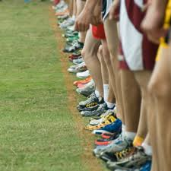
Cross Country at Meadowmill Tuesday 10th December
Good luck to everybody who is taking part in this event.
Don’t forget to bring your snack and drink with you.

Slide 8
Christmas Singing at the Airport Tuesday 10th December
S2 and S3 are going to the airport.
Hope you have a great time singing all the Christmas songs

Slide 9
Wednesday 11th December
We are having our whole school Christmas lunch on Wednesday.
Before our lunch we will be practising for singing at the Centre

Slide 10
Thursday 12th December
Christmas singing at the Centre

