Slide 1
Our weekly bulletin
Week Beginning : Monday 7th October

Slide 2
Day | Date | In School Events | Events and Trips
Monday | 7th | Autumn Watch IDL S4/5 Assembly p6 | S3 swimming (P1&2)
Tuesday | 8th | BGE Assembly during p1 – outside Treasure Hunt 2.30pm for S1-3
Wednesday | 9th | S1-3 Wider Achievement Nature Walk
Thursday | 10th | P1 S1-3 Firework Safety talk (at 8.30am) p4 S1-3 Treasure Hunt p6&7 Art in the Field | PE Swimming Event in Prestonpans
Friday | 11th | Autumn Watch Assembly p4 | End of Term – October Holidays begin 12.15pm

Slide 4
This week is Autumn watch..... There are lots of lovely events happening throughout the week. Enjoy yourselves.

Slide 5
Tuesday 8th October
S1-3
8.30am
All gather around flagpole (come in period 1 class)
Target cards will be given out to each pupil
Autumn poem will be issued and read out
Week will be discussed briefly (AL)
Class door decoration can begin!
P2 Complete Learning Styles sheet and add to Target card
From 2.30pm into p7 S1-3 gather outside – treasure hunt
(Senior Mentoring class co-ordinating)

Slide 6
Wednesday 8th October
Autumn Watch Quiz
p1 – 1A and 3A do quiz
P2 – 1B and 2B do quiz
p3 - 1C and 3C
p4 - 2A and 3B
Completed sheets to Mrs Lindsay
Leave at 1.40pm
p6 and 7 S1-3 Wider Achievement walk to Howden Park for nature
walk and outdoor game

Slide 7
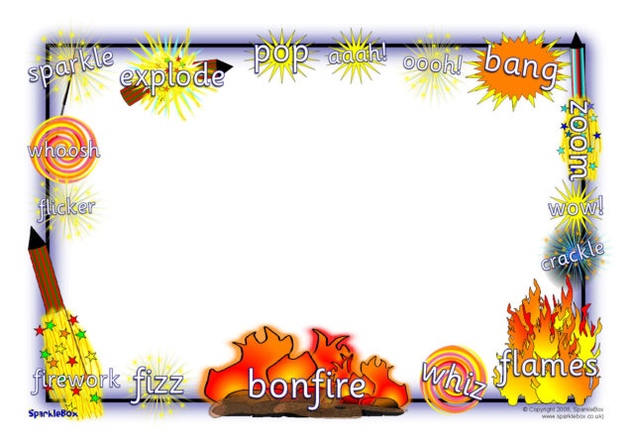
Thursday 10th October
Firework Safety talk for all of S1-3 at 8.30am
This talk will be given by the Fire Service

Slide 8
Thursday 10th October
p4 S1-3 gather outside – treasure hunt
p6 and 7 Art activity on the field to produce a flag
Art classes will remain intact.

Slide 9
Friday 11th October
p4 Autumn watch assembly at the flagpole and in hall
Parents/carers will be invited

Slide 10
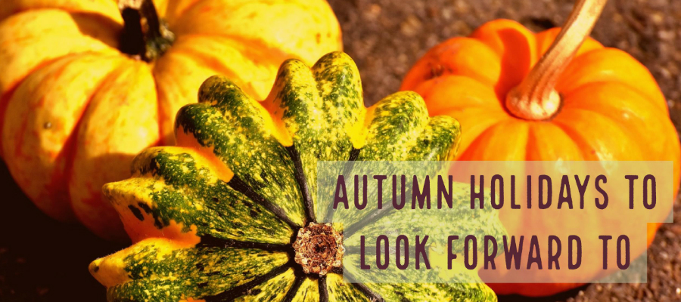
It is the October break next week.
There is no school for over a week.
We are going to be on holiday.
Our last day of term is Friday 11th October.
We hope that you have a lovely break,
you have worked so hard this term.
We look forward to seeing you back at school after the holiday. The first day of the next term is Tuesday 22nd October.

