Slide 1

Our weekly bulletin
Week Beginning : Monday 4th November

Slide 2
Day | Date | In School Events | Events and Trips
Monday | 4th | S4/5 Assembly p5 | S2 Swimming (p1&2)
Tuesday | 5th |  | PE Cross Country at Meadowmill
Wednesday | 6th | S2 Bikeability (pm) S3 Open Afternoon | Nurture Trip (am)
Thursday | 7th | International Outdoor Learning day
Friday | 8th

Slide 3
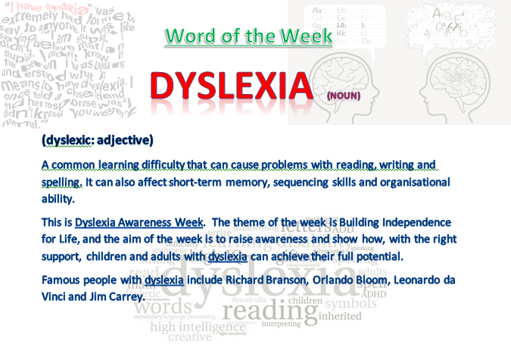

Slide 4
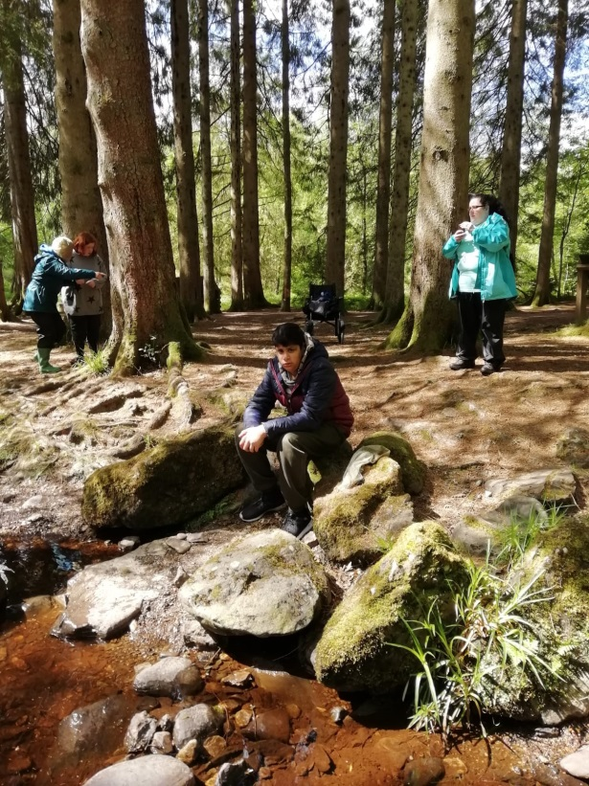
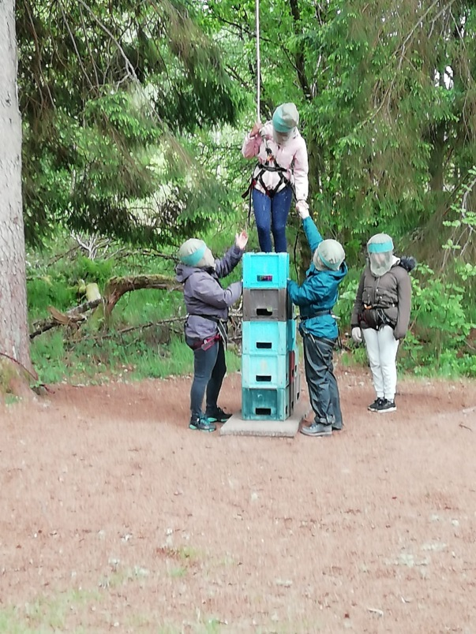
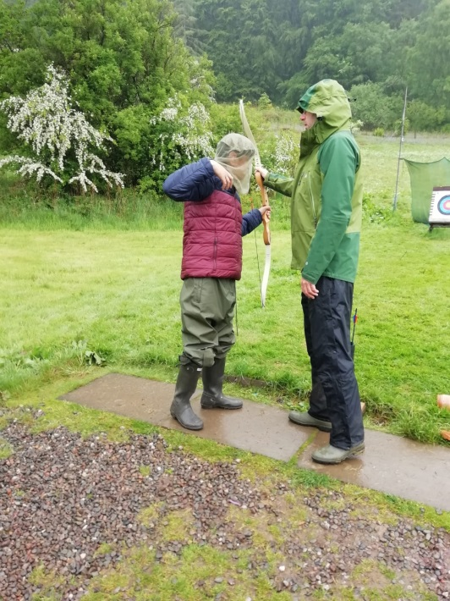
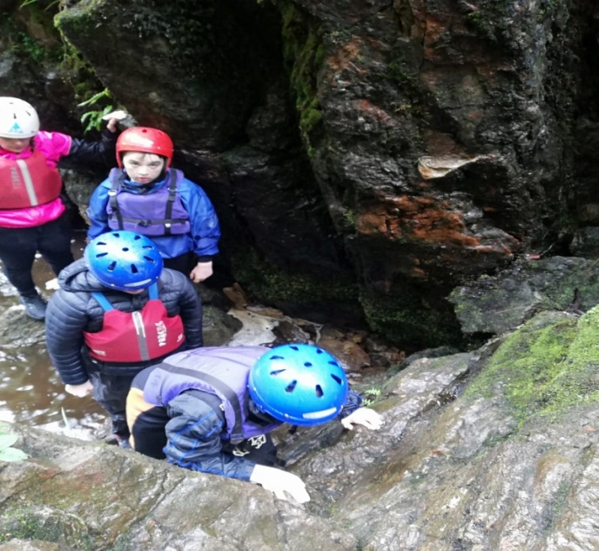
Not got your name down for camp yet?
See
Mr Stewart or Mr Cox ASAP

Slide 5
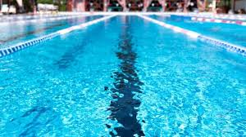
Swimming
S2 start their swimming block this week.
Hope you have a great time.

Slide 6
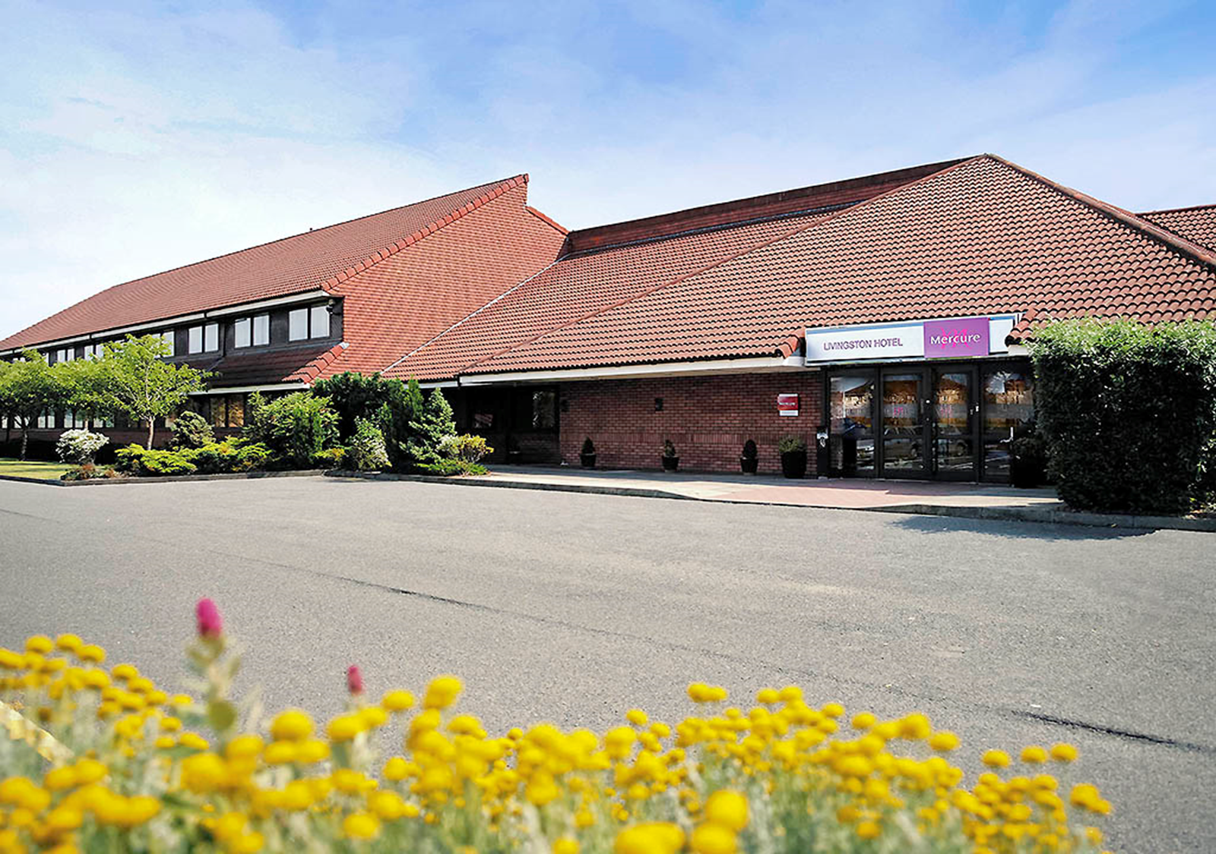
Monday 4th November
All pupils CB @Armadale are visiting the Mercure Hotel in Livingston to find out about the different types of jobs that are available in the industry.

Slide 7
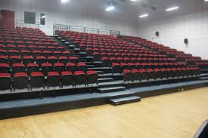
Assembly
Monday 4th November
CB @Deans will have an assembly during p5 today

Slide 8

Cross Country - Meadowmill
Tuesday 5th November
There are lot of students out today,
representing the school at the Cross Country event.
The coach will leave CB main building at 9.30am
Mr Cox will collect students from Deans and Armadale.
The event finishes about 1pm.
Wishing you the best of luck!
For those left at CB, there may be some
changes to your time table from p2- p5.

Slide 9


S3 Open Afternoon
Wednesday 6th November
During p6 and 7, we welcome our S3 student’s
adults who are coming to visit.

Slide 10
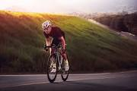
S2 Bikeability
S2 will be continuing their block of BikeAbility Level 2 out on the roads this Wednesday.
Can pupils please bring warm sporty clothes so that you can cycle comfortably and also feel warm. Jogging bottoms and a hoody/light jacket would be ideal.

Slide 11
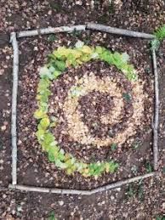

Thursday 7th November
S1- 3 International Outdoor Learning Day
Outdoor Classroom Day is a global campaign to celebrate and inspire outdoor learning and play.
You will be outside, learning during the day.
Please bring a jumper, as well warm and water
proof coat to school.

Slide 12

Christmas Fayre Requests
Annie and Ms Fallon are
making bird feeders to sell
at the Christmas Fayre.
If you have any spare ribbon or empty tins (soup, beans etc) please could you bring them into school for them to use.
Thank you

Slide 13
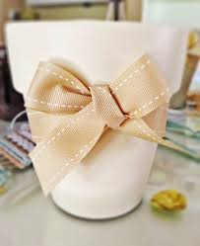
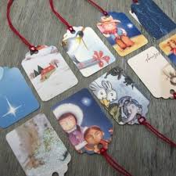
Christmas Fayre Requests
3C are making Christmas gift tags and planting
seasonal bulbs.
If you have any old cards (just the front of them)
please could you bring them in.
If you have any bulbs (hyacinths, snowdrops, daffodils, etc) that you
can donate, we’d really appreciate them.
If you have any ribbon, to help decorate the pots, that would be fab.

