Slide 1
Our weekly bulletin
Week Beginning : Monday 2nd December

Slide 2
Day | Date | In School Events | Events and Trips
Monday | 2nd | S4/5 Assembly | S2 Swimming (p1&2) S1 Christmas Party Trip
Tuesday | 3rd | S1 & 2 Assembly | S3 Green Plan it Celebration Event at Botanic Gardens, Edinburgh
Wednesday | 4th | S2 Bikeability (pm) | Nurture trip to the Dogs Trust
Thursday | 5th | S6 12 week Transition course begins
Friday | 6th

Slide 4
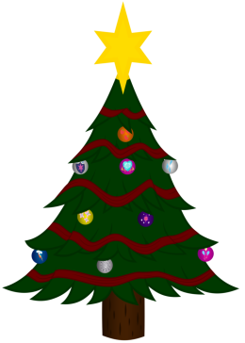
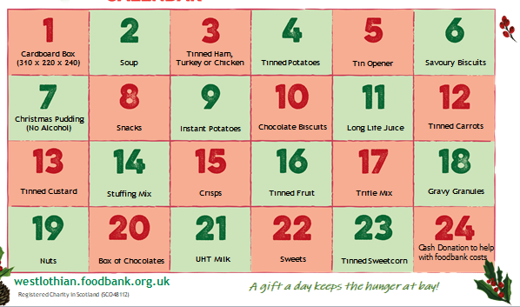
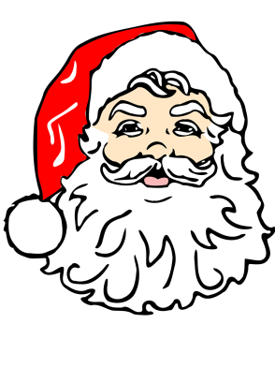
Festive Foodbank Collection
S2B are accepting donations for the Festive Foodbank collection from Monday 2nd December until Friday 13th December. Below, is a list of the type of items that we are looking for as donations. S2B will visit classes during Life Skills for donations, each day.
Many thanks.

Slide 5
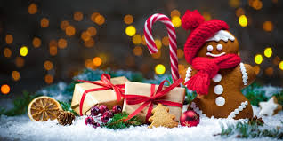
S1 Christmas Party
S1 are travelling to the Crown Plaza today to enjoy a Christmas Party hosted by the Variety Club. They are leaving at 11am.
We hope you have a fantastic time.

Slide 6
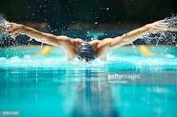
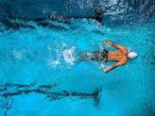
S2 Swimming Monday 2nd December
S2 Swimming back on!

Slide 7
S1 and 2 Assembly p1, Tuesday 3rd December
Our assembly will be about being safe while using the internet.
Anti-bullying week poster winners will also be announced.

Slide 8
S3 Green Plan it Celebration Tuesday 3rd December
S3 will be going to the Botanic Gardens in Edinburgh to present their garden design .
They have worked really hard on this for the last 10 weeks. The design they have come up with is brilliant.

Slide 9
Nurture Trip Wednesday 4th December
Nurture group are going to visit the Dogs Trust this morning.
Hope you have a wonderful time, meeting the dogs and learning about how to care for them.

Slide 10
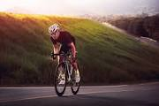
S2 Bikeability
S2 will be continuing their block of Bike Ability Level 2 out on the roads this Wednesday.
Can pupils please bring warm sporty clothes so that you can cycle comfortably and also feel warm. Jogging bottoms and a hoody/light jacket would be ideal.

Slide 11
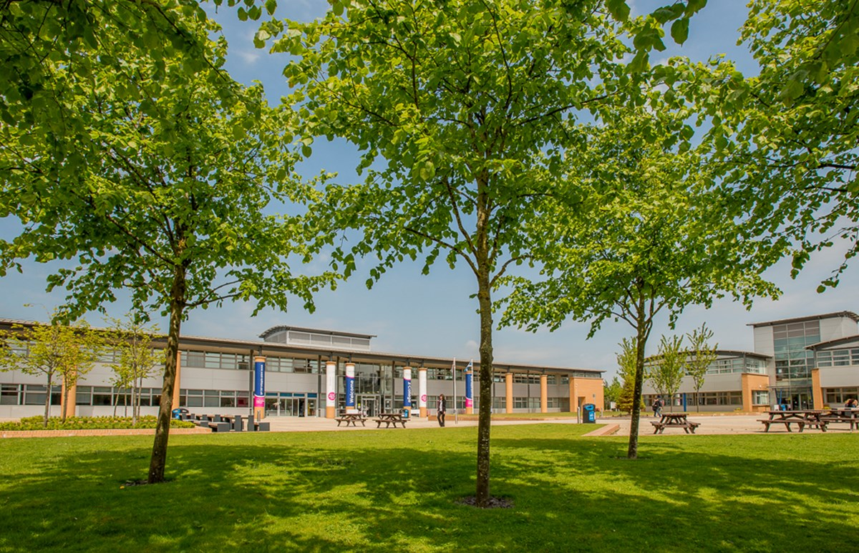
S6 College Transition Course Thursday 5th December
Wishing all the best S6 CB @ Armadale for the beginning of your transition course. This will last for 12 weeks.

