Slide 1
Our weekly bulletin
Week Beginning : Monday 2nd March

Slide 2
Day | Date | In School Events | Events and Trips
Monday | 2nd | S4/5 Assembly | S1 Swimming
Tuesday | 3rd | BGE Assembly – Communication by 1B Fair Trade Assembly by 3C | Some students CB@Deans are attending: West Lothian College for Construction Taster Event Hard Landscaping course at Crofthead Farm
Wednesday | 4th
Thursday | 5th
Friday | 6th | Fire Service visit (TBC) for S1 from 10.45 | Fair Trade Tuck Shop and Café 9.30-10.30am

Slide 3
Word of the Week
sabotage (verb/noun)
(verb) Deliberately damage or destroy something, especially for your own gain.
(noun) The act of sabotaging something.
If you wanted to stop a colleague from getting a promotion at work, especially if it would benefit you, you might sabotage their efforts, perhaps by hiding their application form or by spreading rumours about them. This act of sabotage would make you a saboteur.

Slide 4
2A and 2B will continue to visit the Howden Park Woods during wider achievement on Wednesday afternoons.

Slide 5
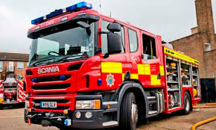
S1 Fire Service visit (TBC) Friday 6th March
1A and 1C from 10.45am to 11.20am
1B from 11.25am to 12noon

Slide 6
It is Fairtrade fortnight from 24th February until 8th March.
As part of our Green Flag, we are aiming for our Fair Aware award this year.
Fair trade Café and Tuckshop
Friday 6th March
9.30 to 10.30am
Come to the café for Chocolate chip muffins
Come to the tuck shop to buy things like jelly beans and chocolate
All items will be Fairtrade.

