Slide 1
Our weekly bulletin
Week Beginning : Monday 9th March

Slide 2
Day | Date | In School Events | Events and Trips
Monday | 9th | British Science Week “Our Diverse Planet” – Poster Competition Launch for S1-6 Break and Lunch time activity – Chalk Animals
Tuesday | 10th | Break and Lunch Time Activity – Body Clocks
Wednesday | 11th | Break and Lunch time Activity – Self Portrait
Thursday | 12th | Break and Lunch time activity - Camouflage
Friday | 13th | Deadline for Science Week poster

Slide 3
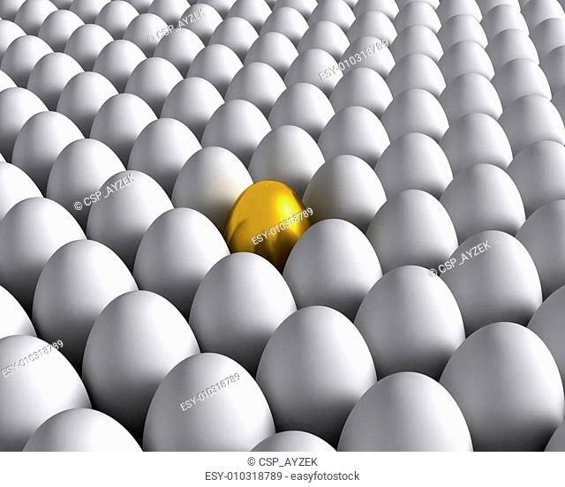
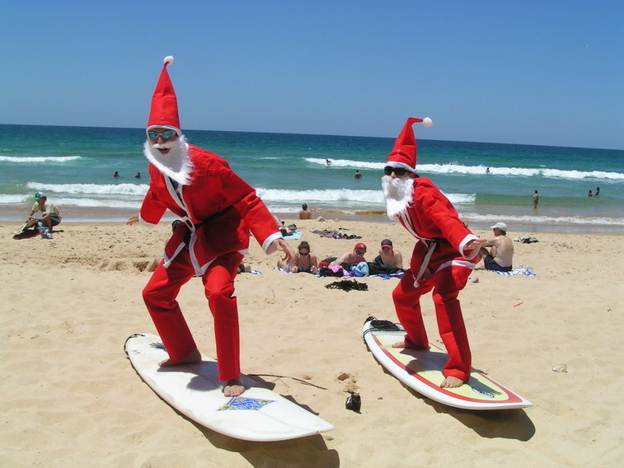
Word of the Week
incongruous (adjective)
Out of place, inappropriate, not fitting in with the surroundings.
“The bright yellow rubber duck looked a little incongruous, floating on the dirty puddle in the middle of the path”
“His silly joke in the middle of an important business meeting was so incongruous that it made everyone gasp in shock”

Slide 4
Our Diverse Planet
S1- 6 Poster competition
Investigate and imagine ‘Our Diverse Planet’ and everything that makes it special.
Poster deadline Friday 13th March
Hera are some topic ideas to get you inspired:
Why not think about biodiversity? From the diversity in your own garden, to the diversity at the very bottom of the ocean, investigate all the amazing creatures and organisms that live on our planet?
The diversity of science and STEM subjects. Have a think about all the diverse ways that science affects our lives and who you know that uses science every day. Remember that science is everywhere, you just have to look for it!
Think about other kinds of diversity our planet houses – from the diversity of each and every molecule that make up essential parts of life, to the differences between you and your friends.
Our planet is unique, but why not investigate what makes it different from the other planets in our solar system?
Complete you poster at home

Slide 5
Science Week Activities
S1- 3 Break time and after Lunch
Monday......chalk animals onto the playground. Can you draw an animal that lives in a desert? Or rainforest? Or deepest parts of the Ocean?
Tuesday......Body Clocks – let’s think about our day. What time do you get up?
Have dinner? Do your friends get up at the same time?
Wednesday.... Self portrait - we will be making bunting with these
Thursday.....Camouflage – can you find the objects hidden in the yard?
Get involved with the activities, collect a sticker each day. Four stickers = Certificate ☺

Slide 6
Full Pupil Council Meeting Monday 9th March with Ms O'Hagan p6 in room 10.
Agenda items:
Rights Respecting School Bronze Award
PEF Pupil Participatory Budget

