Slide 1
Our weekly bulletin
Week Beginning : Monday 16th March

Slide 2
Day | Date | In School Events | Events and Trips
Monday | 16th | S5 Transition Visit to AA S3 Transition Visit to DCHS
Tuesday | 17th |  | PE Event: Cross Country, Glasgow
Wednesday | 18th | BGE Waste Minimisation Assembly 9am | BGE Community Litter Pick during Wider Achievement lesson 1C to trip to Dobbies for an ASDAN Challenge
Thursday | 19th
Friday | 20th

Slide 3
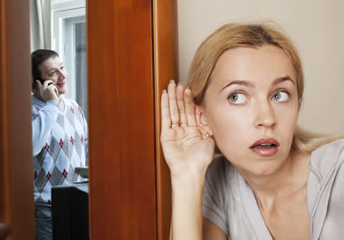
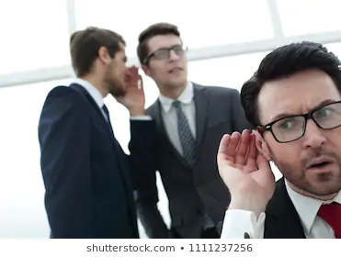
Word of the Week
eavesdrop (verb)
Secretly listen to a conversation.
If you listen to a conversation without the speakers knowing you are doing so, you are an eavesdropper and are eavesdropping.
The word originates from people hiding under the eaves of a house to listen to other people talking without being seen.

Slide 4
Digiken
Week 1
To help us with our digital learning, this week you
will be asked by your teachers to check that you
can log onto your Glow account.
You will also receive invitations to join a Class TEAM
for each subject.

Slide 5
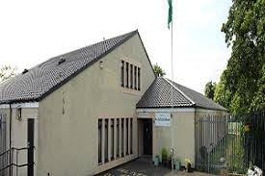
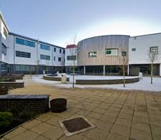
Transition Events
S3 to S4 Transition Event Monday 16th March
Leaving CB Main Building at 1.50pm
Activities during the afternoon at CB@DCHS
Return to CB Main Building for 3.20pm

Slide 6
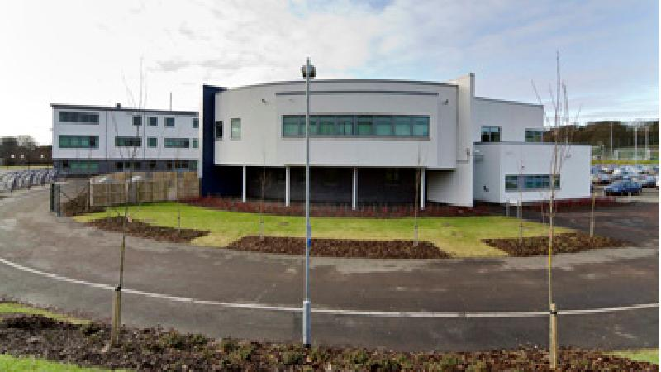
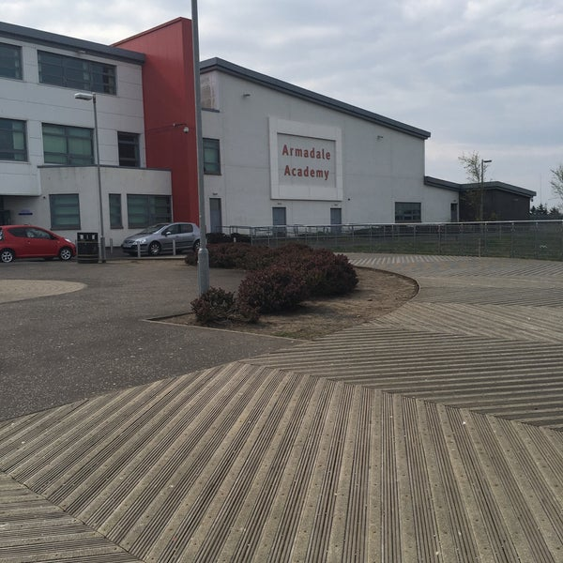
S5 will visit Armadale Academy on Monday
We will leave at 1.30 and return for our taxis.
Have fun!!!

Slide 7
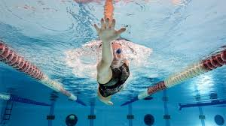
Swimming for S2
S2 will begin their swimming block this week. Please remember to bring your swimming gear.

Slide 8
Waste Minimisation Assembly and Litter Pick Wednesday 18th March
During p1 there will be an S1-3 Assembly about
using the bins correctly and how to reduce the
amount of waste we produce.
S1-3 (not 1C) involved in the community
litter pick.

Slide 9
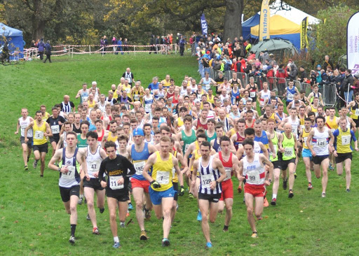
Cross country Thursday 19th March
The Cross country will be taking place this Thursday. Please remember to dress warmly for the event.
Let’s hope the weather is better than last week!

Slide 10
Thank you to everybody that joined in Science week!
Poster winners will be announced later this week.

