Slide 1
Our weekly bulletin
Week Beginning : Monday 17th August

Slide 2
It was so wonderful to see you all last week.
Wishing you a great week

Slide 3
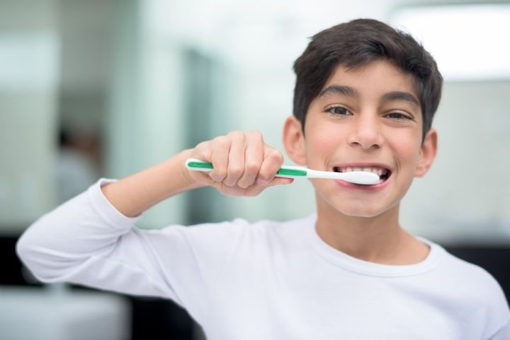
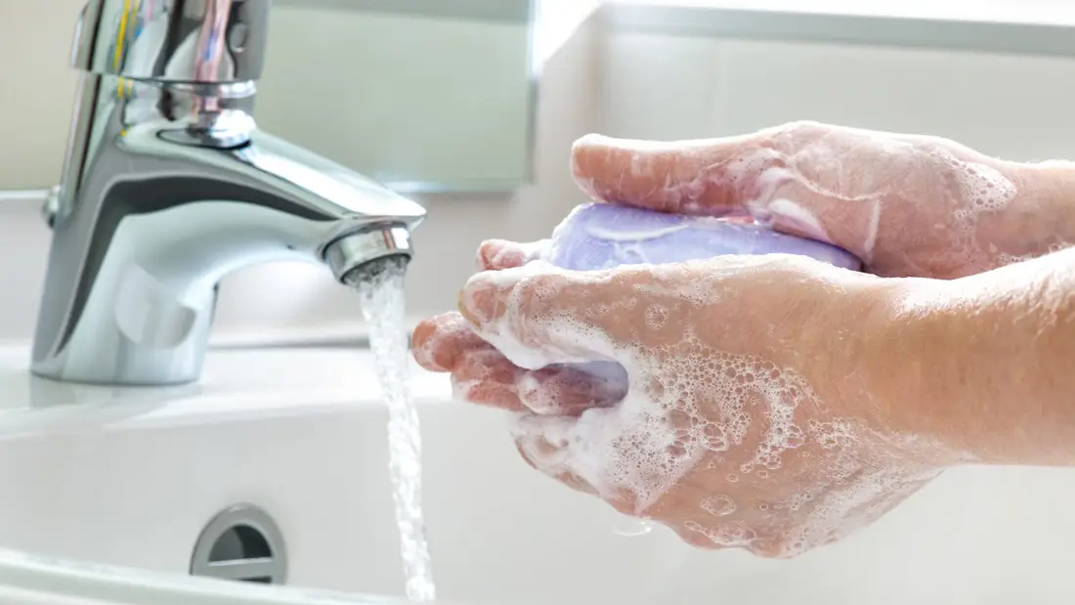
Word of the Week
hygiene (noun)
The practice of keeping yourself and your surroundings clean, especially so that illness and the spread of disease can be prevented.
Washing your hands, brushing your teeth and having regular baths or showers are all important parts of your personal hygiene.
We have all been practising good hand hygiene, by washing our hands regularly, and sanitising whenever we enter or leave the room.

Slide 4
Reminder for PE
On the days that you have PE, please come into school in your PE kit.
PE lessons will be outside, so make sure you are wearing kit that is suitable for this

