Slide 1
Our weekly bulletin
Week Beginning : Monday 24th August

Slide 2
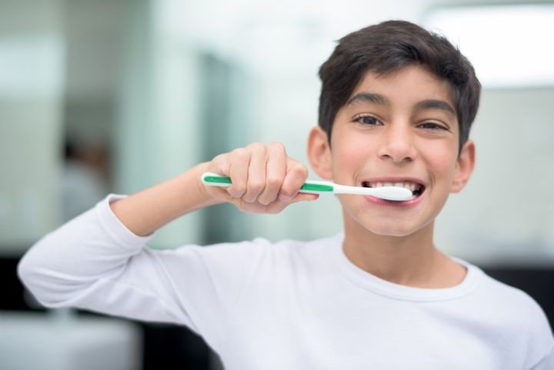
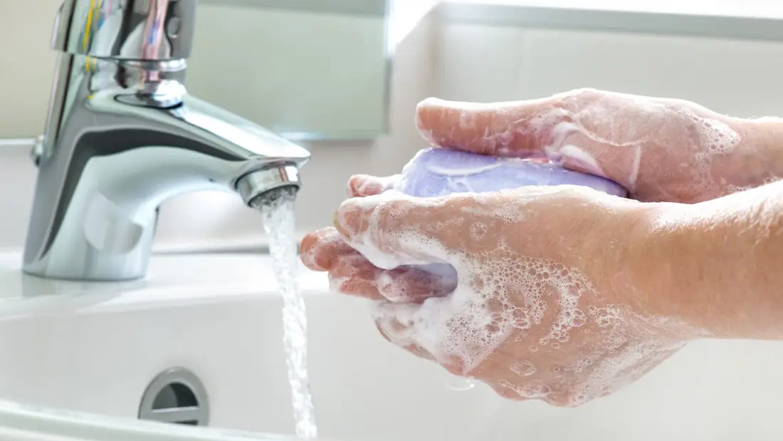
hygiene (noun)
The practice of keeping yourself and your surroundings clean, especially so that illness and the spread of disease can be prevented.
Washing your hands, brushing your teeth and having regular baths or showers are all important parts of your personal hygiene.
We have all been practising good hand hygiene, by washing our hands regularly, and sanitising whenever we enter or leave the room.

Slide 3
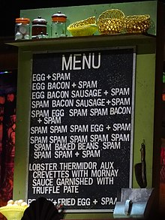
Word of the Week
spam (noun/verb)
Irrelevant or unwanted messages received over the internet, typically sent to a large number of users, often for the purposes of advertising. The verb version refers to the act of sending spam (“That company is spamming me by sending me unwanted emails every day”). The word originates from the word for…
A type of canned meat, made of pork. It was introduced in 1937 and was popular during World War II.
Nowadays, spam might not be as annoying as it once was, as we can now have a ‘spam folder’ in our emails, and anything that looks like spam might automatically go there.

Slide 4
Reminder for S1-3 PE
On the days that you have PE,
please come into school in your PE kit.
PE lessons will be outside, so make sure you are wearing kit that is suitable for this.

Slide 5
S4 and S5
You have PE on Wednesdays and Fridays.
Remember to come to school in your uniform and get changed at school!
You don't wear your PE kit all day.

