Slide 1
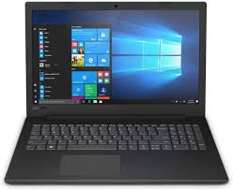
Digital Learning
Using netbooks as a learning tool

Slide 2
L.I To understand how our netbooks will be used to help with our learning in class.
To identify ways of looking after our netbooks and keeping ourselves safe online.

Slide 3
Digital Technologies
At Cedarbank we use lots of different digital technologies to help us with our learning.

Slide 4
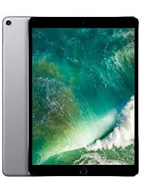
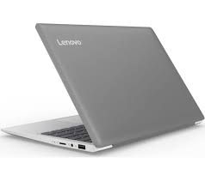
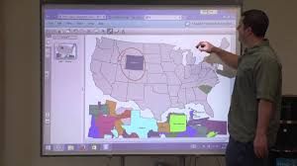
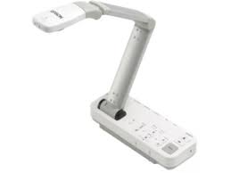
Digital devices
For example, digital devices such as;
i pads
Netbooks
Promethean of SMARTBoards
visualisers
digital cameras

Slide 5
Digital Technologies
We also use a number of digital technologies, such as;

Slide 6
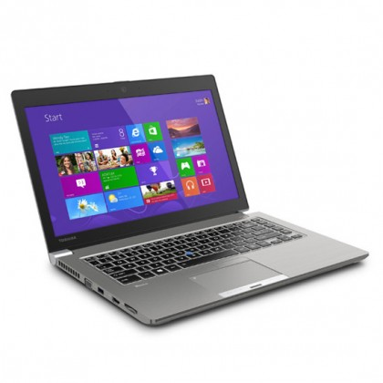
Netbooks for Pupils
From 7th September each pupil will each have a netbook that can be used in school.
All pupils will sign Cedarbank’s Responsible Usage Agreement.
This is being sent home today (Tuesday 25th August). Please read it, sign it and return it to school.

Slide 7
What is a Responsible Usage Agreement and why do we need one?
It is a set of rules that we, as a school, think are fair and will allow us to make good choices and keep ourselves and others safe, when using digital technologies.
These rules were discussed and chosen by pupils of Cedarbank in February of this year.

Slide 8
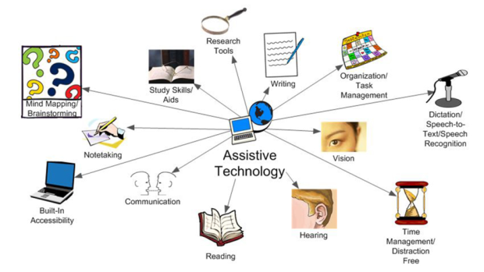
Netbooks will be a digital learning tool to help staff
Make your learning more engaging
(interesting).
Support us with our learning
(make it easier to work in class)
AND
Teach you the skills to staff safe online and become a responsible digital citizen.
Link to digital citizen video

Slide 9
Responsible Usage Agreement
Take a look at each point from the responsible usage agreement. Discuss what each one means and ask any questions you may have to ensure you understand. (feel free to write notes on each slide).

Slide 10
Keep your passwords safe and secure, don’t share these with anyone.

Slide 11
Take care of digital devices, treat them with respect to avoid damage.

Slide 12
Make sure that devices are stored correctly at the end of the day and charged at appropriate times to ensure they are ready for use in learning.

Slide 13
Log off when finished using a device

Slide 14
Only use devices for learning activities approved by the class teacher.

Slide 15
Do not take or post pictures, personal information or videos of myself or others through any form of electronic communication. This includes all pupils and staff.

Slide 16
Be respectful to others whilst online.

Slide 17
Report, to a member of staff, any content, messages or images that may be inappropriate or that make you feel uncomfortable

Slide 18
Any other questions?

Slide 19
Remember
Tuesday 7th – all pupils will have netbooks
All pupils to sign and return a responsible usage agreement by so that the netbooks are ready to be used.

