Slide 1
Our weekly bulletin
Week Beginning : Monday 31st August

Slide 2
Face coverings
From 31st of August, the Scottish Government has recommended the use of face coverings (subject to exemptions) for staff and young people in secondary schools in places where physical distancing is difficult.
This means when moving in corridors at break times, lunchtimes and when you are in communal areas, as well as on school transport.
You do not need to wear a face covering during class - unless you would like to.

Slide 3
What if I'm exempt?
Some people are exempt from wearing a face covering.
This means that they do not have to wear a mask or face covering.
We do not ask why someone is not wearing a mask.
This could be for any of these reasons: • They have a disability or health condition that means they
cannot put a covering on • A covering will cause them severe distress or anxiety • They need to communicate with someone who relies on lip
reading.
If you are exempt from wearing a face covering, don't worry you will be not asked to wear a face covering.

Slide 4
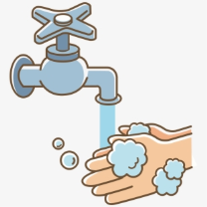
Top tips on wearing a face covering
In order for your face covering to keep you and those around you safe, remember:
Face coverings should not be shared with others
Wash your hands or use hand sanitiser before putting it on
and try not to touch your face
It’s important to make sure the face covering is the right size to cover the nose, mouth and chin and you shouldn't touch
the front once it's on
When you take it off, try not to touch the part you’ve been
breathing on

Slide 5
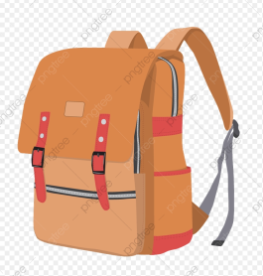
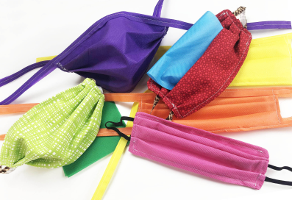
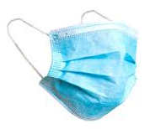
When you're not using your face covering (for example, during class), it should
be placed in a washable bag or container.
Avoid placing it on surfaces, due to the possibility of contamination.
If it's a fabric face covering, keep the face covering in a plastic
bag until you can wash it, then wash it at 60 degrees centigrade
after each day of use.
It can go in the wash with other laundry.
If you're using a disposable face covering, wrap it in a bag and put it in
a bin.

Slide 6
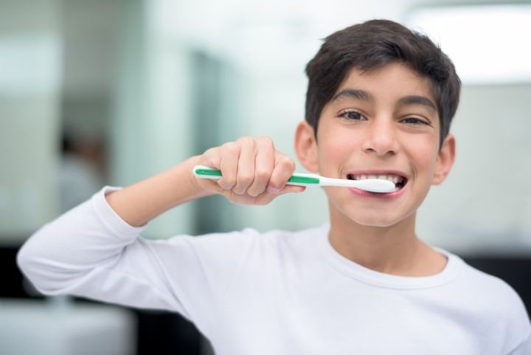
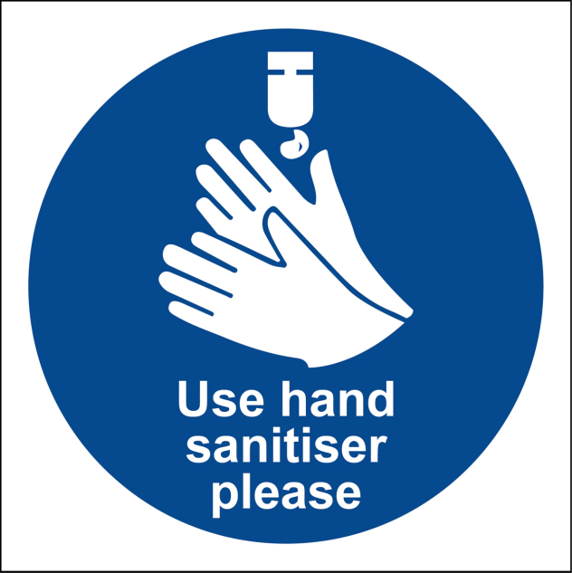
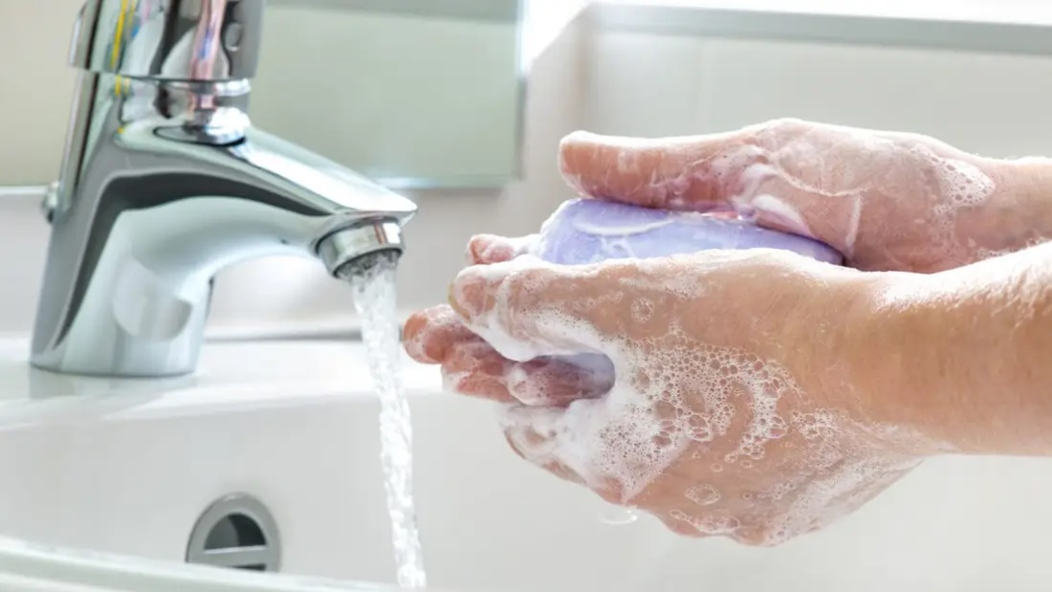
hygiene (noun)
The practice of keeping yourself and your surroundings clean, especially so that illness and the spread of disease can be prevented.
Washing your hands, brushing your teeth and having regular baths or showers are all important parts of your personal hygiene.
We have all been practising good hand hygiene, by washing our hands regularly, and sanitising whenever we enter or leave the room.

Slide 7
Word of the Week
rigmarole (noun)
A lengthy and complicated procedure.
The word has been around for a long time, and in the 18th century it was used to refer to a series of meaningless and confused statements. It slowly changed meaning, and now refers to something that takes a long time, is complicated and might seem more trouble than it is worth.
“Have you seen all the rigmarole that you have to go through at airport security nowadays?”
“I was locked out of the computer, and then go through the whole rigmarole of changing my password before I could get signed on”.

Slide 8
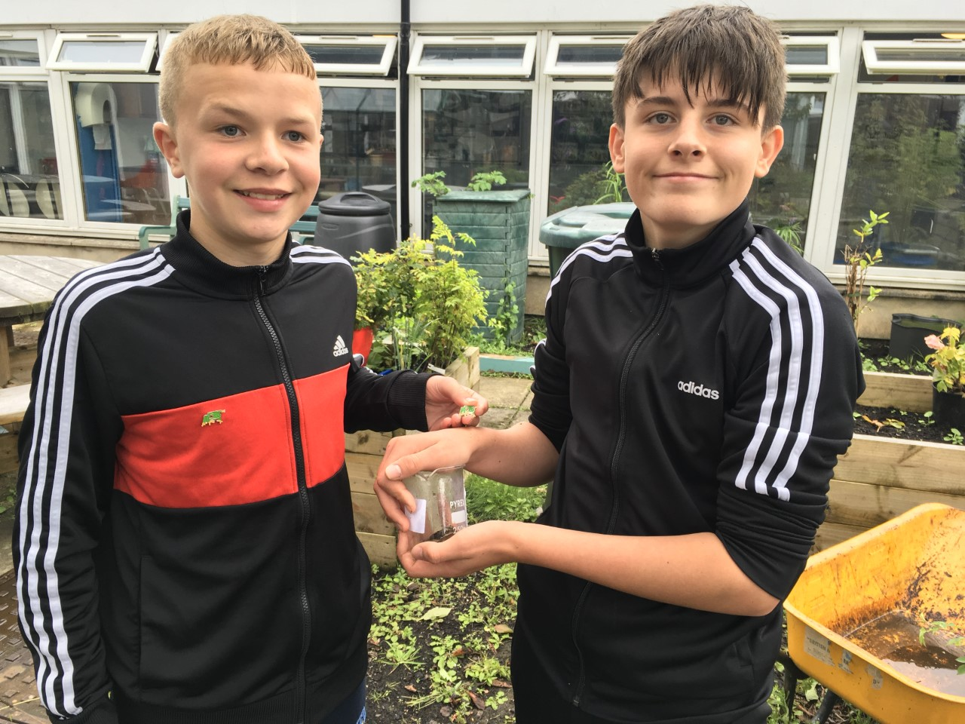
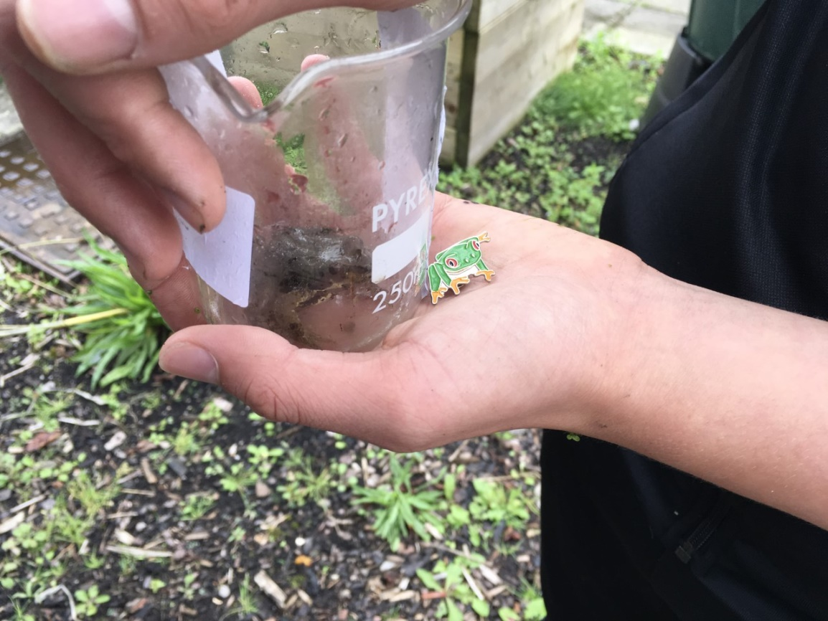
Their role in school is to promote the wildlife pond and introduce new pupils to it.

Slide 9
Congratulations to S6 pupils
You have settled into Armadale Academy so well

Slide 10
Reminder for S1-3 PE
On the days that you have PE,
please come into school in your PE kit.
PE lessons will be outside, so make sure you are wearing kit that is suitable for this.

Slide 11
S4 and S5
You have PE on Wednesdays and Fridays.
Remember to come to school in your uniform and get changed at school!
You don't wear your PE kit all day.

