Slide 1
Our weekly bulletin
Week Beginning : Monday 7th September

Slide 2
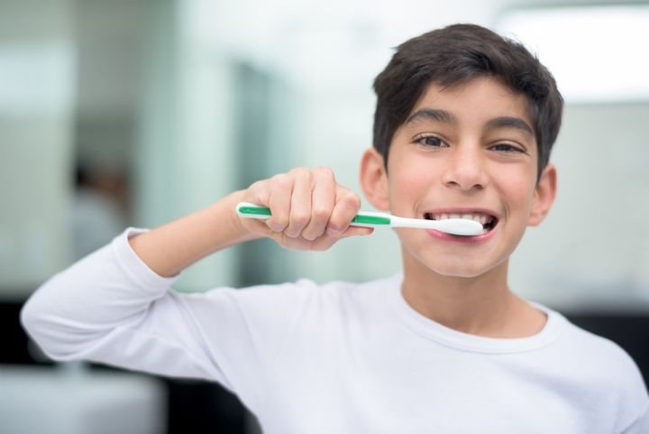
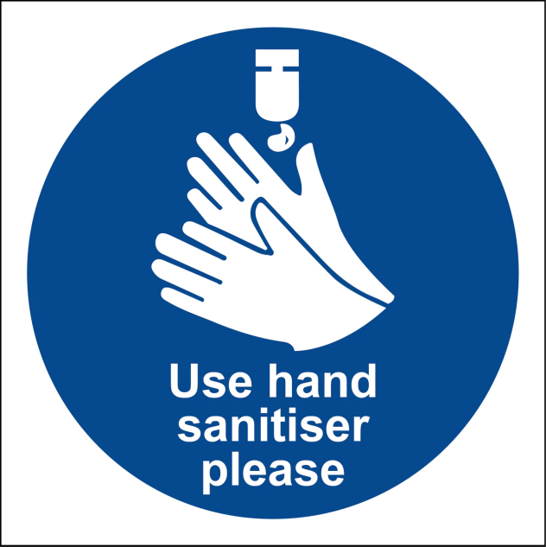
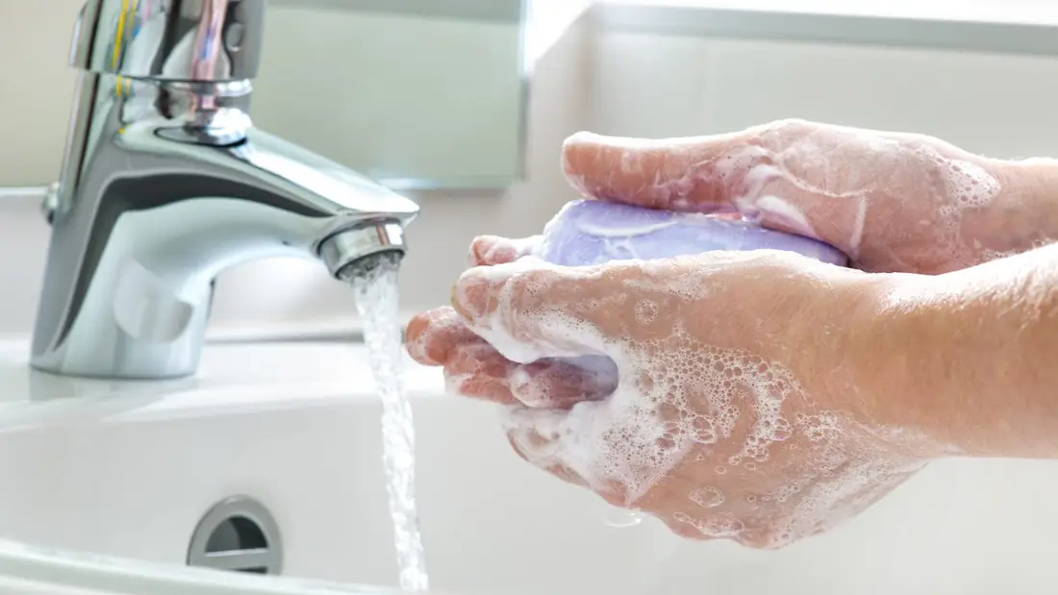
hygiene (noun)
The practice of keeping yourself and your surroundings clean, especially so that illness and the spread of disease can be prevented.
Washing your hands, brushing your teeth and having regular baths or showers are all important parts of your personal hygiene.
We have all been practising good hand hygiene, by washing our hands regularly, and sanitising whenever we enter or leave the room.

Slide 3
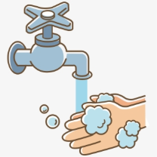
Top tips on wearing a face covering
In order for your face covering to keep you and those around you safe, remember:
Face coverings should not be shared with others
Wash your hands or use hand sanitiser before putting it on
and try not to touch your face
It’s important to make sure the face covering is the right size to cover the nose, mouth and chin and you shouldn't touch
the front once it's on
When you take it off, try not to touch the part you’ve been
breathing on

Slide 4
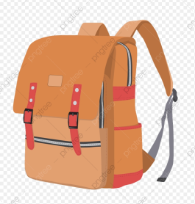
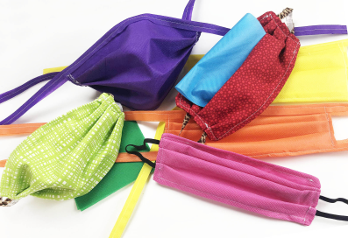
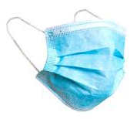
When you're not using your face covering (for example, during class), it should
be placed in a washable bag or container.
Avoid placing it on surfaces, due to the possibility of contamination.
If it's a fabric face covering, keep the face covering in a plastic
bag until you can wash it, then wash it at 60 degrees centigrade
after each day of use.
It can go in the wash with other laundry.
If you're using a disposable face covering, wrap it in a bag and put it in
a bin.

Slide 5
Word of the Week
hectic (adjective)
Full of activity, or very busy and fast.
If someone had to attend a meeting after work, rush home, do some exercise and get their dinner before going out again to meet friends, that would be quite a hectic evening.
Lots of people like to go somewhere peaceful and relax on holiday, to get away from their normal hectic pace of life.
Your life may have seemed hectic since we returned to school, compared to the peace and quiet we might have experienced during lockdown.

Slide 6
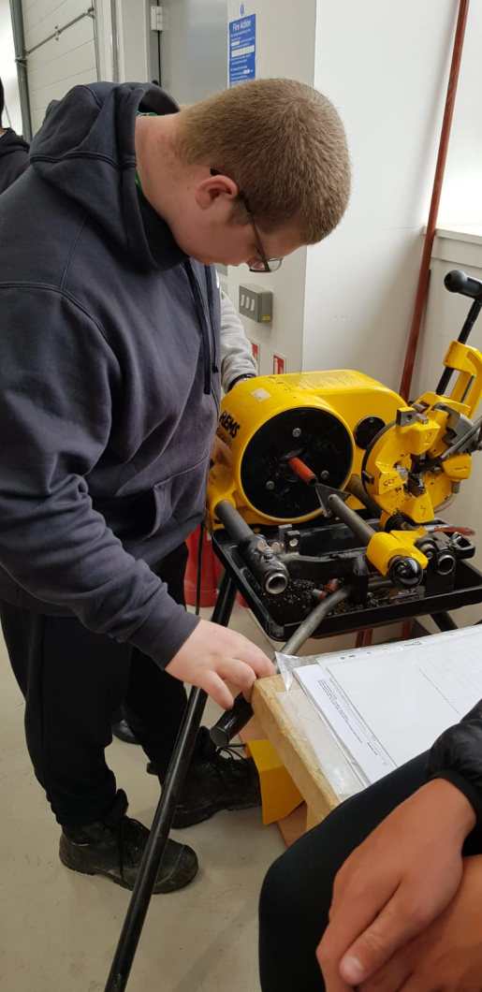
Well done to our S6 students that have started their construction course at college

Slide 7
Reminder for S1-3 PE
On the days that you have PE,
please come into school in your PE kit.
PE lessons will be outside, so make sure you are wearing kit that is suitable for this.

Slide 8
S4 and S5
You have PE on Wednesdays and Fridays.
Remember to come to school in your uniform and get changed at school!
You don't wear your PE kit all day.

