Slide 1
Our weekly bulletin
Week Beginning : Monday 14th September

Slide 2
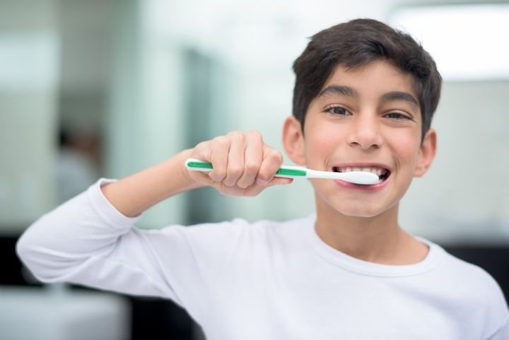
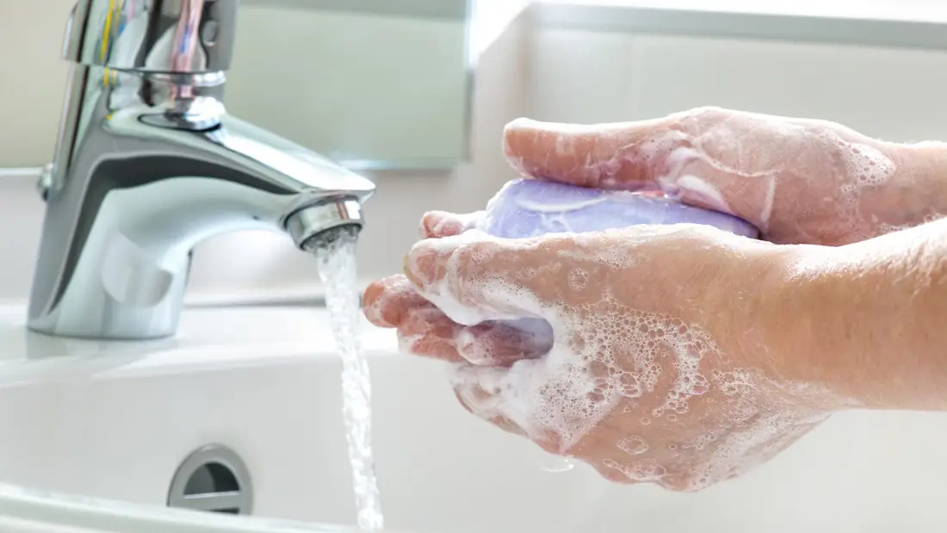
hygiene (noun)
The practice of keeping yourself and your surroundings clean, especially so that illness and the spread of disease can be prevented.
Washing your hands, brushing your teeth and having regular baths or showers are all important parts of your personal hygiene.
We have all been practising good hand hygiene, by washing our hands regularly, and sanitising whenever we enter or leave the room.

Slide 3
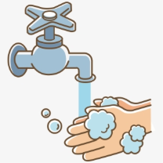
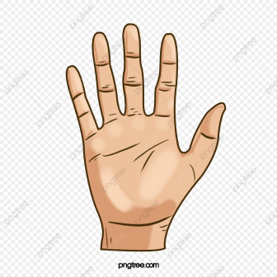
Top tips on wearing a face covering
In order for your face covering to keep you and those around you safe, remember:
Face coverings should not be shared with others
Wash your hands or use hand sanitiser before putting it on
and try not to touch your face
It’s important to make sure the face covering is the right size to cover the nose, mouth and chin and you shouldn't touch
the front once it's on
When you take it off, try not to touch the part you’ve been
breathing on

Slide 4
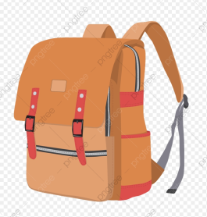
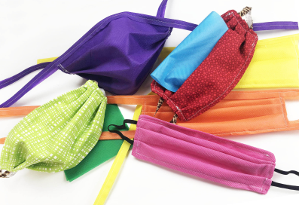
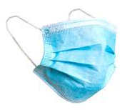
When you're not using your face covering (for example, during class), it should
be placed in a washable bag or container.
Avoid placing it on surfaces, due to the possibility of contamination.
If it's a fabric face covering, keep the face covering in a plastic
bag until you can wash it, then wash it at 60 degrees centigrade
after each day of use.
It can go in the wash with other laundry.
If you're using a disposable face covering, wrap it in a bag and put it in
a bin.

Slide 5
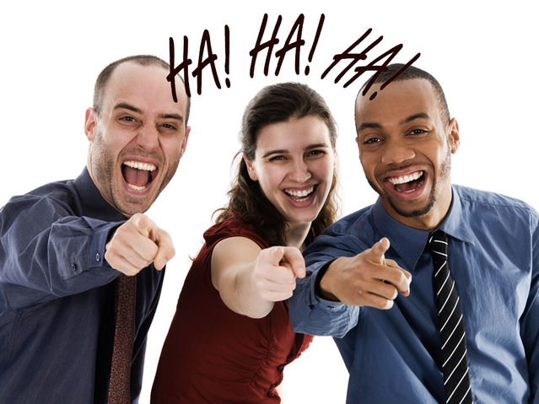
Word of the Week
satire (noun)
Satirical: adjective
A humorous way of criticising people to show that they have faults; a way of making fun of people by using silly or exaggerated language.
Politicians are often a target for satire, especially if they are acting dishonestly or are ‘full of themselves’.
One of the first satirical TV news programmes was a show called ‘That Was the Week That Was’, in the 1960s, which poked fun at politicians and the politics of the time. More recent examples have been ‘Have I Got News For You’ and ‘Mock the Week’.
You might also see satirical news stories shared on the internet. These examples of ‘fake news’ often seem realistic, but are meant to make you laugh, and are not supposed to be taken seriously.

Slide 6
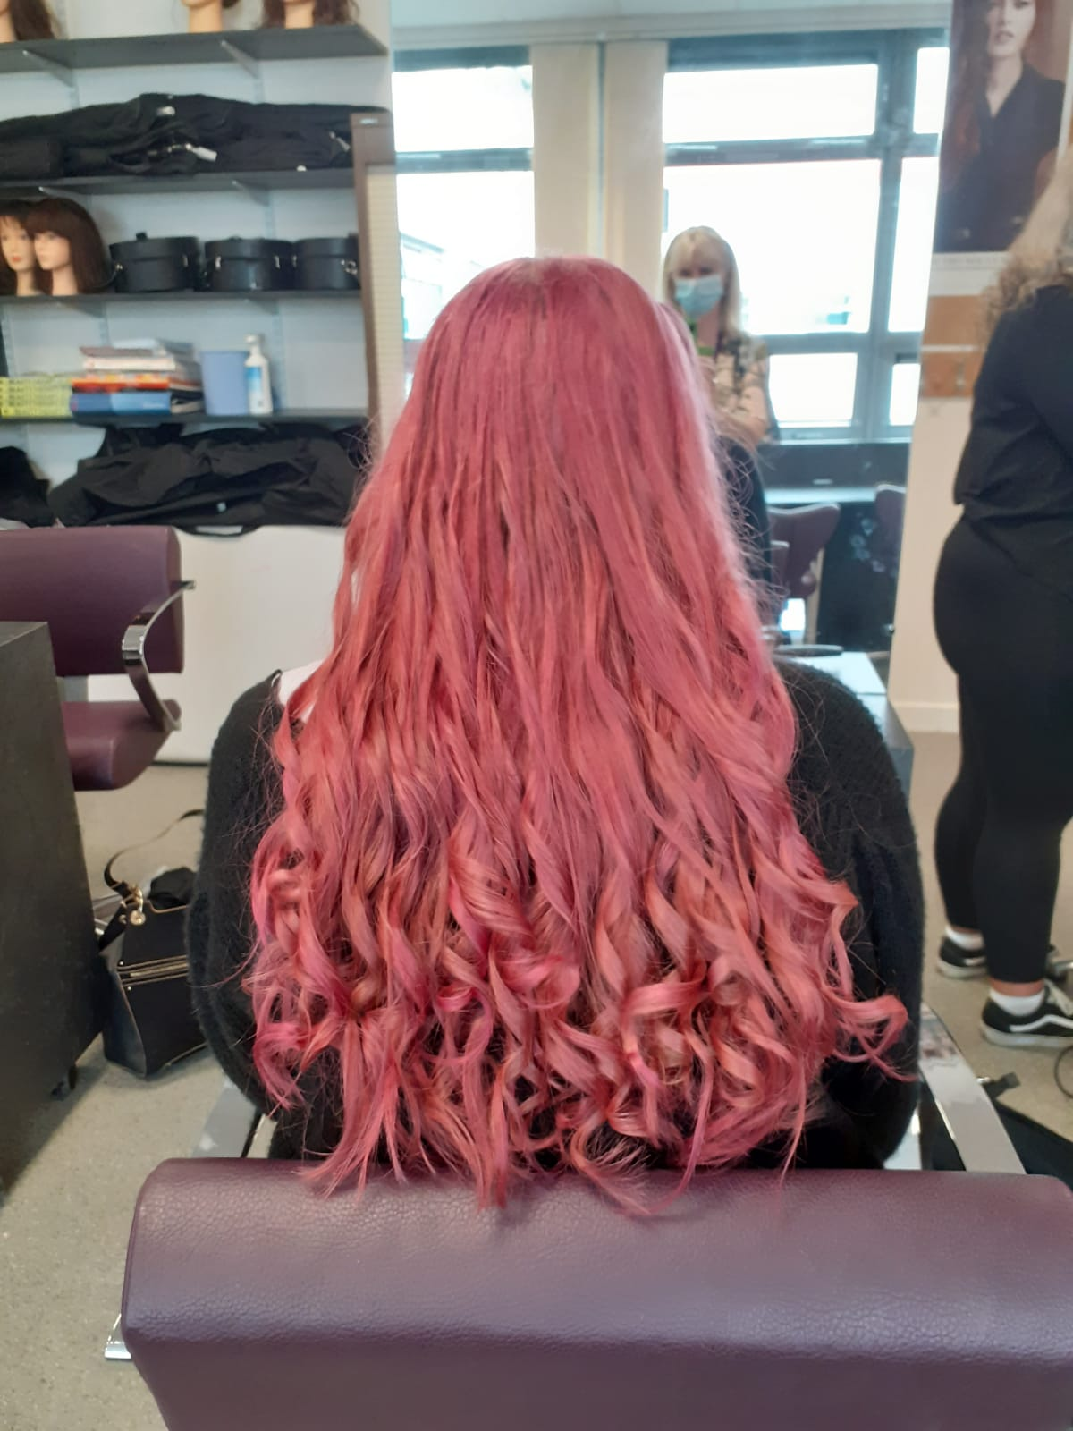
News from S6 pupils: Girls getting creative in hairdressing

Slide 7
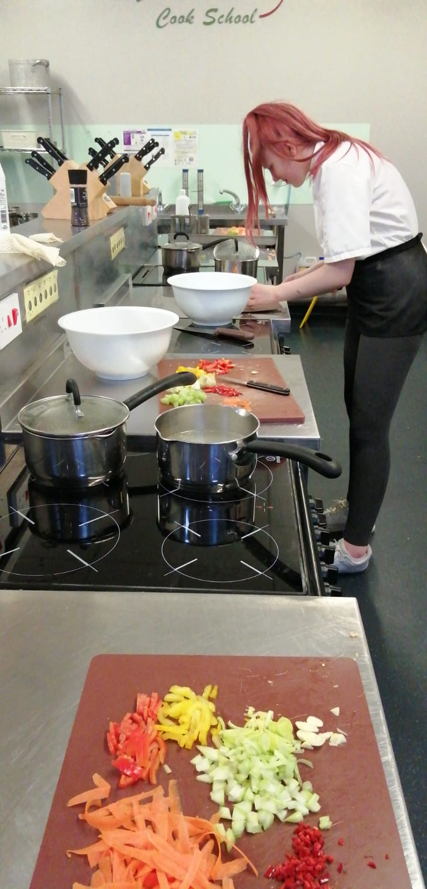
Our upcoming chefs at the larder

Slide 8
Team work at college

Slide 9
Roald Dahl Day
Yesterday was Roald Dahl Day. Some classes are celebrating in school today.
You can join in at https://www.roalddahl.com/roald-dahl-story-day

Slide 10
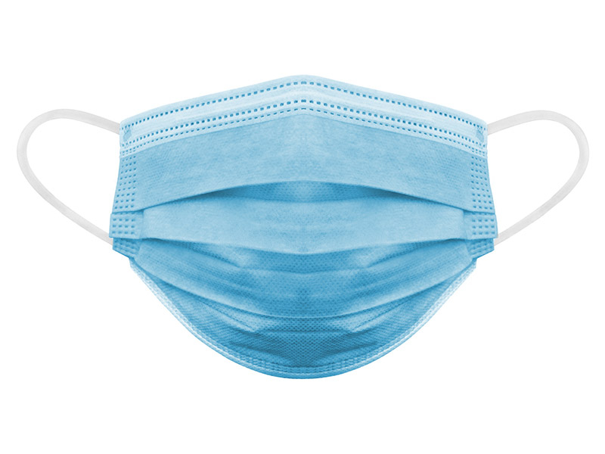
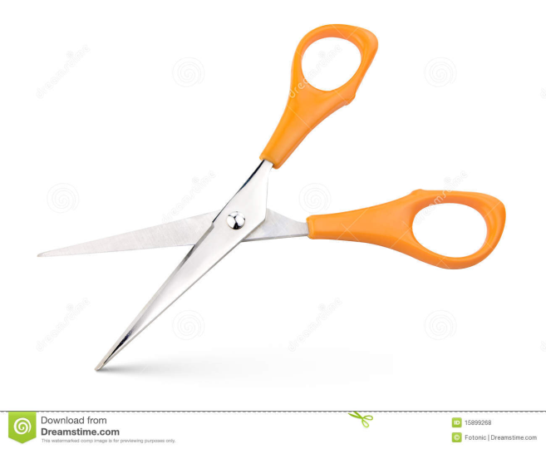
If you wear a disposable mask, please cut the elastic
before you put them in the bin.
This will help look after wild animals.

