Slide 1
Our weekly bulletin
Week Beginning : Monday 21st September

Slide 2
Hope that you had a lovely long weekend.

Slide 3
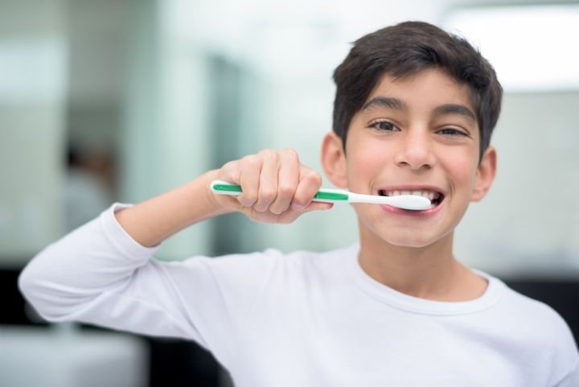
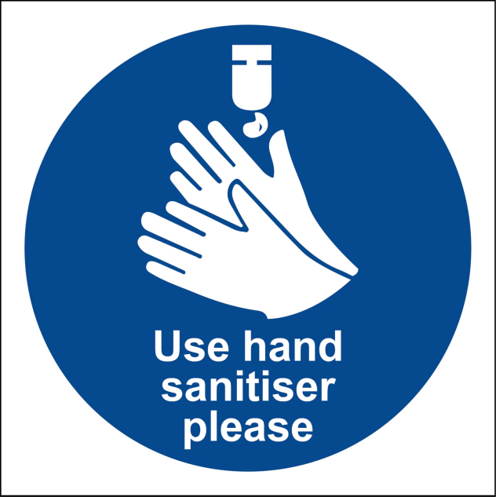
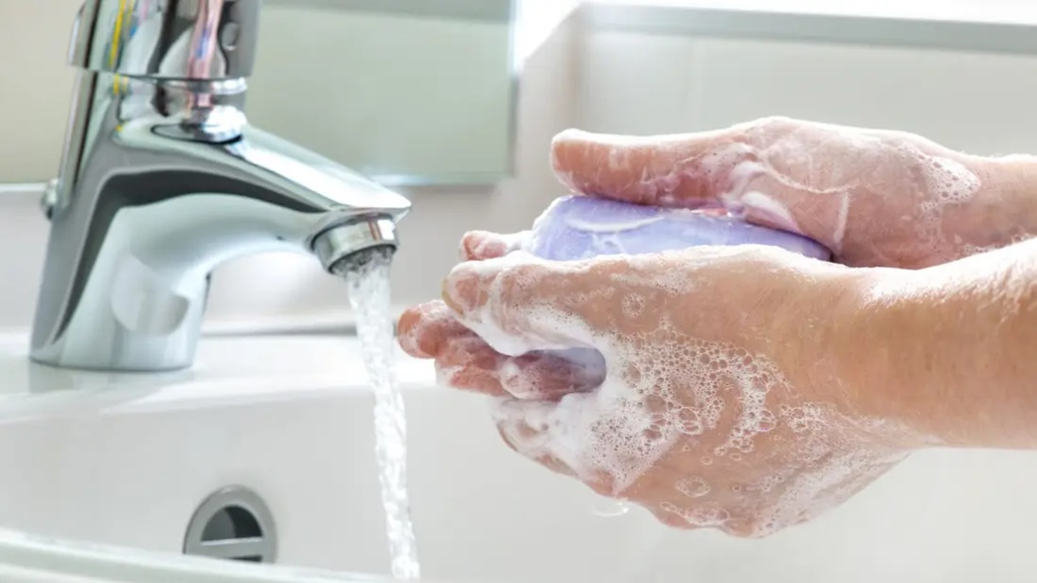
hygiene (noun)
The practice of keeping yourself and your surroundings clean, especially so that illness and the spread of disease can be prevented.
Washing your hands, brushing your teeth and having regular baths or showers are all important parts of your personal hygiene.
We have all been practising good hand hygiene, by washing our hands regularly, and sanitising whenever we enter or leave the room.

Slide 4
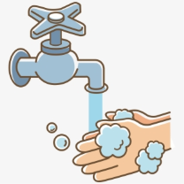
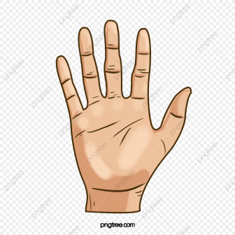
Top tips on wearing a face covering
In order for your face covering to keep you and those around you safe, remember:
Face coverings should not be shared with others
Wash your hands or use hand sanitiser before putting it on
and try not to touch your face
It’s important to make sure the face covering is the right size to cover the nose, mouth and chin and you shouldn't touch
the front once it's on
When you take it off, try not to touch the part you’ve been
breathing on

Slide 5
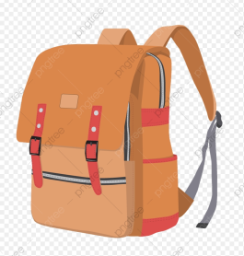
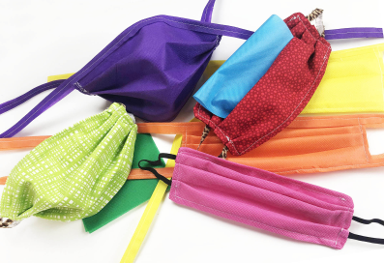
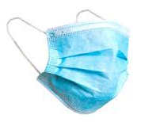
When you're not using your face covering (for example, during class), it should
be placed in a washable bag or container.
Avoid placing it on surfaces, due to the possibility of contamination.
If it's a fabric face covering, keep the face covering in a plastic
bag until you can wash it, then wash it at 60 degrees centigrade
after each day of use.
It can go in the wash with other laundry.
If you're using a disposable face covering, wrap it in a bag and put it in
a bin.

Slide 6
Doctors learn how to wash their hands properly as part of their training…and they have to pass a handwashing test!
https://www.bbc.co.uk/programmes/p01jkn04

Slide 7
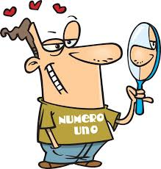
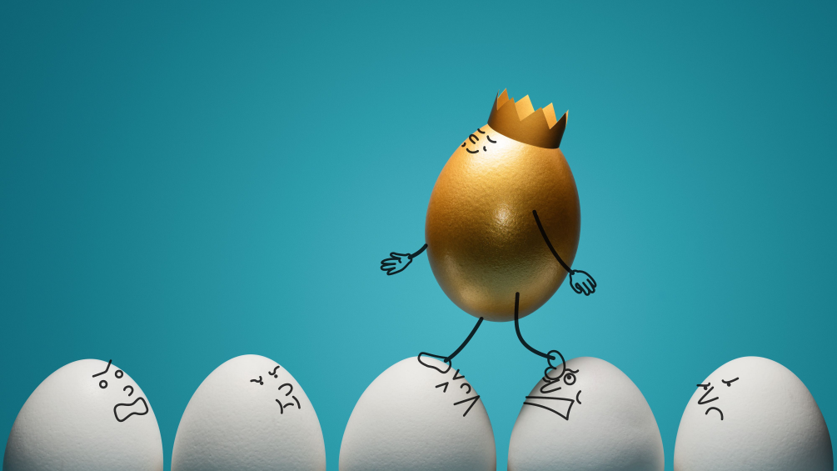
Word of the Week
narcissist (noun)
Narcissistic (adjective); narcissism (noun)
A person who has an excessive interest in or admiration of themselves.
A narcissist might be vain, selfish and full of self-importance, and they might believe that they deserve special treatment. Some people might say that social media encourages narcissism and narcissistic behaviour.
Narcissus was a character in Greek mythology, who fell in love with his own reflection.

Slide 8
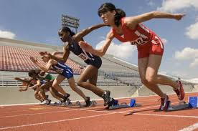
Virtual Pentathlon
Well done to the S1-S3 completing the challenge of a 15x5m sprint challenge.

Slide 9
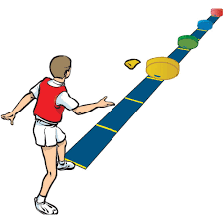
Virtual Pentathlon
Well done to our S1 –S3 completing last weeks challenge of the target throw. We even had some pupils getting all 12 throws on target.

Slide 10
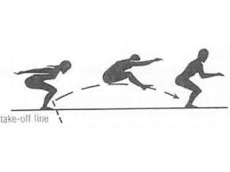
Virtual pentathlon
This week S1 – S3 will be completing the long jump challenge to see who can jump the furthest. Good luck everyone.

Slide 11
Art & Design Supported Study, CB@DCHS
for pupils of Art 1 and Art 2
When: Tuesday lunchtime, room 2
with Mrs Thomson
Sign up on Mondays to attend.
Max of 10 places. Bring your lunch.
Supported study is for completing your
A&D homework or keeping on track
with your National Award artwork.
Starting w/c 28 September

Slide 12
During Fair Trade fortnight
we organised and ran a
Fair Trade tuckshop and café.
The current S4 students (they
were in S3 when they did this)
did an assembly to all of S1-3.
We all also took part in a
Fair Trade audit.
All this work has meant we have now achieved our Fair Aware Award.
Congratulations Everyone!

Slide 13
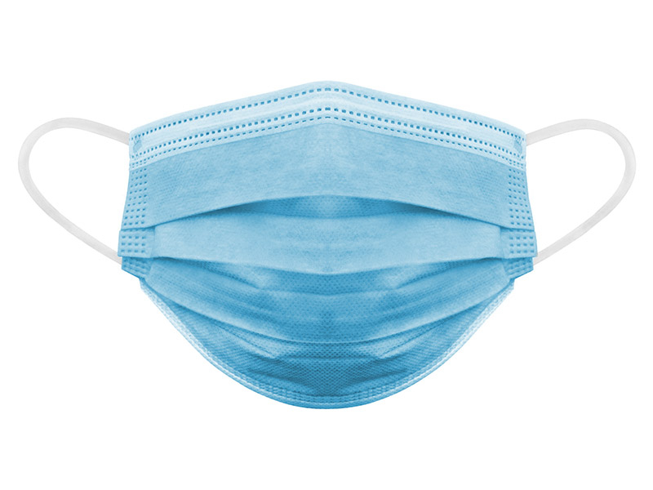
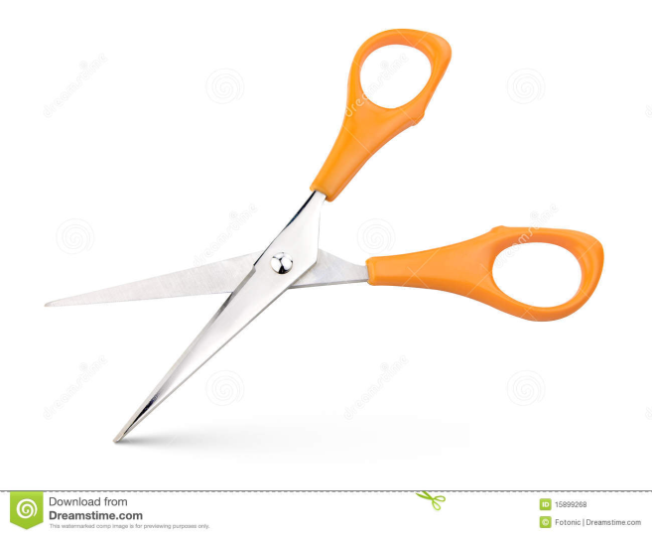
If you wear a disposable mask, please cut the elastic
before you put them in the bin.
This will help look after wild animals.

