Slide 1
Our weekly bulletin
Week Beginning : Monday 5th October
IDL Week: Autumn Watch

Slide 2
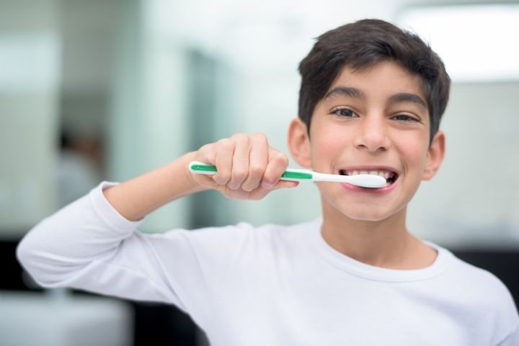
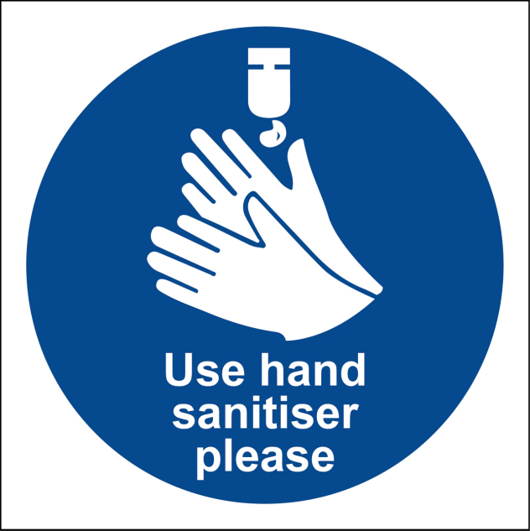
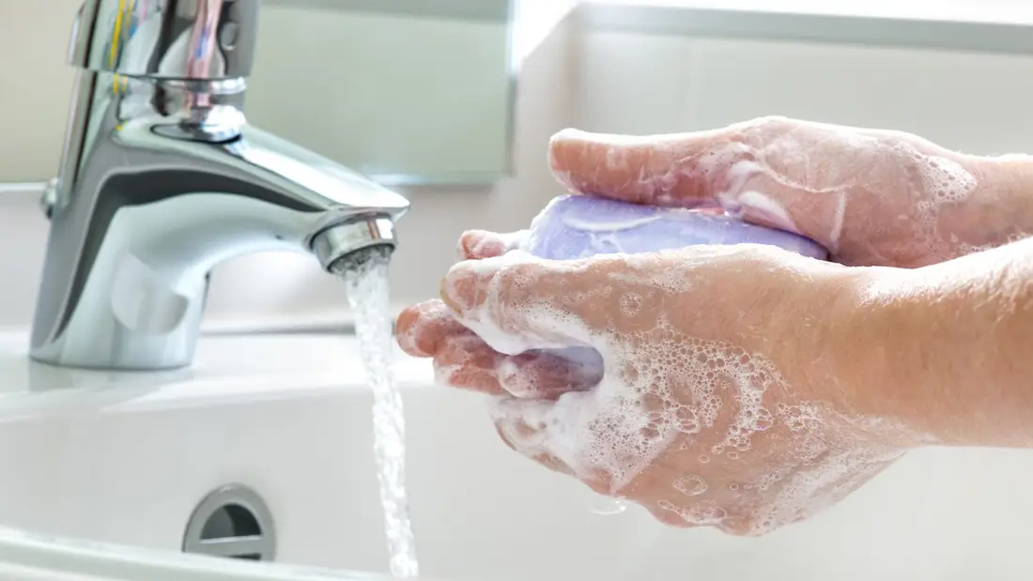
hygiene (noun)
The practice of keeping yourself and your surroundings clean, especially so that illness and the spread of disease can be prevented.
Washing your hands, brushing your teeth and having regular baths or showers are all important parts of your personal hygiene.
We have all been practising good hand hygiene, by washing our hands regularly, and sanitising whenever we enter or leave the room.

Slide 3
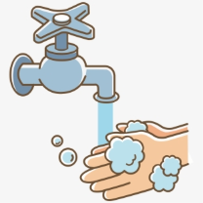
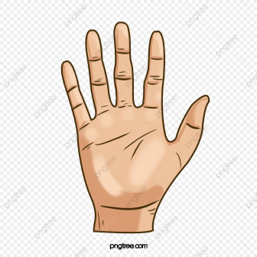
Top tips on wearing a face covering
In order for your face covering to keep you and those around you safe, remember:
Face coverings should not be shared with others
Wash your hands or use hand sanitiser before putting it on
and try not to touch your face
It’s important to make sure the face covering is the right size to cover the nose, mouth and chin and you shouldn't touch
the front once it's on
When you take it off, try not to touch the part you’ve been
breathing on

Slide 4
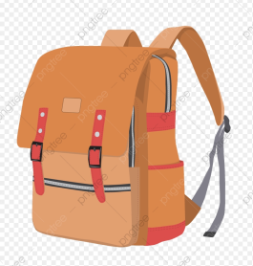
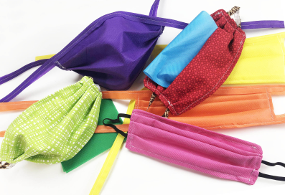
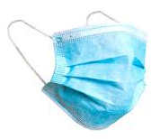
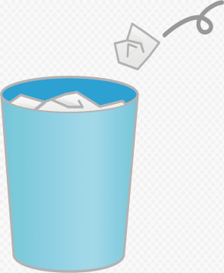
When you're not using your face covering (for example, during class), it should
be placed in a washable bag or container.
Avoid placing it on surfaces, due to the possibility of contamination.
If it's a fabric face covering, keep the face covering in a plastic
bag until you can wash it, then wash it at 60 degrees centigrade
after each day of use.
It can go in the wash with other laundry.
If you're using a disposable face covering, wrap it in a bag and put it in
a bin.

Slide 5
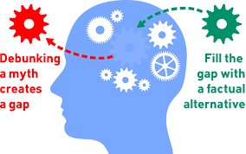
Word of the Week
debunk (verb)
Expose an idea or belief as false or exaggerated.
If you debunk a widely-held belief, you are showing it to be false, while if you debunk something that is widely admired, you are demonstrating that it is not as good as people think it is.
A scientist might debunk a widely-believed theory by providing evidence that it is not true. Some people believe, for example, that there is a monster in Loch Ness, but various studies have been carried out with the aim of debunking that belief by proving that no such monster exists.

Slide 6
The weather will get cooler over the next few weeks and
months. Please be prepared for Monday afternoons so you
can enjoy Outdoor Learning feeling warm, dry and happy.
If it is wet, you will need to bring some wellies and a
waterproof jacket.

Slide 7
Art & Design Supported Study, CB@DCHS
for pupils of Art 1 and Art 2
When: Tuesday lunchtime, room 2
with Mrs Thomson
Sign up on Mondays to attend.
Max of 10 places. Bring your lunch.
Supported study is for completing your
A&D homework or keeping on track
with your National Award artwork.
Starting w/c 28 September

Slide 8
“Good for you and good for the planet”
We are having a Harvest picnic this afternoon, Monday 5th October,
during our outdoor learning lesson.
Please bring a healthy and sustainable snack
that you can eat during the picnic

Slide 9
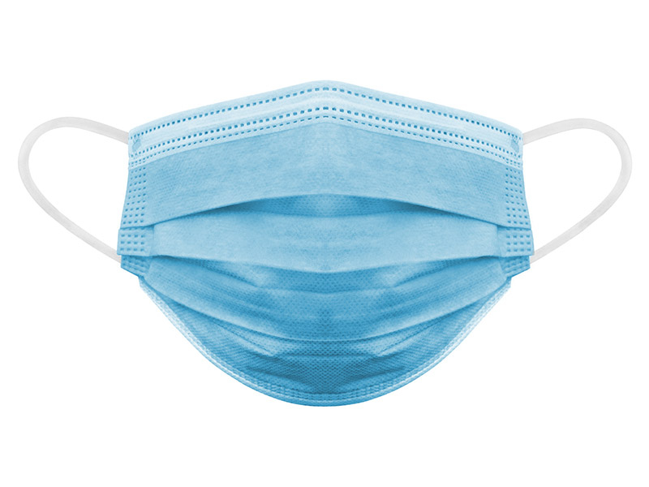
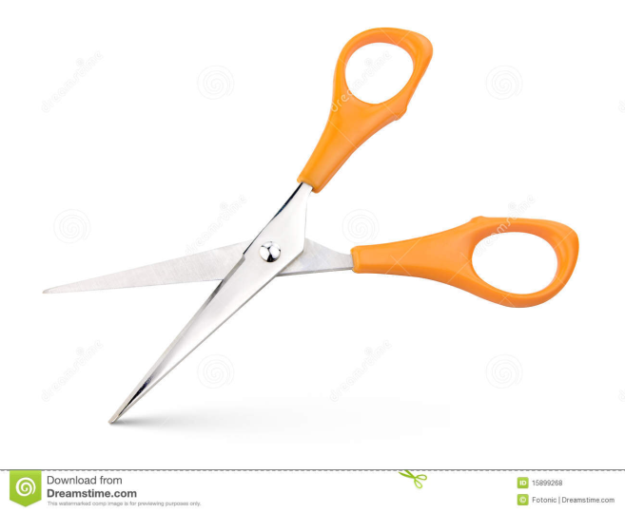
If you wear a disposable mask, please cut the elastic
before you put them in the bin.
This will help look after wild animals.

Slide 10
It is the October break next week.
There is no school for over a week.
We are going to be on holiday.
Our last day of term is Friday 9th October.
We hope that you have a lovely break,
you have worked so hard this term.
We look forward to seeing you back at school after the holiday. The first day of the next term is Wednesday 21st October.

