Slide 1
Our weekly bulletin
Week Beginning : Monday 26th October
IDL Week: STEM Week

Slide 2
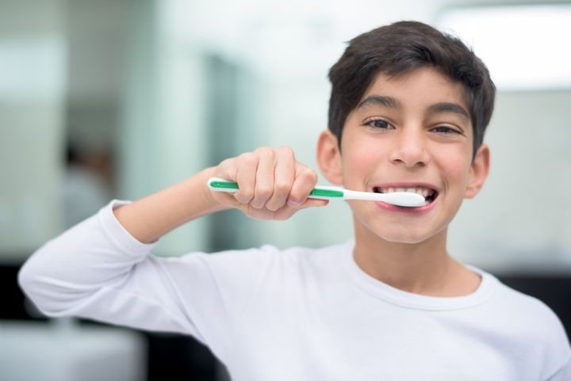
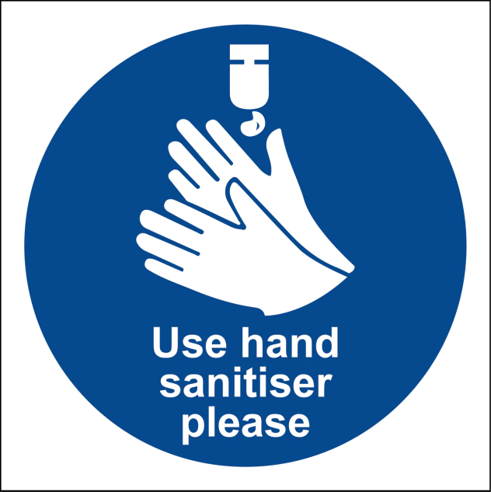
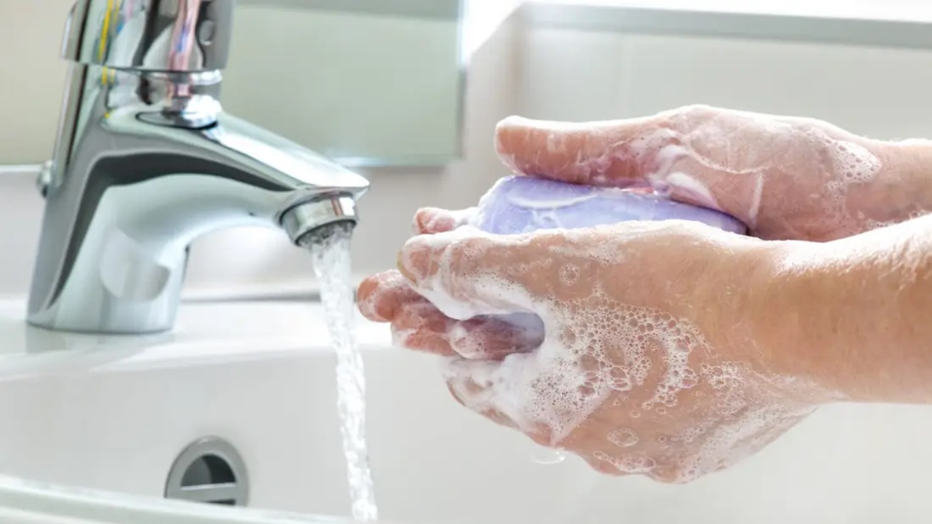
hygiene (noun)
The practice of keeping yourself and your surroundings clean, especially so that illness and the spread of disease can be prevented.
Washing your hands, brushing your teeth and having regular baths or showers are all important parts of your personal hygiene.
We have all been practising good hand hygiene, by washing our hands regularly, and sanitising whenever we enter or leave the room.

Slide 3
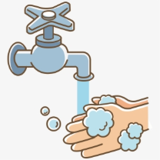
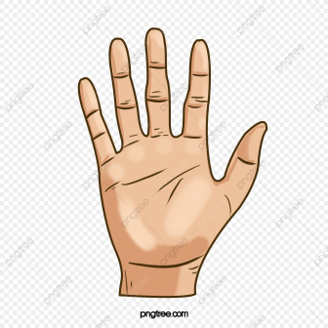
Top tips on wearing a face covering
In order for your face covering to keep you and those around you safe, remember:
Face coverings should not be shared with others
Wash your hands or use hand sanitiser before putting it on
and try not to touch your face
It’s important to make sure the face covering is the right size to cover the nose, mouth and chin and you shouldn't touch
the front once it's on
When you take it off, try not to touch the part you’ve been
breathing on

Slide 4
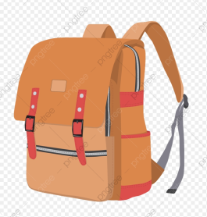
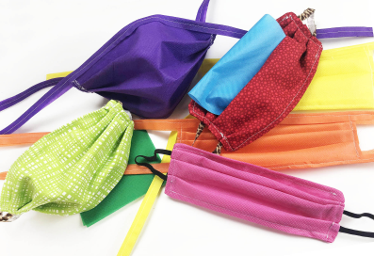
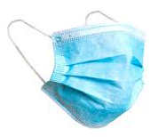
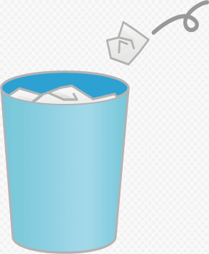
When you're not using your face covering (for example, during class), it should
be placed in a washable bag or container.
Avoid placing it on surfaces, due to the possibility of contamination.
If it's a fabric face covering, keep the face covering in a plastic
bag until you can wash it, then wash it at 60 degrees centigrade
after each day of use.
It can go in the wash with other laundry.
If you're using a disposable face covering, wrap it in a bag and put it in
a bin.

Slide 5
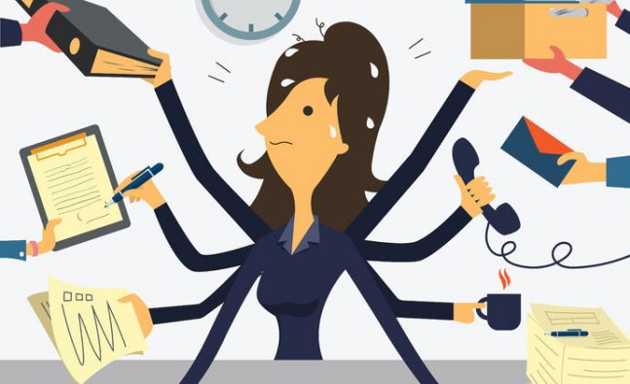
Word of the Week
Multitask (verb)
To do more than one thing at a time.
A person who is multitasking is performing various tasks, all at once. If you are texting while watching TV, eating a sandwich and having a conversation, you are multitasking. Driving a car is a good example of multitasking, as you have to do lots of things at the same time.
However, some experts say that your brain can’t really cope with trying to do too much at once, so someone who is multitasking might take longer to do each task than if they did them one at a time.
Multitasking is also a computer term, meaning that the computer is executing various programmes at once.

Slide 6
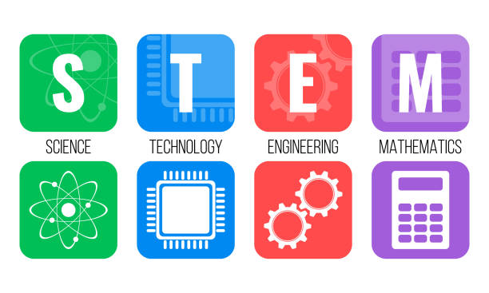
STEM Week 26th to 30th October
This week we are going to look at STEM across our curriculum, as are lots of other schools across the country. #YoungSTEMLeaderWeek
Each day has a theme:
Monday DISCOVER about iconic STEM discoveries
Tuesday CREATE video about STEM creations or of your own creation
Wednesday INSPIRE Do something inspirational or tell us who or what you find inspiring.
Thursday LEAD - students leading a STEM activity or interaction
Friday - SHOW - show how you got involved during the week
There are daily prizes available, £50 for best tweet, two runner up prizes of £25 which are for the winning school. This is a national competition.

Slide 7
The weather will get cooler over the next few weeks and
months. Please be prepared for Monday afternoons so you
can enjoy Outdoor Learning feeling warm, dry and happy.
If it is wet, you will need to bring some wellies and a
waterproof jacket.

Slide 8
Art & Design Supported Study, CB@DCHS
for pupils of Art 1 and Art 2
When: Tuesday lunchtime, room 2
with Mrs Thomson
Sign up on Mondays to attend.
Max of 10 places. Bring your lunch.
Supported study is for completing your
A&D homework or keeping on track
with your National Award artwork.
Starting w/c 28 September

Slide 9
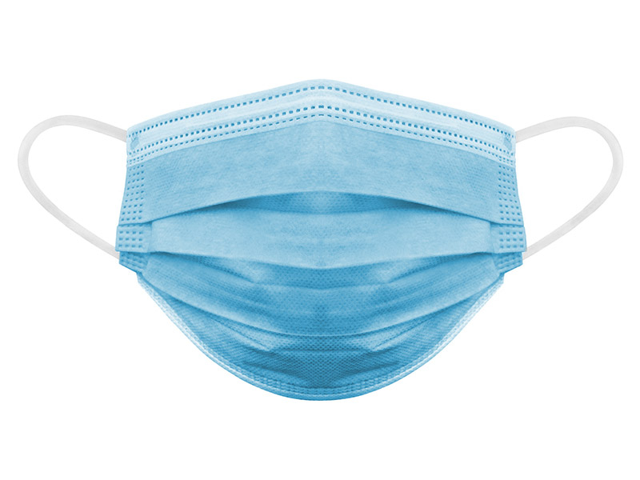
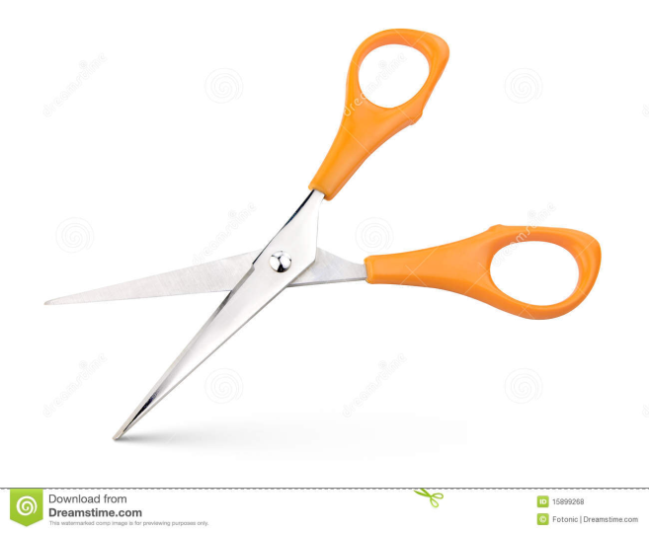
If you wear a disposable mask, please cut the elastic
before you put them in the bin.
This will help look after wild animals.

