Slide 1
Our weekly bulletin
Week Beginning : Monday 9th November
Anti- Bullying Week : United Against Bullying

Slide 2
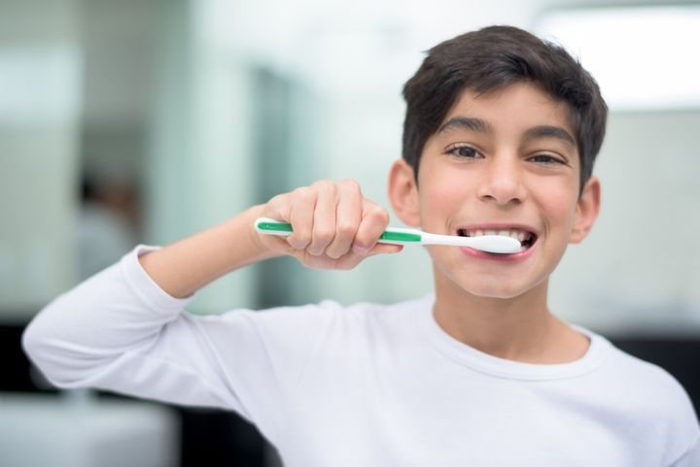
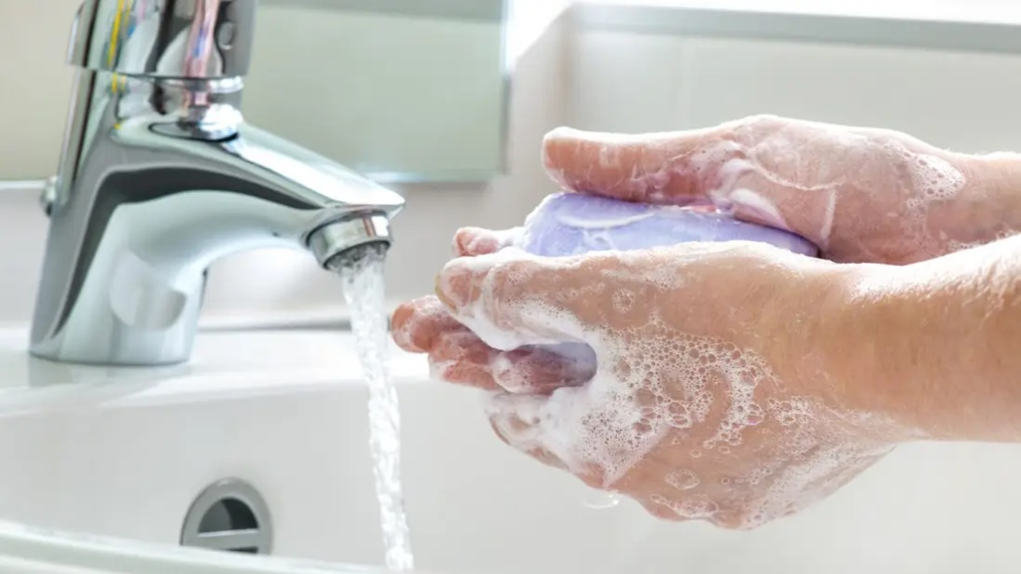
hygiene (noun)
The practice of keeping yourself and your surroundings clean, especially so that illness and the spread of disease can be prevented.
Washing your hands, brushing your teeth and having regular baths or showers are all important parts of your personal hygiene.
We have all been practising good hand hygiene, by washing our hands regularly, and sanitising whenever we enter or leave the room.

Slide 3
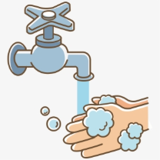
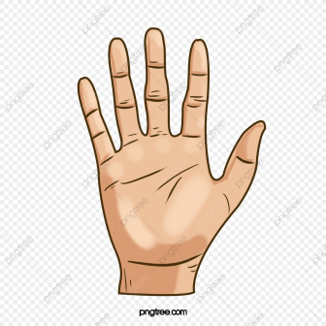
Top tips on wearing a face covering
In order for your face covering to keep you and those around you safe, remember:
Face coverings should not be shared with others
Wash your hands or use hand sanitiser before putting it on
and try not to touch your face
It’s important to make sure the face covering is the right size to cover the nose, mouth and chin and you shouldn't touch
the front once it's on
When you take it off, try not to touch the part you’ve been
breathing on

Slide 4
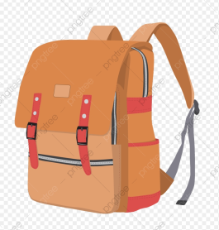
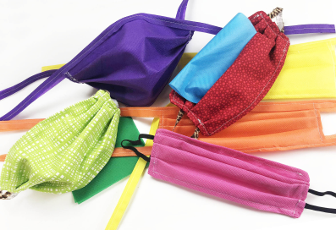
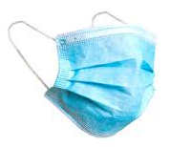
When you're not using your face covering (for example, during class), it should
be placed in a washable bag or container.
Avoid placing it on surfaces, due to the possibility of contamination.
If it's a fabric face covering, keep the face covering in a plastic
bag until you can wash it, then wash it at 60 degrees centigrade
after each day of use.
It can go in the wash with other laundry.
If you're using a disposable face covering, wrap it in a bag and put it in
a bin.

Slide 5
Word of the Week
remembrance (noun)
The act of remembering something or someone, specifically the dead.
A memory or recollection.
Armistice Day is on 11 November and is also known as Remembrance Day. It marks the day World War One ended, at 11am on the 11th day of the 11th month, in 1918. A two-minute silence is held at 11am to remember the people who have died in wars.
The poppy is the symbol of remembrance.

Slide 6
Monday 9th November
Odd Socks Day is designed to be fun! It’s an opportunity to encourage people to express themselves and celebrate their individuality and what makes us all unique!

Slide 7
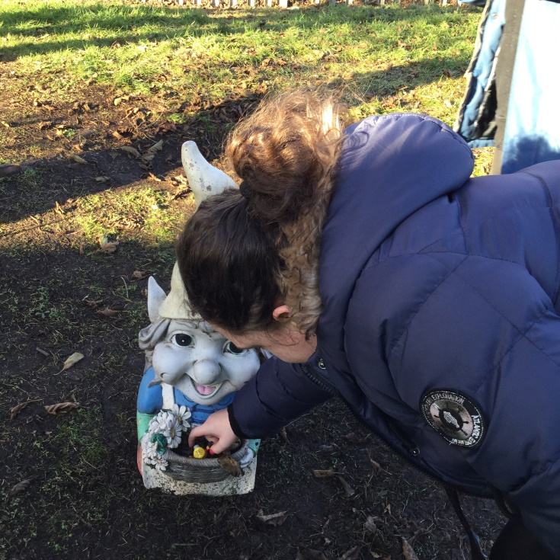
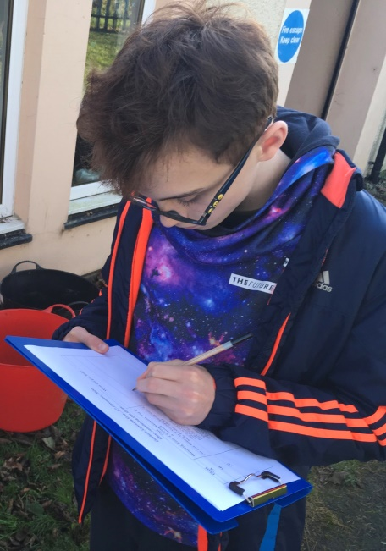
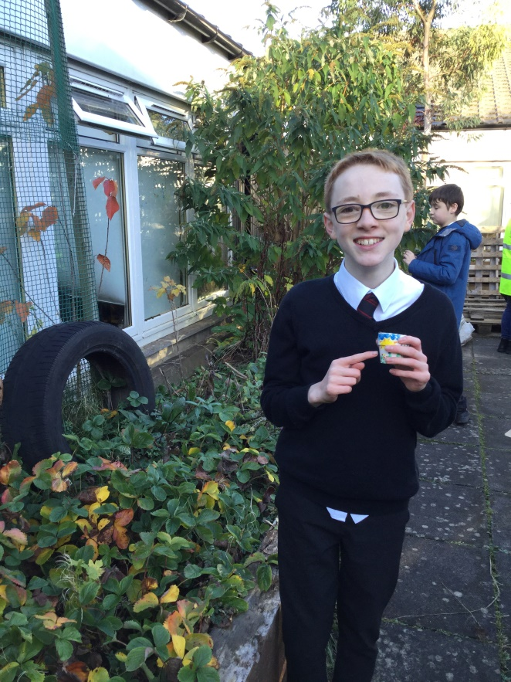
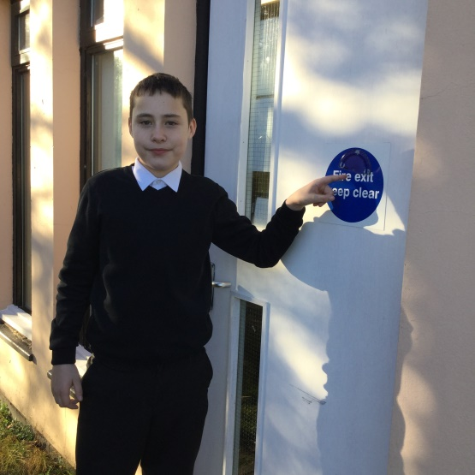
Wow!
What an Outdoor Classroom day
Each BGE class wrote a clue for the BGE other classes
to work out. They knew if they had been right when they
found the hidden object.
A fun way to use so many of our skills: communication,
creativity, thinking, literacy and
numeracy.
And what lovely weather for
a late Autumn afternoon.
Well done everyone!

Slide 8
Art & Design Supported Study, CB@DCHS
for pupils of Art 1 and Art 2
When: Monday lunchtime, room 2
with Mrs Thomson
Sign up to attend.
Max of 10 places. Bring your lunch.
Supported study is for completing your
A&D homework or keeping on track
with your National Award artwork.
New day starting 9/11/20

Slide 9
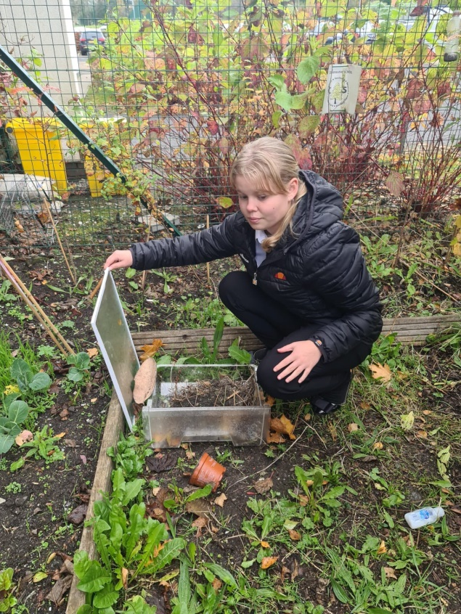
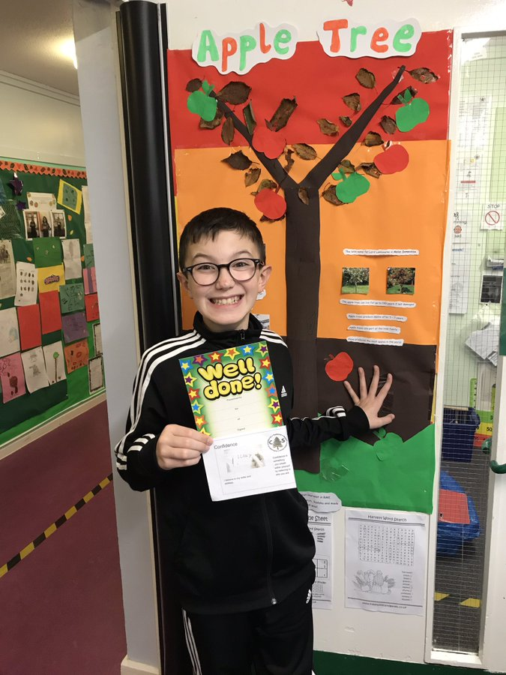
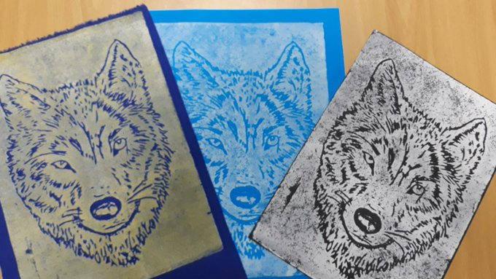
It is nearly the end of Autumn, and we have had a really lovely time at
Cedarbank celebrating it.
There have been so many fantastic things happening during Autumn, here is just a few:
We have had our annual Autumn Week,
Our Senior Animal care class have made a mini-beast hotel and,
Amazing art work
What do you enjoy or notice about Autumn?
What are your favourite things about this season?
You could share your thoughts with others

Slide 10
The weather will get cooler over the next few weeks and
months. Please be prepared for Monday afternoons so you
can enjoy Outdoor Learning feeling warm, dry and happy.
If it is wet, you will need to bring some wellies and a
waterproof jacket.

Slide 11
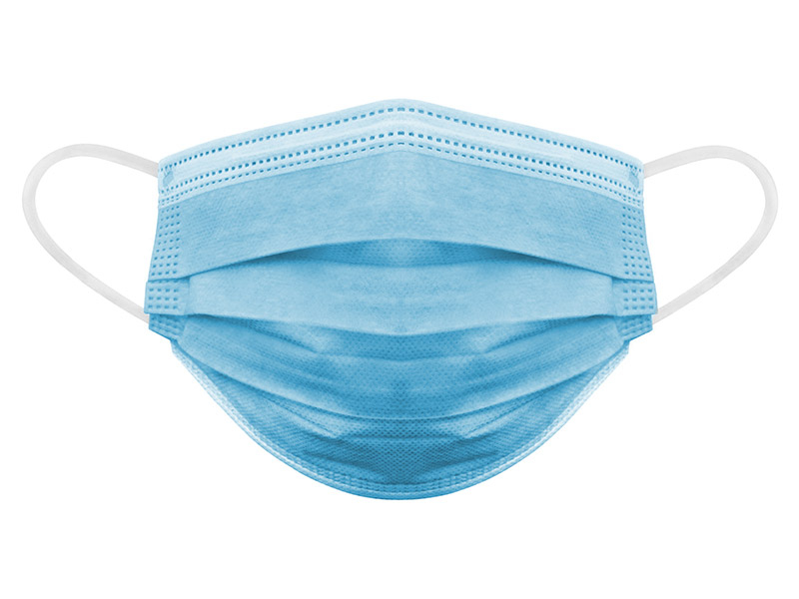
If you wear a disposable mask, please cut the elastic
before you put them in the bin.
This will help look after wild animals.

