Slide 1
Our weekly bulletin
Week Beginning : Monday 30th November

Slide 2
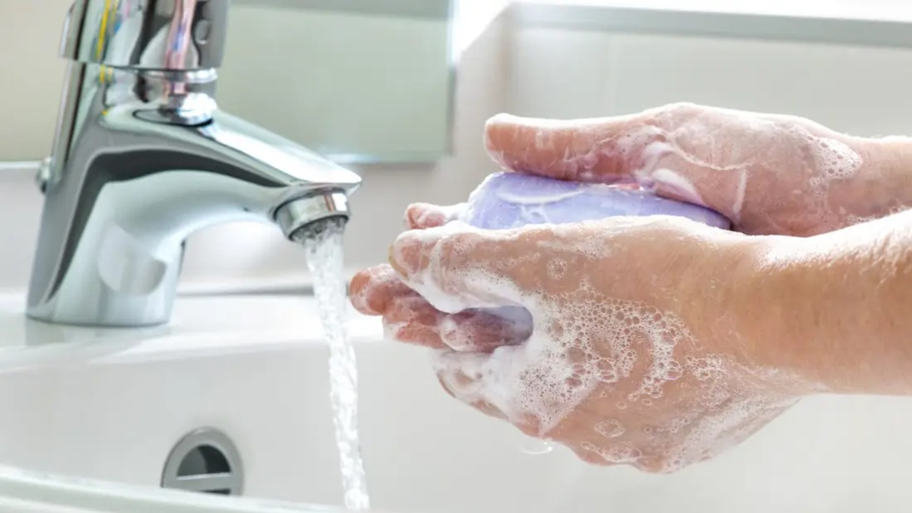
hygiene (noun)
The practice of keeping yourself and your surroundings clean, especially so that illness and the spread of disease can be prevented.
Washing your hands, brushing your teeth and having regular baths or showers are all important parts of your personal hygiene.
We have all been practising good hand hygiene, by washing our hands regularly, and sanitising whenever we enter or leave the room.

Slide 3
Top tips on wearing a face covering
In order for your face covering to keep you and those around you safe, remember:
Face coverings should not be shared with others
Wash your hands or use hand sanitiser before putting it on
and try not to touch your face
It’s important to make sure the face covering is the right size to
cover the nose, mouth and chin and you shouldn't touch
the front once it's on
When you take it off, try not to touch the part you’ve been
breathing on

Slide 4
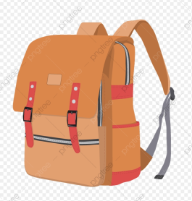
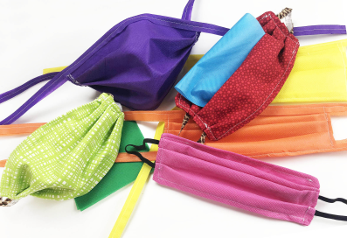
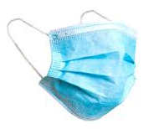
When you're not using your face covering (for example, during class), it should
be placed in a washable bag or container.
Avoid placing it on surfaces, due to the possibility of contamination.
If it's a fabric face covering, keep the face covering in a plastic
bag until you can wash it, then wash it at 60 degrees centigrade
after each day of use.
It can go in the wash with other laundry.
If you're using a disposable face covering, wrap it in a bag and put it in
a bin.

Slide 5
Word of the Week
saltire (noun)
The correct name for the Scottish flag, or St. Andrew’s cross, is the Saltire. It consists of a white, x-shaped cross on a blue background. The Saltire flag flies on all Scottish government buildings, from 8 a.m. until sunset every day.
The blue and white (diagonal) sections of the Union Flag come from the Saltire.
You might see the Saltire being used on many occasions where Scottish pride is evident, such as rugby and football matches, or when Andy Murray is playing an important tennis match!

Slide 6
Cedarbank School Virtual Christmas Fayre 2020
We are delighted to present our first ever Virtual Christmas Fayre!
On Friday the catalogue and order form became
live for all to see the wonderful goodies that have been made within the school.
Our staff and pupils have been busy
creating a variety of items, many of
which will be made to order.
Happy Shopping and Merry Christmas!

Slide 7
The weather will get cooler over the next few weeks and
months. Please be prepared for Monday afternoons so you
can enjoy Outdoor Learning feeling warm, dry and happy.
If it is wet, you will need to bring some wellies and a
waterproof jacket.

Slide 8
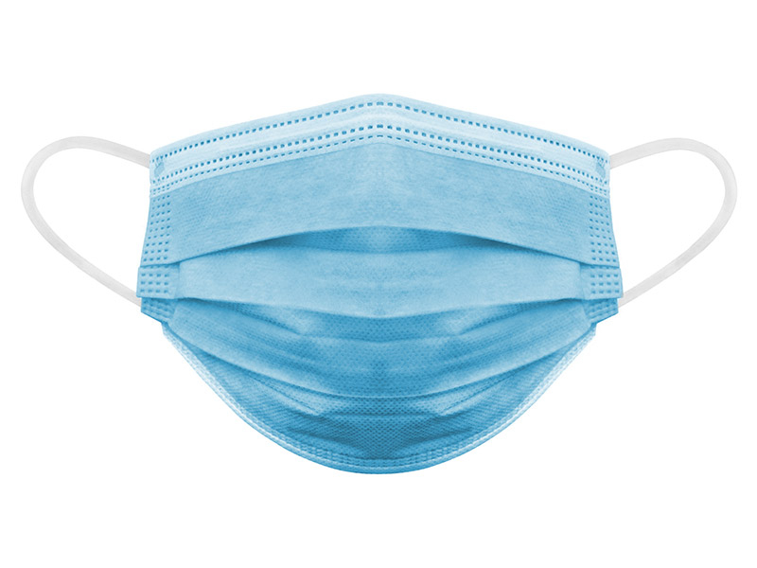
If you wear a disposable mask, please cut the elastic
before you put them in the bin.
This will help look after wild animals.

