Slide 1
Our weekly bulletin
Week Beginning : Monday 7th December

Slide 2
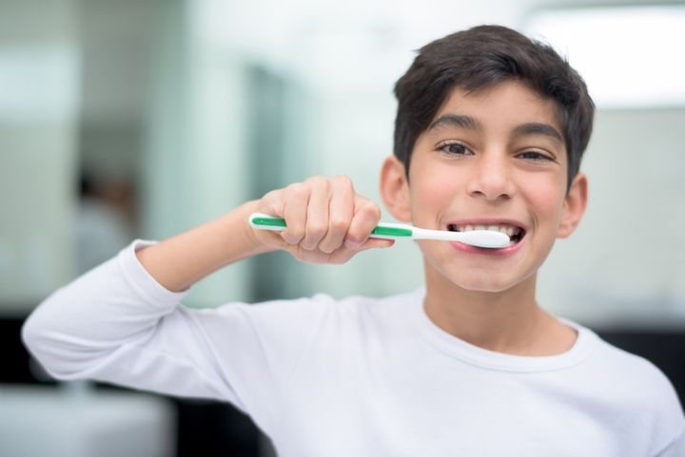
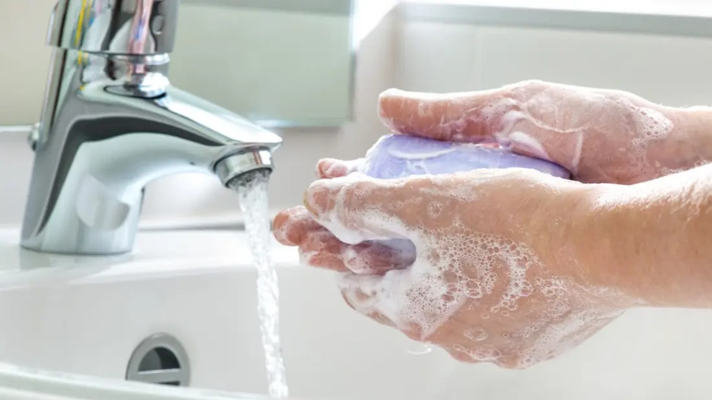
hygiene (noun)
The practice of keeping yourself and your surroundings clean, especially so that illness and the spread of disease can be prevented.
Washing your hands, brushing your teeth and having regular baths or showers are all important parts of your personal hygiene.
We have all been practising good hand hygiene, by washing our hands regularly, and sanitising whenever we enter or leave the room.

Slide 3
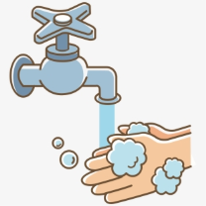
Top tips on wearing a face covering
In order for your face covering to keep you and those around you safe, remember:
Face coverings should not be shared with others
Wash your hands or use hand sanitiser before putting it on
and try not to touch your face
It’s important to make sure the face covering is the right
size to cover the nose, mouth and chin and you
shouldn't touch the front once it's on
When you take it off, try not to touch the part you’ve been
breathing on

Slide 4
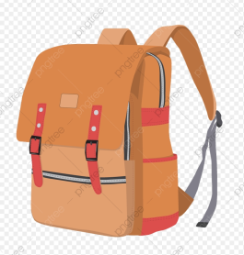
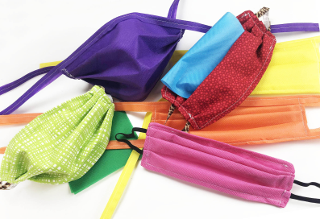
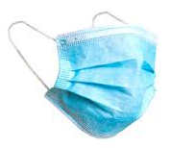
When you're not using your face covering (for example, during class), it
should be placed in a washable bag or container.
Avoid placing it on surfaces, due to the possibility of contamination.
If it's a fabric face covering, keep the face covering in a plastic
bag until you can wash it, then wash it at 60 degrees centigrade
after each day of use.
It can go in the wash with other laundry.
If you're using a disposable face covering, wrap it in a bag
and put it a bin.

Slide 5
Word of the Week
merry (adjective)
Noun: merriment; adverb: merrily
Cheerful and lively.
To be merry is to be happy, jaunty, and ready to frolic. A group of people laughing as they walk down the street is a merry gang. Anything merry is festive, often involving games, celebrations, and parties. A merry-go-round makes kids happy as it spins them around. Smiling and laughing are signs of being merry.
We have been wishing people a ‘Merry Christmas’ since the 17th century, when the song ‘We Wish you a Merry Christmas’ became popular, but it really took off after Charles Dickens’ novel ‘A Christmas Carol’ was published in the 19th century.

Slide 6
Cedarbank Playground Rules
Last year as part of our Pupil Council’s work towards the
UN Rights Respecting School, they came up with a set of rules
for the playground.
Please be reminded that in the playground you are asked to:
Be respectful
Be kind to each other
Help each other
Give each other personal space

Slide 7
Hour of Code
All pupils will be learning about coding in Digital skills and IT over the coming weeks.
We will be taking part in Hour of Code where pupils will get to learn some simple coding skills for themselves.

Slide 8
Cedarbank School Virtual Christmas Fayre 2020
We are delighted to present our first ever Virtual Christmas Fayre!
The catalogue and order form are
live for all to see the wonderful goodies that have been made within the school.
Our staff and pupils have been busy
creating a variety of items, many of
which will be made to order.
Happy Shopping and Merry Christmas!

Slide 9
Congratulations everyone!
All the gardening that you do around the school has earned
a five star award from the Royal Horticultural Society (RHS)
We have been working towards over the last three years.
What a fabulous achievement everyone!

Slide 10
The weather will get cooler over the next few weeks and
months. Please be prepared for Monday afternoons so you
can enjoy Outdoor Learning feeling warm, dry and happy.
If it is wet, you will need to bring some wellies and a
waterproof jacket.

Slide 11
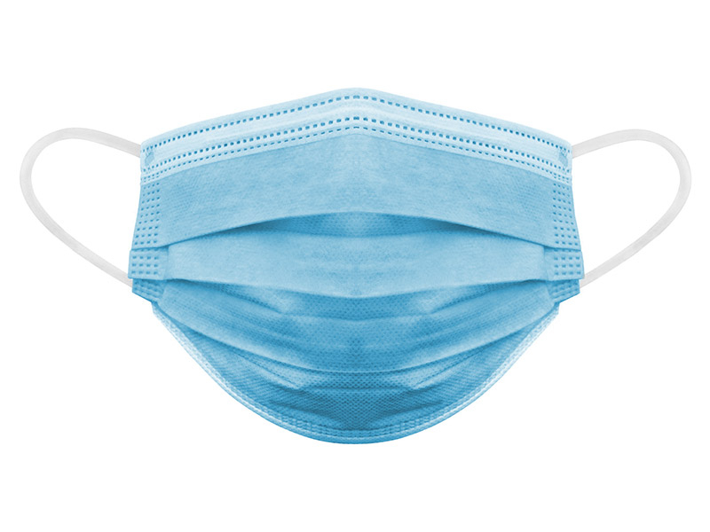
If you wear a disposable mask, please cut the elastic
before you put them in the bin.
This will help look after wild animals.

