Slide 1
Our weekly bulletin
Week Beginning : Monday 14th December

Slide 2
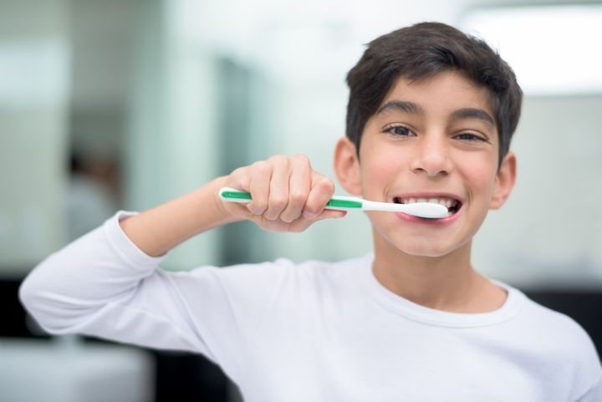
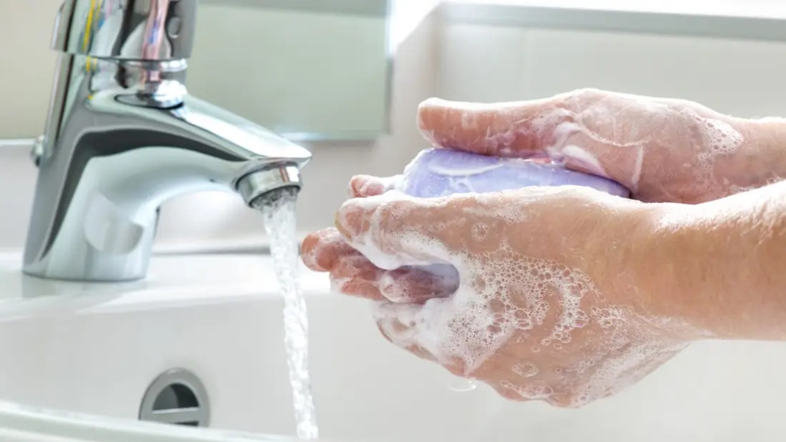
hygiene (noun)
The practice of keeping yourself and your surroundings clean, especially so that illness and the spread of disease can be prevented.
Washing your hands, brushing your teeth and having regular baths or showers are all important parts of your personal hygiene.
We have all been practising good hand hygiene, by washing our hands regularly, and sanitising whenever we enter or leave the room.

Slide 3
Top tips on wearing a face covering
In order for your face covering to keep you and those around you safe, remember:
Face coverings should not be shared with others
Wash your hands or use hand sanitiser before putting it on
and try not to touch your face
It’s important to make sure the face covering is the right
size to cover the nose, mouth and chin and you
shouldn't touch the front once it's on
When you take it off, try not to touch the part you’ve been
breathing on

Slide 4
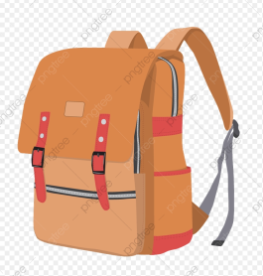
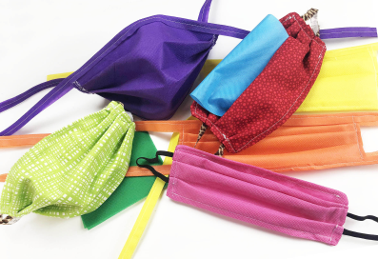
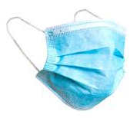
When you're not using your face covering (for example, during class), it
should be placed in a washable bag or container.
Avoid placing it on surfaces, due to the possibility of contamination.
If it's a fabric face covering, keep the face covering in a plastic
bag until you can wash it, then wash it at 60 degrees centigrade
after each day of use.
It can go in the wash with other laundry.
If you're using a disposable face covering, wrap it in a bag
and put it a bin.

Slide 5
Word of the Week
festive (adjective)
Relating to a festival, especially Christmas: “The festive season seems to begin earlier each year”.
Cheerful and celebratory: “The sombre atmosphere has given way to a festive mood”.
Despite the situation this year, I hope you will all have time to get into a festive mood during this festive season, and join in with some festivities!

Slide 6
Cedarbank Playground Rules
Last year as part of our Pupil Council’s work towards the
UN Rights Respecting School, they came up with a set of rules
for the playground.
Please be reminded that in the playground you are asked to:
Be respectful
Be kind to each other
Help each other
Give each other personal space

Slide 7
Pupil Toilets
Please remember that the toilets are for everyone to use.
Please treat them with respect.

Slide 8
Hour of Code
All pupils will be learning about coding in Digital skills and IT over the coming weeks.
We will be taking part in Hour of Code where pupils will get to learn some simple coding skills for themselves.

Slide 9
Robin Hood and his Socially Distanced Men
Our Online Pantomime
On Monday, the whole of Cedarbank School will have an afternoon at the Pantomime.
We will watch Robin Hood and his Socially Distanced Men
in our classrooms
at 2pm with our Teachers and PSWs.
S1-S3 will stay in their Tutor class and watch with their Outdoor Learning Teacher.
S4 and 5 will go to their P6 and 7 lesson and watch with their teacher.
S6 will stay in their classroom at Armadale.
Please remember that we cannot share our snacks and sweets with our friends this year.
Have a lovely afternoon!!!!!

Slide 10
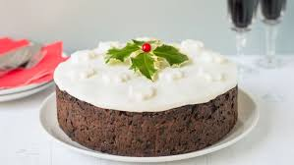
Christmas Cake Bake-along
We are looking forward to seeing all your beautiful Christmas cake creations. Please remember to share your pics with us by 18th December.
All students and staff have received a laminated recipe card and the video guide is on our Twitter page.
Happy baking folks!

Slide 11
Wishing you a restful, relaxing and fun holiday.
The last day of term is Friday 18th December.
We are looking forward to seeing you again in the new year.
The first day of term for students is Wednesday 6th January 2021

Slide 12
The weather will get cooler over the next few weeks and
months. Please be prepared for Monday afternoons so you
can enjoy Outdoor Learning feeling warm, dry and happy.
If it is wet, you will need to bring some wellies and a
waterproof jacket.

Slide 13
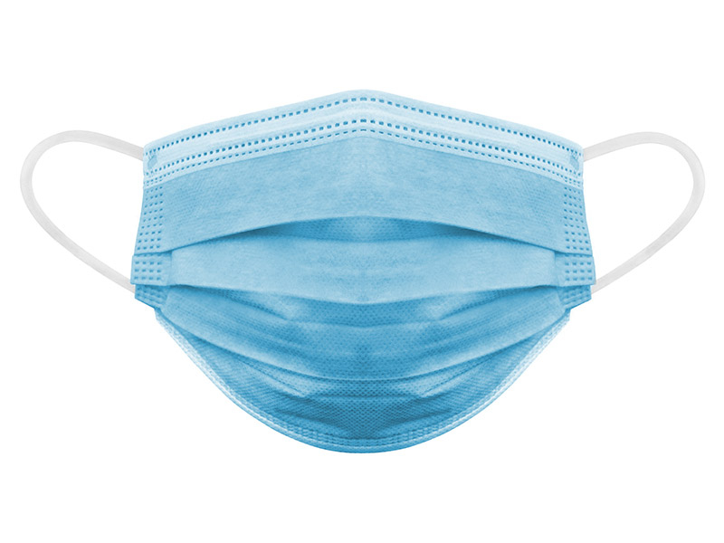
If you wear a disposable mask, please cut the elastic
before you put them in the bin.
This will help look after wild animals.

