Slide 1
Parent Council Meeting Tuesday 15th March 2022 Cedarbank School

Slide 2
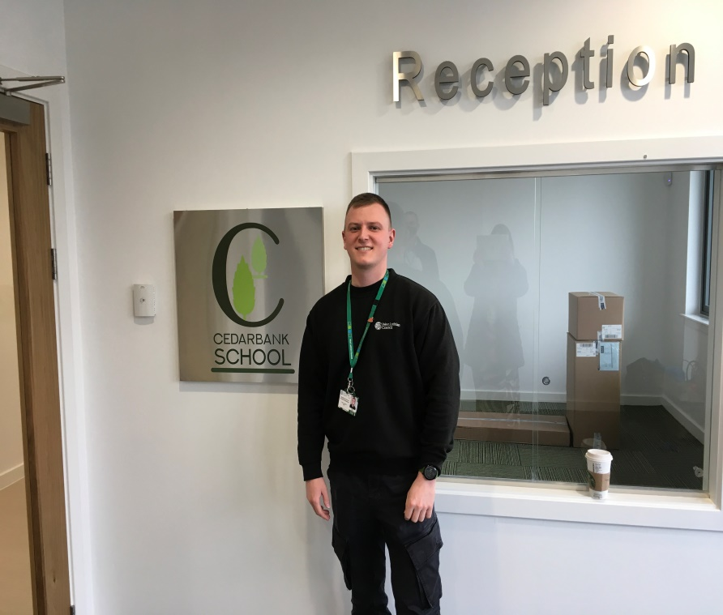
Parent Council Meeting Tuesday 15th March 2022 Cedarbank School

Slide 3
Key Dates
S1-3 start : Tuesday 19th April 2022
S4/5 start: Monday 30th May 2022
Activities week: Monday 30th May 2022
S6 last day: Friday 27th May 2022

Slide 4
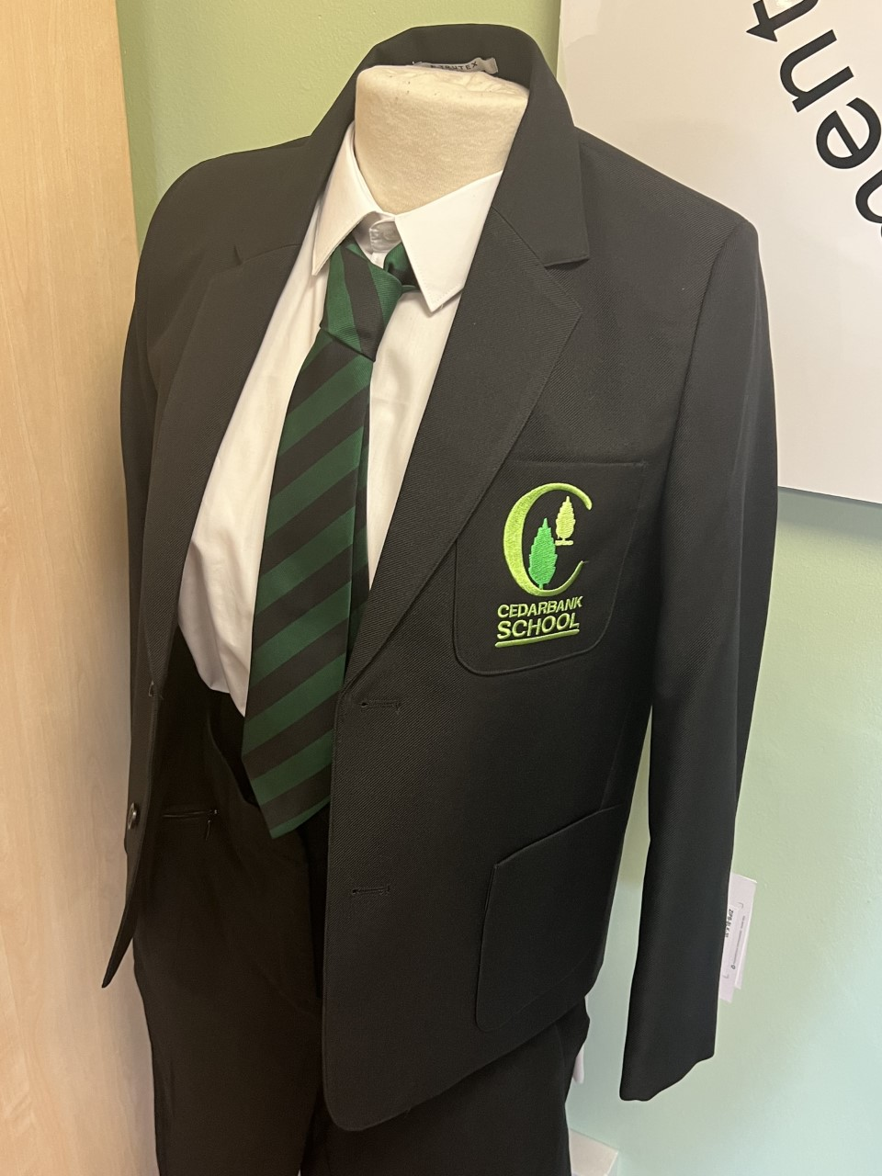
New tie New badge

Slide 5
Uniform S1-3
Black trousers or black skirt
Plain black cardigan/ jumper or black blazer
White/ black shirt or white/black polo shirt
School tie
Plain black shoes

Slide 6
Uniform S4-6
Black trousers or black skirt
Plain black cardigan/ jumper
Black blazer
White/ black shirt
School tie
Plain black shoes

Slide 7
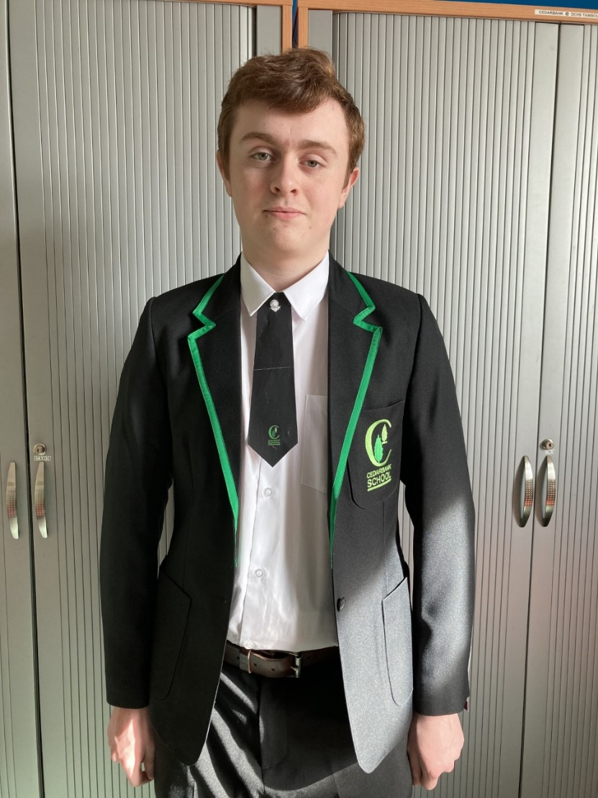
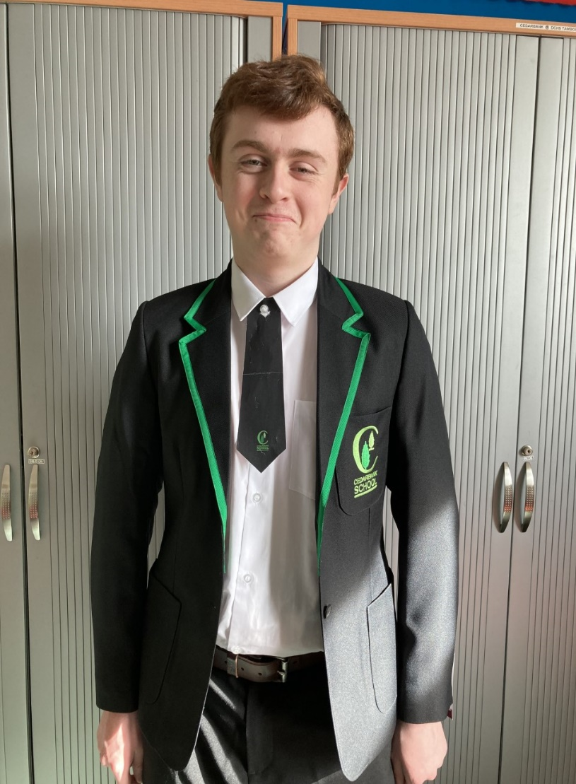
Uniform S6

Slide 8
Why wear school uniform?
It gives young people an identity - a sense of pride and belonging to their school
It increases the school's profile in the local community
It minimises the competition between young people over expensive fashion wear
It limits the opportunity for young people being singled out on the grounds of what they wear
It improves security in school and on school trips, as it is easier to identify who is a pupil in the school
It is more convenient for parents
There are school clothing grants available

Slide 9
Transport
Pupils will continue with their normal transport arrangements
Changes to individual pupil transport arrangements are being arranged.
Transition work will be done with pupils to ensure safe arrival and departure of taxis.

Slide 10
Drop Off/ Pick Up

Slide 11
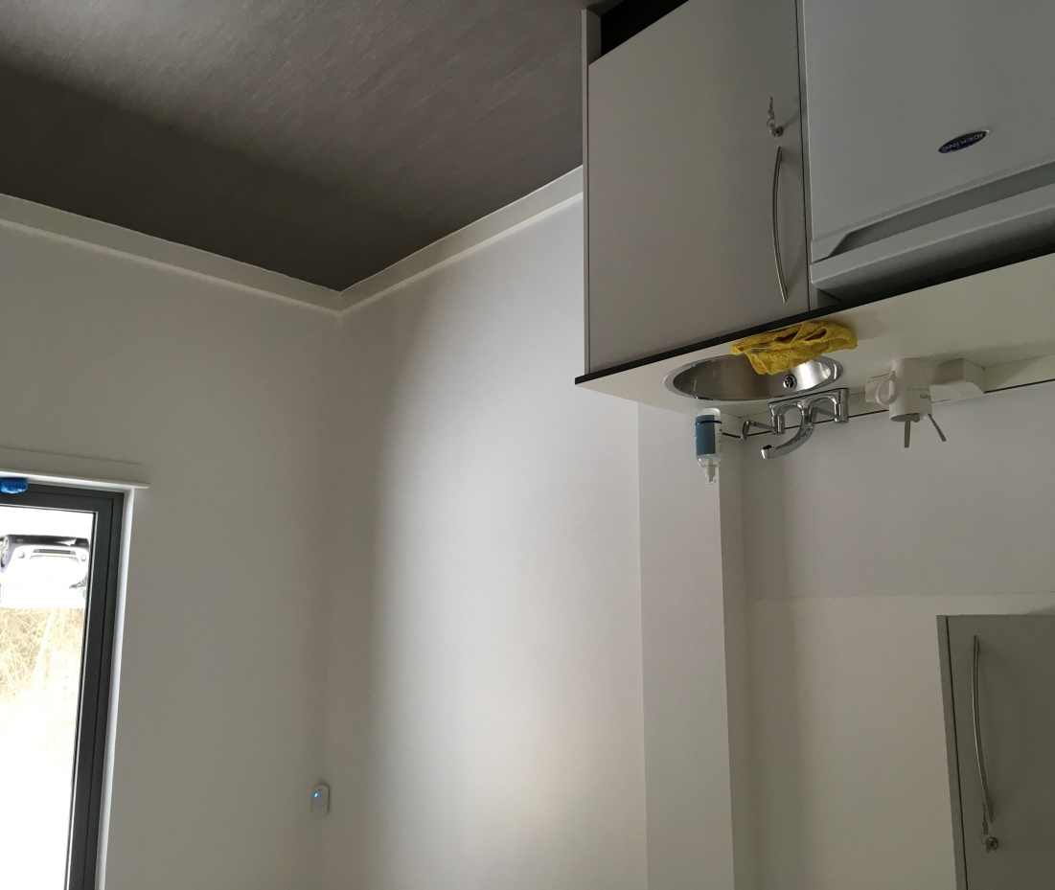
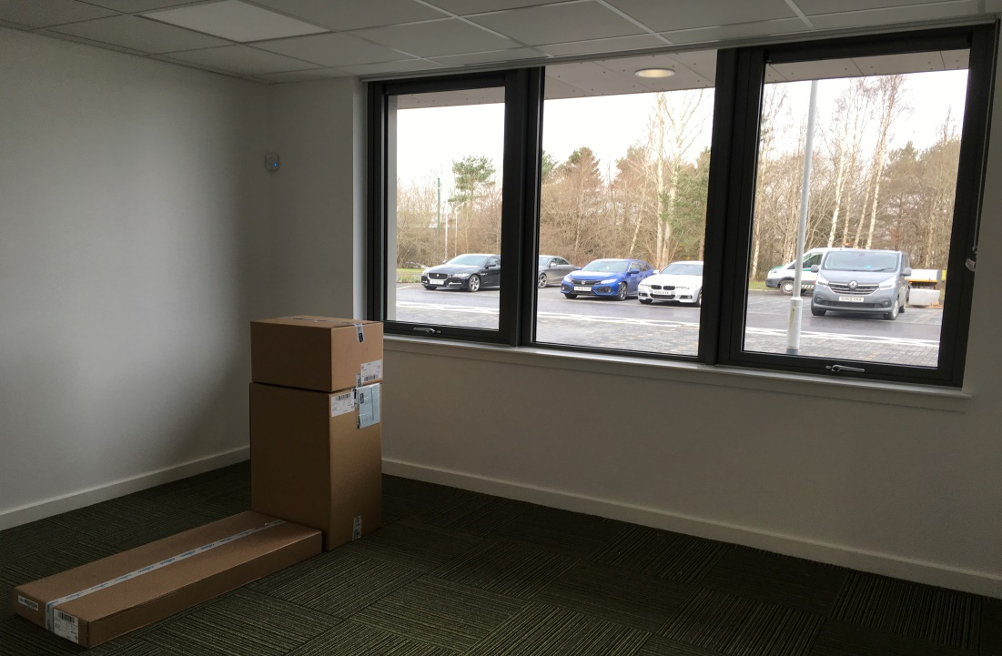
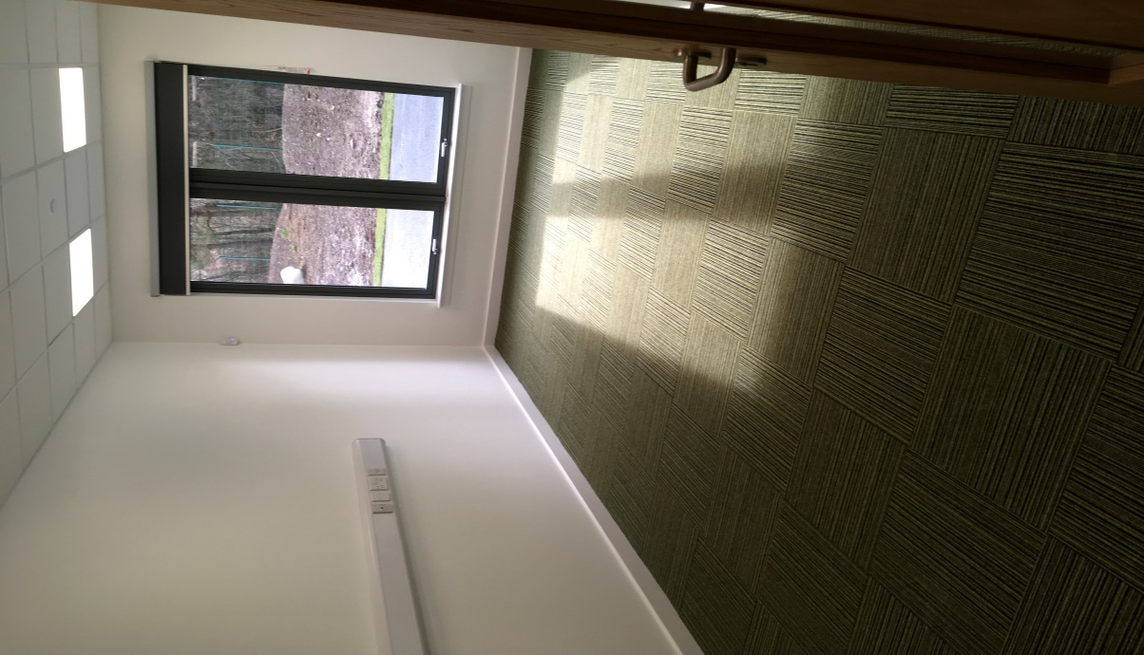
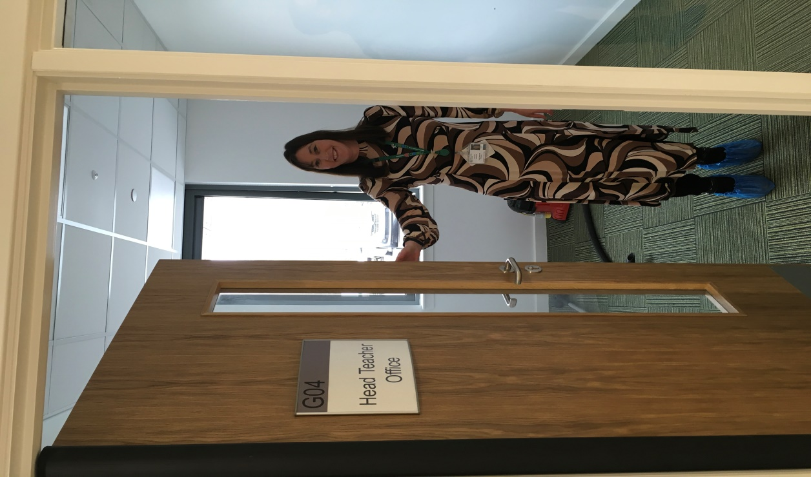

Slide 12
Canteen

Slide 13
Booth Seating

Slide 14
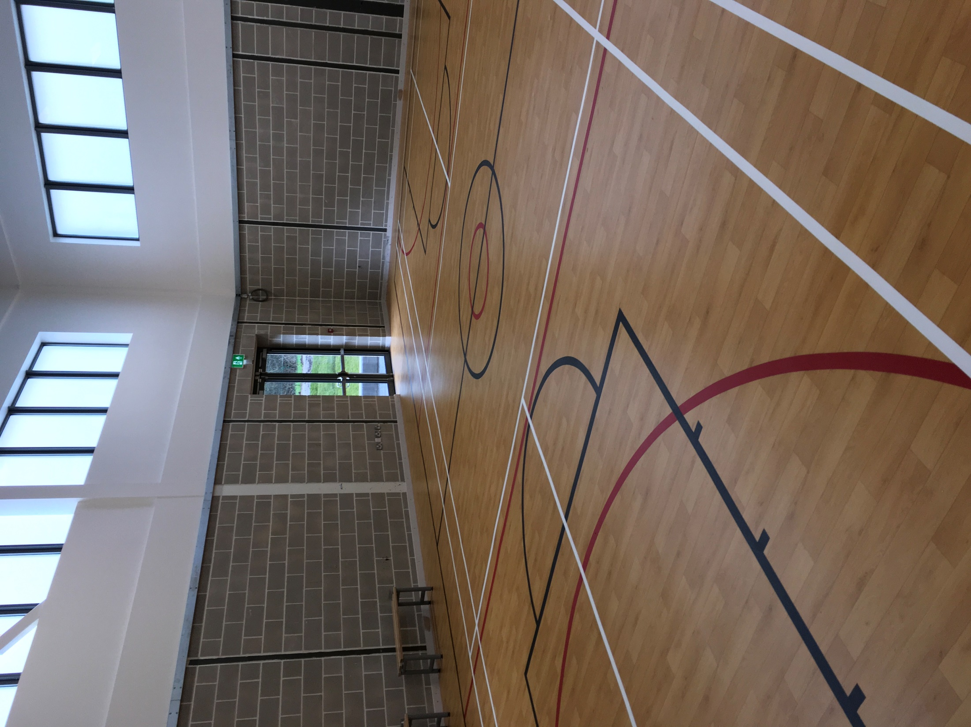

Slide 15
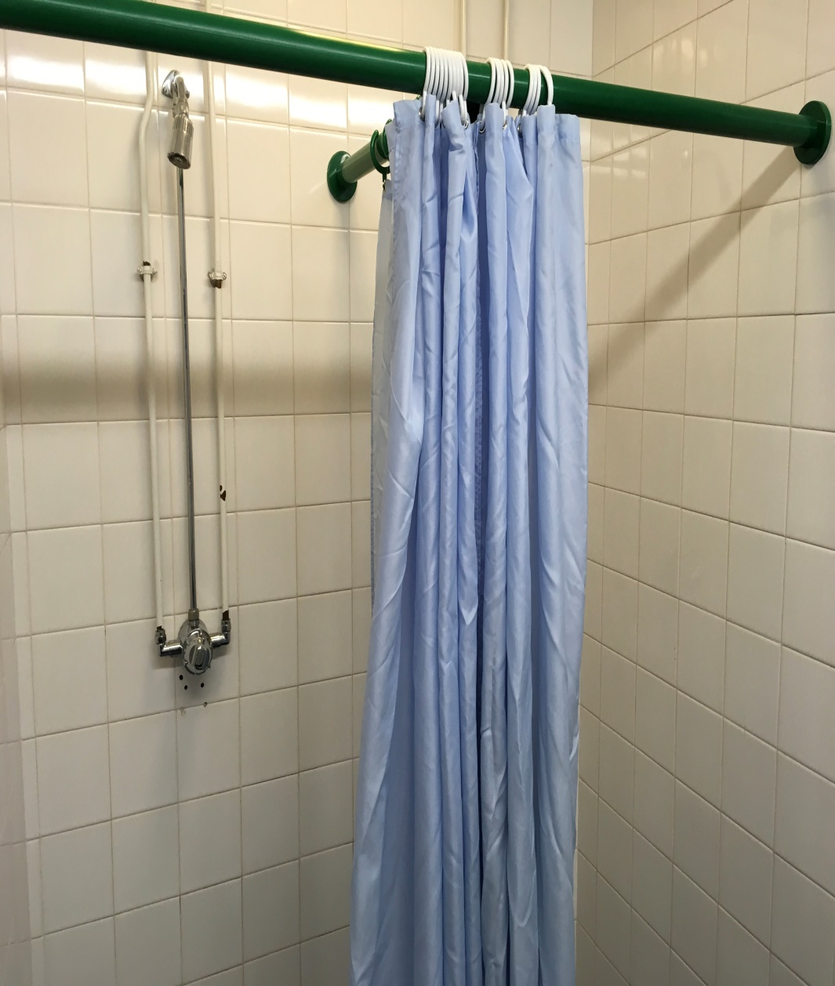
Changing Rooms Now

Slide 16
New Changing Rooms

Slide 17
Science

Slide 18
CDT

Slide 19
Music

Slide 20
Art

Slide 21
Standard classroom

Slide 22
Learning Plaza :ICT

Slide 23
Learning Plaza: Library

Slide 24
Learning Plaza

Slide 27
New Toilets

Slide 30
Outdoor Learning

Slide 31
Outside Learning/ Recreation

Slide 32
Outdoor Learning

Slide 33
Playground

Slide 34
Outdoor Learning

Slide 35
Transition
All pupils have visited the new building – it has been lovely to hear their views and excitement!
We have had projects linking in with our curriculum:
ASDAN short course Gardening and Personal
Development and Developing the Young
Workforce (DYW)
Daily bulletin, visuals (e.g. uniform), daily chats

Slide 36
We visited from the beginning

Slide 37
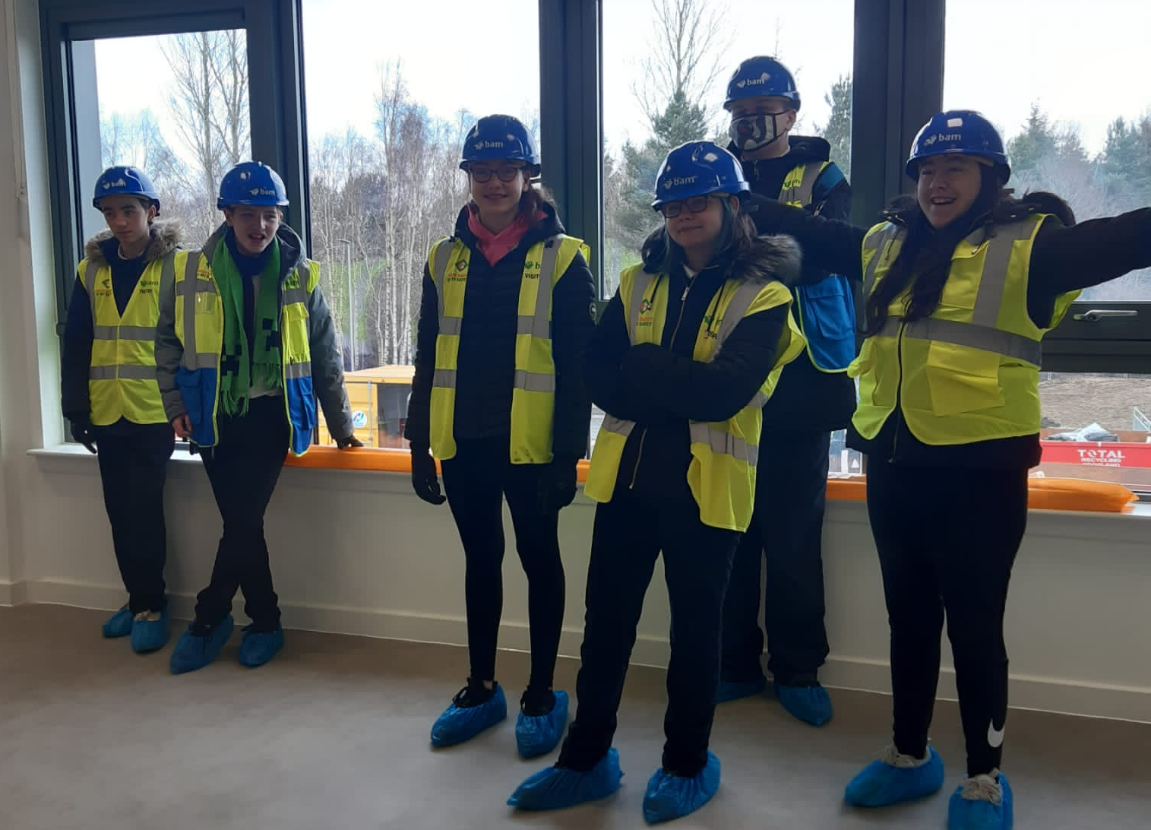

Slide 38
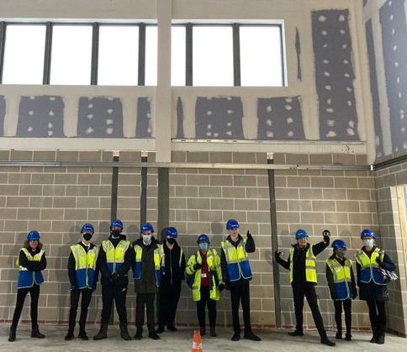
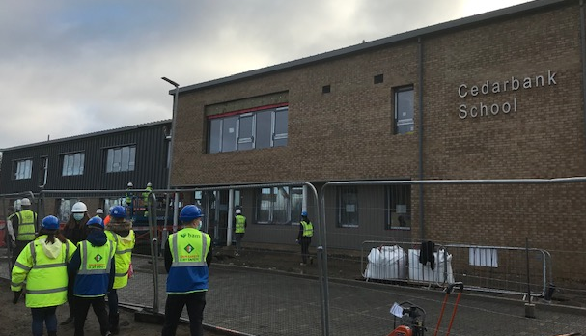

Slide 39
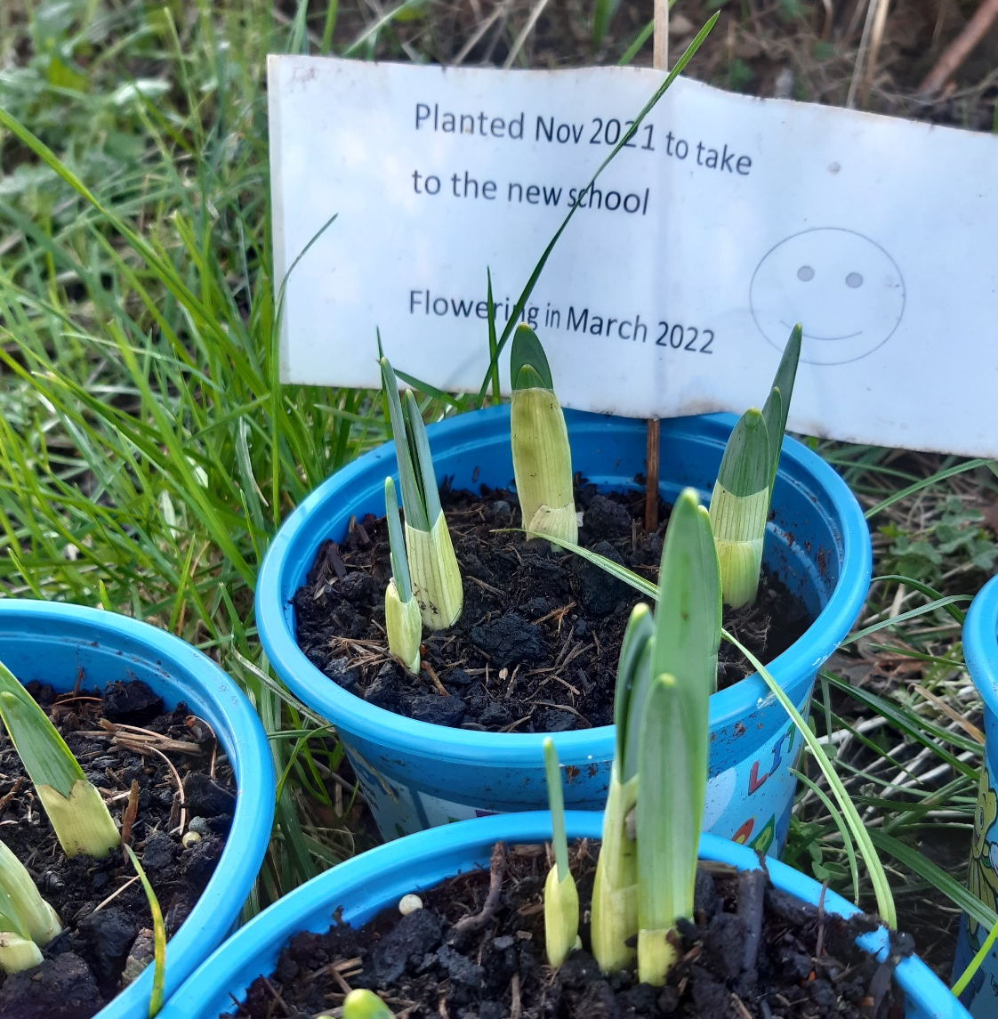

Slide 40
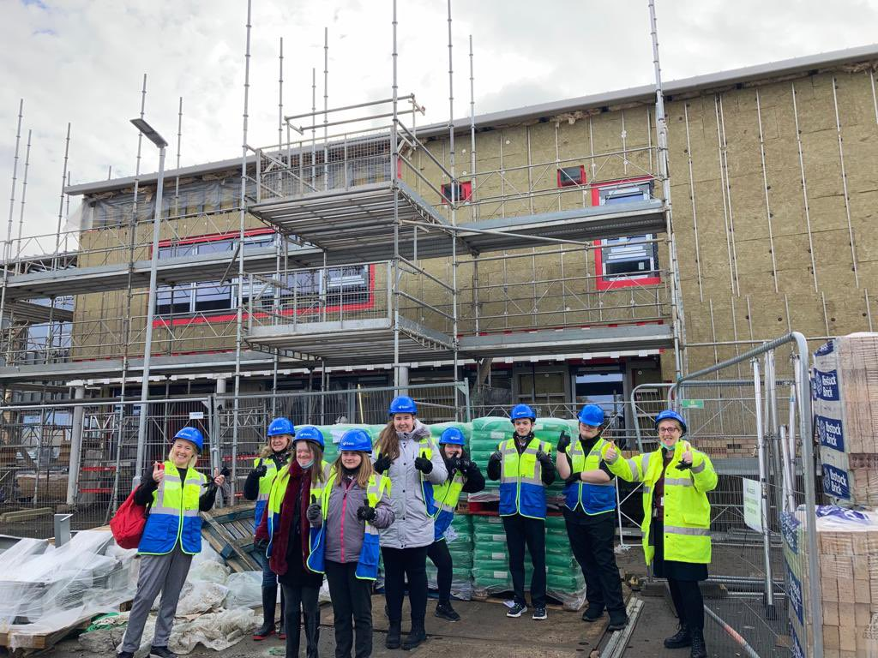

Slide 41
S4/5 School Day
Day 1 and 2 based mainly in main building with induction and orientation activities.
Day 3 and 4 activities with rest of school to allow relationship building.
Monday 6th June : start of new timetable

Slide 43
Enhanced Transition
Some young people require additional and specific supports around thinking about and moving to the new school
Fears such as phobias about eg. high ceilings or toilet fears are being addressed
Additional visits supports by staff are being scheduled for some pupils
Individualised strategies such as social stories are being used to prepare young people for change.

Slide 44
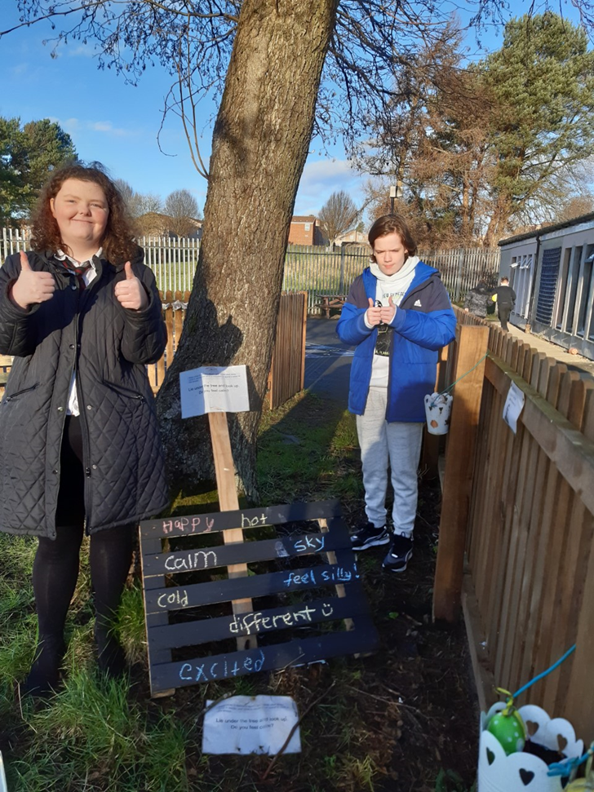
We talk about new experiences and words to describe how we feel about moving to the new Cedarbank
Thoughts of pupils about moving to the new school
“I am a bit worried”
“I like the trees round the school”
“It is so cool”
“It has really good windows and nice toilets”
“It is so big and smells of paint”

Slide 45
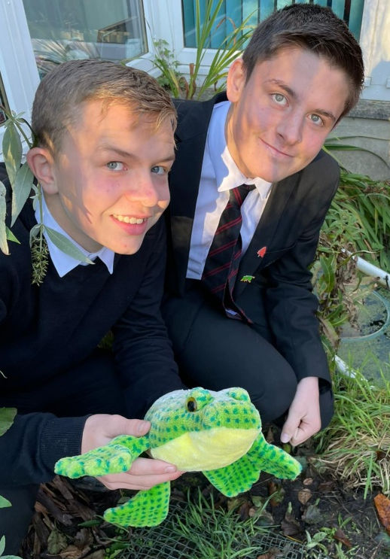
S1-3 School Day
S1-3 will continue with the same timetable and enjoy the new environment with lots of chat!
Pupils will have the same staff currently assigned.
We look forward to exploring our
new environment – both inside and
outside the new building

Slide 46
S4 – S5 Transition
All pupils have visited the site during the course of the last few months
Some pupils are anxious about the change and others are very excited. For those who are anxious, we will visit every so often when the S1 – S3 have settled in.
It’s good to chat and keep it current and in the minds of pupils – they speak openly about their worries.
Some S4 & S5 are only interested in the answer to
Can I go to the Centre for my lunch?

Slide 47
How can I help?
Talk to your child about the changes they are facing
Do a trial run of the journey to school
Help your child prepare by getting everything ready they might need night before, for example uniform, school bag, etc.
Keep a copy of the timetable where it can be easily seen. This will remind your child about days when certain books, or PE kit are needed.
Take an interest in what your child is learning and help them. Take an interest in new friends they are making.
Talk positively about the new school and attend any events offered by the school.

Slide 48
Curriculum Design / Learning Framework
What: BGE & Senior Phase
IDL (Inter-disciplinary Learning)
STEAM (Science, Technology, Engineering, Arts & Science)
Digital Literacy
Wider Achievement
Outdoor Learning
Personalisation & Choice
Rights Respecting Schools
LIFESKILLS
Independence
Skills for Learning, Life & Work
Career Education
Developing the Young Workforce
Employability
Appropriate Pace & Challenge for all
Nurture
MORE LIFESKILLS
National Qualifications
Celebration of Success
Building Positive Relationships
Raising Achievement & Attainment
EVEN MORE LIFESKILLS

Slide 49
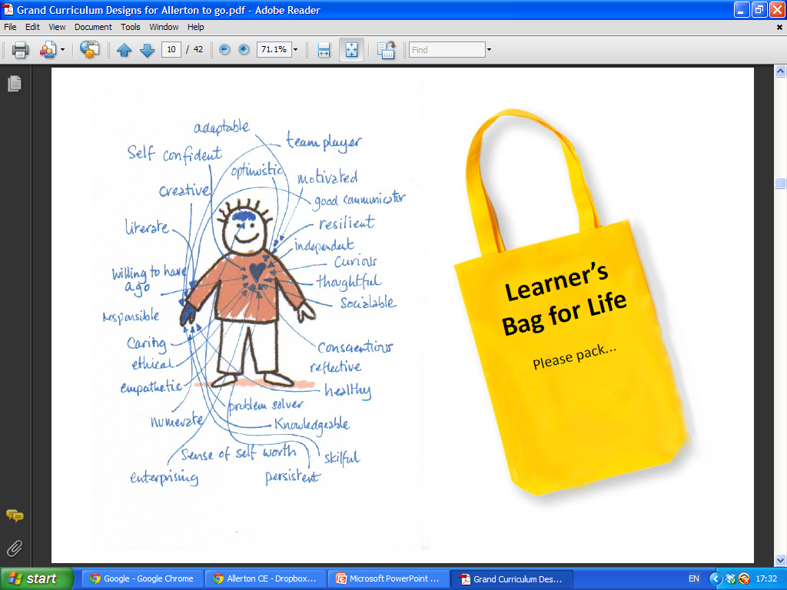
Why: Enable and equip our young people with the skills, values and attributes for life’s journey.

Slide 50
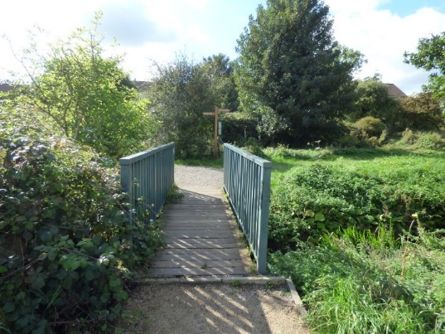
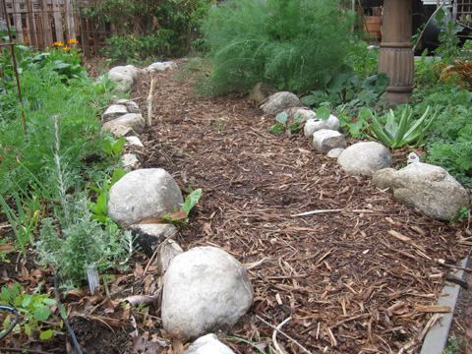
Curriculum Pathways

Slide 51
S1 – S3
S1 & S2 core curriculum will remain the same with the exception of Art, HE, Music and CDT which will be on rotation.
S3 pupils will have a core curriculum that they will all study alongside personal choice of subjects that they want to try out before moving into the Senior Phase.

Slide 52
S4 – S6
S5 Pathway A
SFW Courses
RBV
Lifeskills
Extended Work Placement
2 weeks Work Experience
Volunteering Award
S6 Pathway A
SFW Courses
Personal Finance
Lifeskills
Independant Living Skills Course
2 weeks Work Experience for all
Volunteering Award
College Transition Programme (if leaving at end of year)
College Transition Programme
5 NQ's including Maths & English
RBV
Lifeskills
1 Week Work Experience
Personal Development /Achievement Awards
Independant Living Skills
MHWB Award
Access to WLC 16+ courses
PE
PE
Employability
Personal Development /Achievement Awards
NPA's
NPA's
Access to partnership opportunities
Access to partnership opportunities
S4
WLC Schools Courses / FA
Mentoring
MHWB Award
ASDAN Short Courses
Access to Mainstream
Extended Work Placement
NQ's - Breadth and/or Depth
NQ's - Breadth and/or Depth
Access to Mainstream
PE
Skills Focus / Careers / DYW Events

Slide 53
Course Choices – our Timeline
Course Choice Virtual Market Place – goes live on website on afternoon of Wednesday 16th March for parents and pupils to view in their own time over the course of the following 5 days – presented to pupils in school too.
Live on-line Question & Answer session for parents / carers on Tuesday 22nd March 4pm – 5pm
Course Choice booklet and form distributed to pupils on Wednesday 23rd March – to be returned by Tuesday 29th March

Slide 54
Any questions?

